Slide 1
Amgen Biotech Experience (ABE)
ABE began 35 years ago as a collaboration between Amgen scientists and local high school teachers. Today, the accomplished innovative, hands-on program is now available across 17 countries, and virtual laboratory simulations are accessible to anyone through LabXchange, a free online platform for science education.

Slide 2
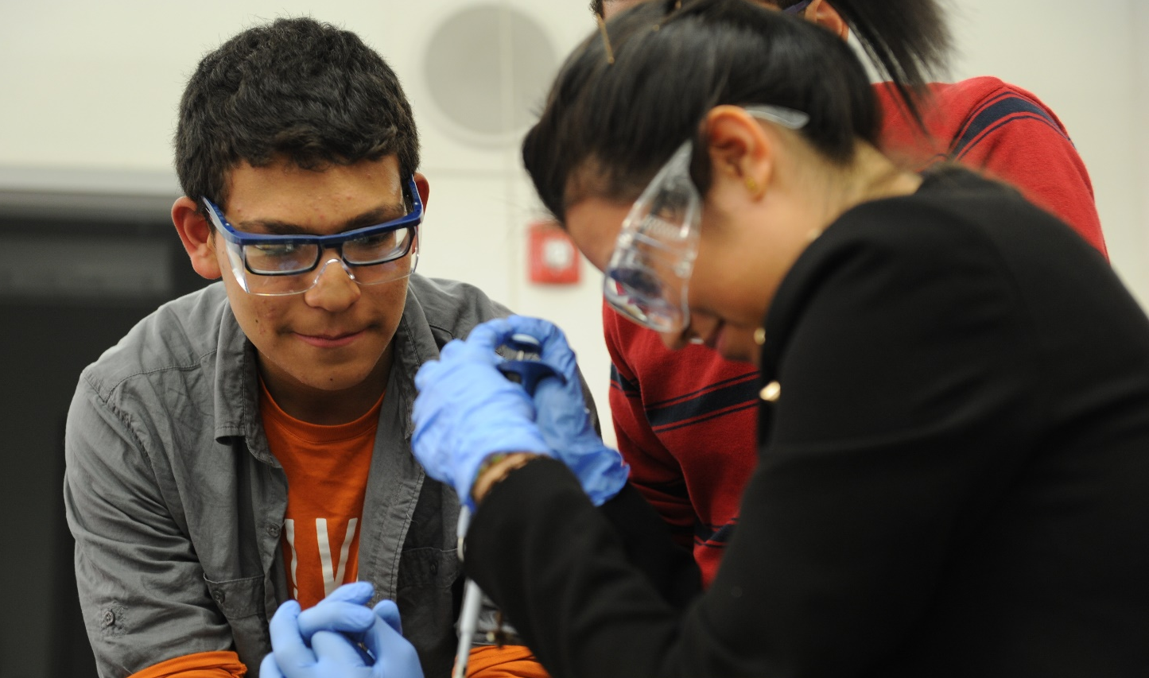
  “I wouldn’t have known about this field, how stimulating and enjoyable it is, without having sampled the life of a scientist through the labs used in the Amgen Biotech Experience.”
  —Former ABE student
  “I wouldn’t have known about this field, how stimulating and enjoyable it is, without having sampled the life of a scientist through the labs used in the Amgen Biotech Experience.”
  —Former ABE student

Slide 3
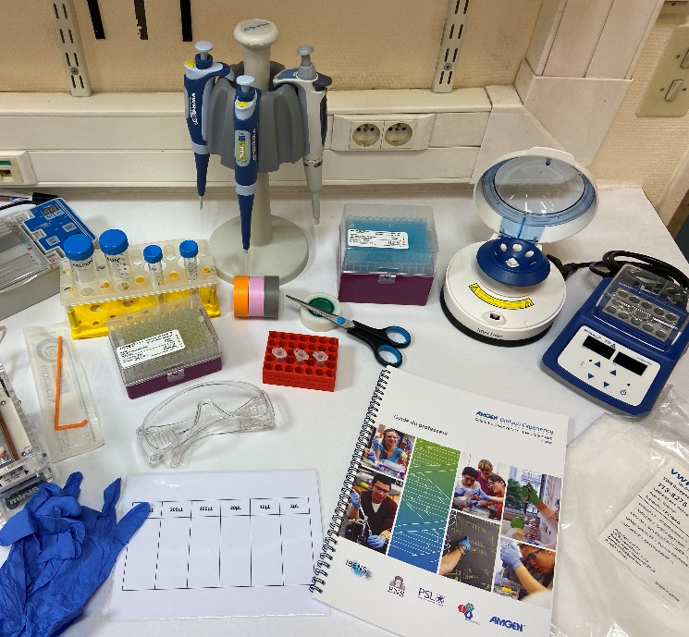
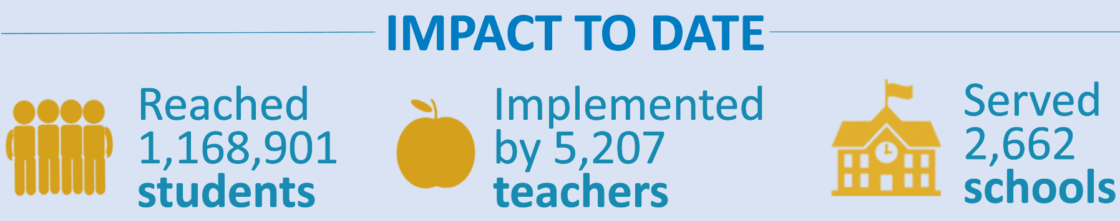
ABE Reach and focus
ABE introduces students to foundational technologies used in discovery and production of human therapeutics
ABE provides students the opportunity to use research-grade scientific equipment, practice their critical-thinking skills, and glimpse into the field of biotechnology and related careers
ABE is made possible by the Amgen Foundation which brings the program to classrooms around the world
Notes:
In a typical year, ABE reaches approximately 90,000 students and 1,500 teachers.
Globally, the program has impacted more than 1.1 million students to date.

Slide 4
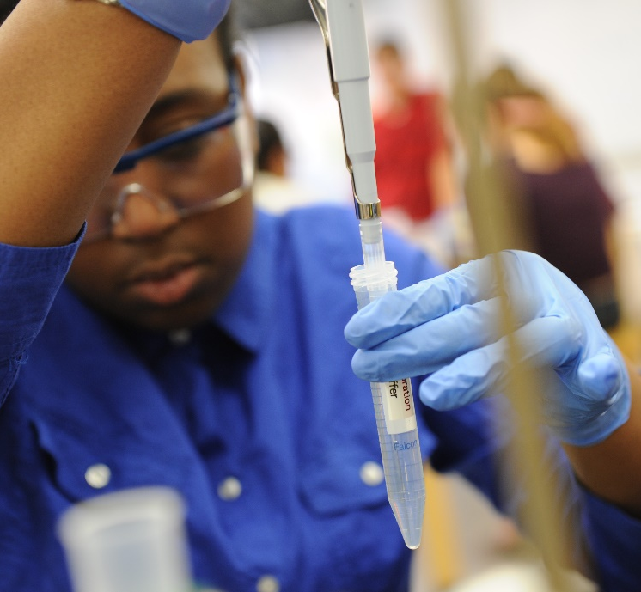
ABE Inspires!
This program is designed to support students in learning the tools and techniques of biotechnology.
OPTIONAL Our class will invite guest speakers from Amgen to share their pathway to a science career and an overview of their work.
OPTIONAL This program supports our unit on [add relevant Unit name and overview of a sample activity slide, if desired].
OPTIONAL Your student will be participating in ABE on the following dates: [insert dates]
ABE students show significant and substantial increased interest and confidence in science and biotechnology. We hope that by participating in ABE, your child is inspired to consider a higher education degree or career in science.
Notes:
Teachers: Amend this slide depending on what you are doing in your classroom (Foundations of Biotech labs, ABE Precision Medicine, Amgen staff engagement, other career connections, etc.)

Slide 5
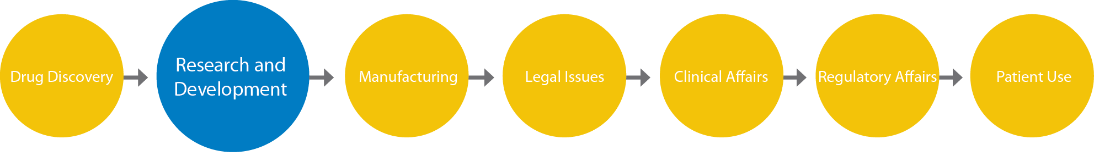
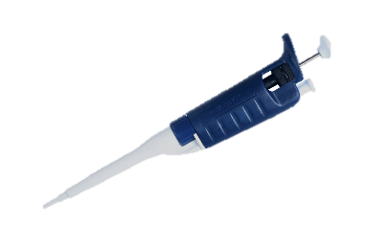

Lab sequence
Lab 1
Learn how to use biotechnology lab tools.
Lab 2
Use restriction enzymes to digest a plasmid and isolate the gene of interest.
Lab 3
Use ligase to make a recombinant plasmid from the DNA fragments.
Lab 4
Verify the restriction and ligation procedures.
Lab 5
Transform bacteria by adding the recombinant plasmid.
Lab 6
Grow bacteria to produce protein of interest, and purify the protein.
Notes:
The Amgen Biotech Experience labs introduce students to the core of biotechnology—using recombinant DNA techniques to create products of interest. The labs engage students in the same process that scientists use to discover new drugs and research tools.
The ABE labs bring students through the steps used in industry’s research and development of biotech medicines.

Slide 6
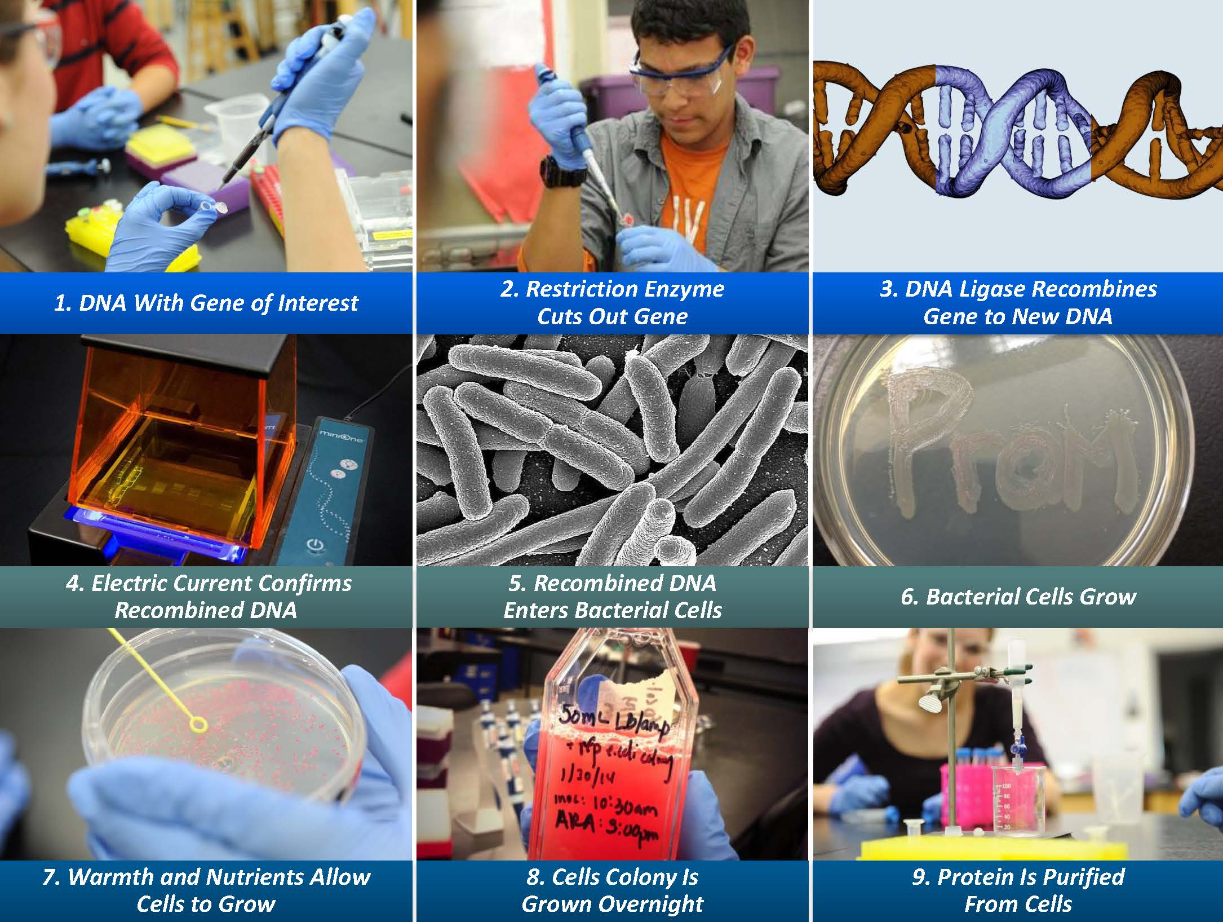
Notes:
The full sequence of ABE labs

Slide 7
amgenbiotechexperience.com
Visit our website to find out more about this exciting program!

Slide 8
Optional slides

Slide 9



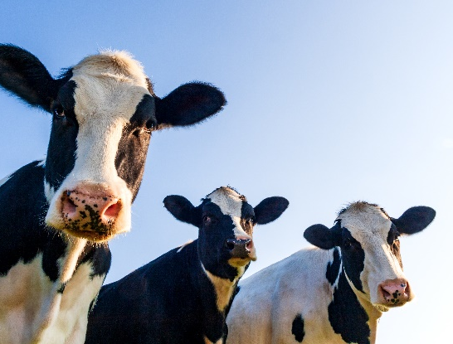
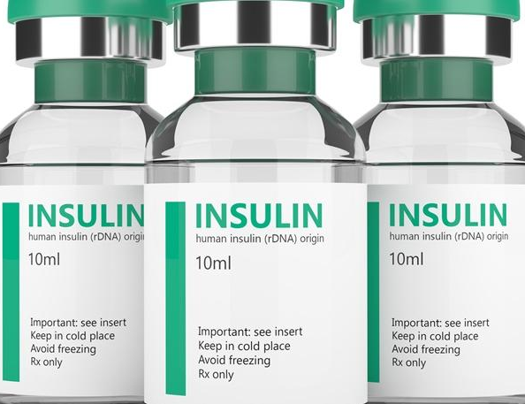
What is Biotech?
Biotechnology is using a biological organism (yeast) in baking bread and brewing beer
Biotechnology is editing genes for improved health
Biotechnology is the development of antibiotics*
Biotechnology is the selective breeding of animals and plants
Biotechnology is producing medicines to save lives**
*This Photo by Unknown Author is licensed under CC BY
**This Photo by Unknown Author is licensed under CC BY

Slide 10
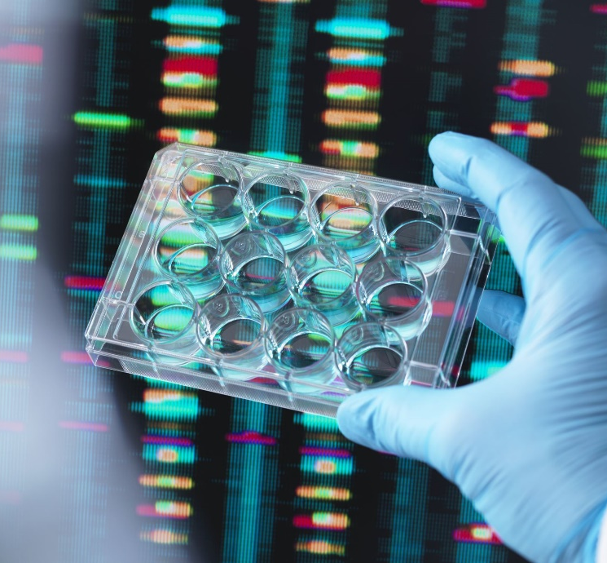
Biotechnology Jobs
Jobs in biotechnology are expected to continue to grow
Computational biology: 16% projected job growth (2018–2028)
Biotechnology jobs exist in many areas, including:
  Medicine
  Environmental science
  Agriculture

Slide 11
[Template: insert abe photos from previous years]
Notes:
Teachers: Insert your ABE photos from previous years.

