Slide 1
RECOMBINANT PLASMID WITH BEADS!
ACTIVITY for ABE Lab 2 and Lab 3
© 2026 Susan Senior and Paola Travascio

Slide 2
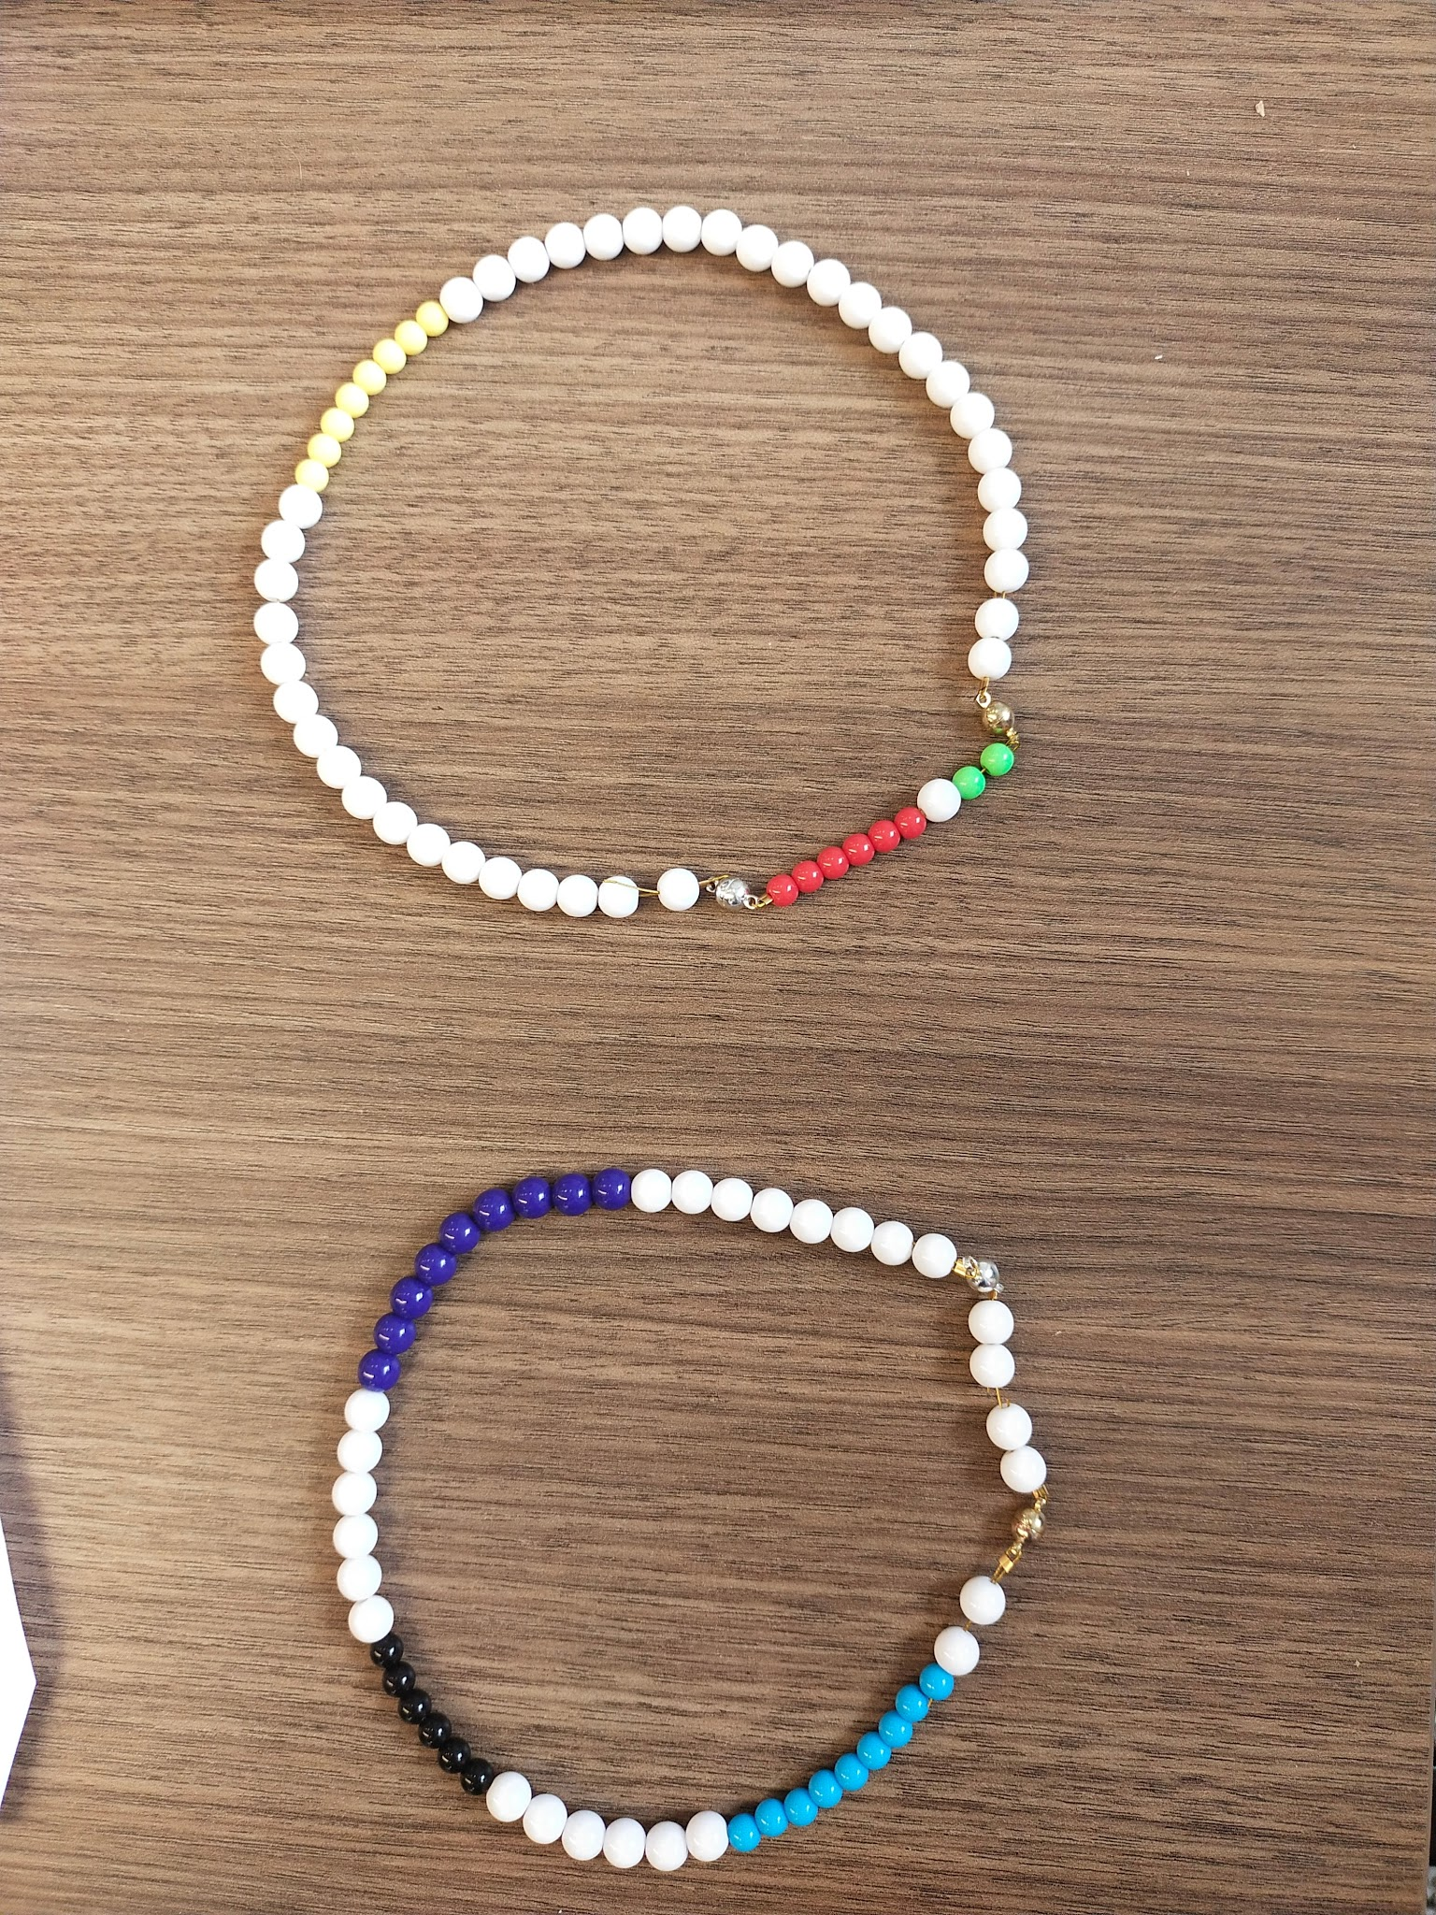
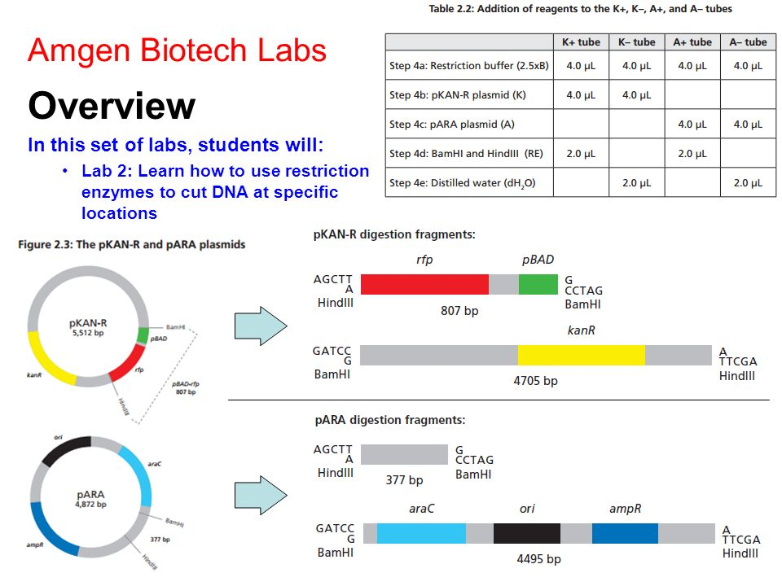
From Biotech…..to Beads!

Slide 3
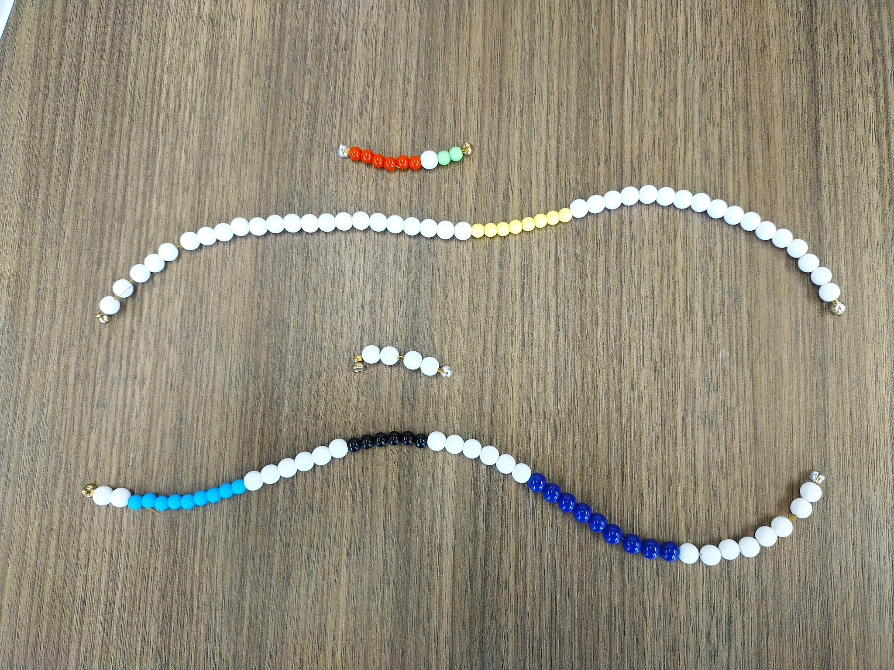
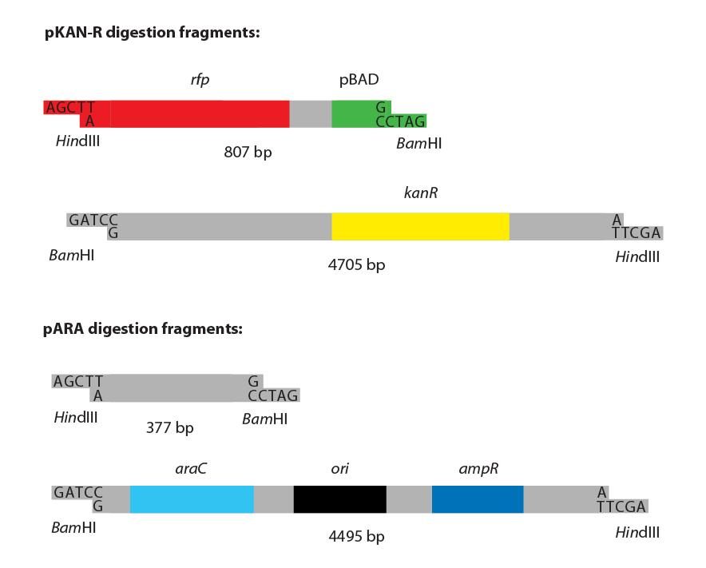
From Biotech ….to Beads!

Slide 4
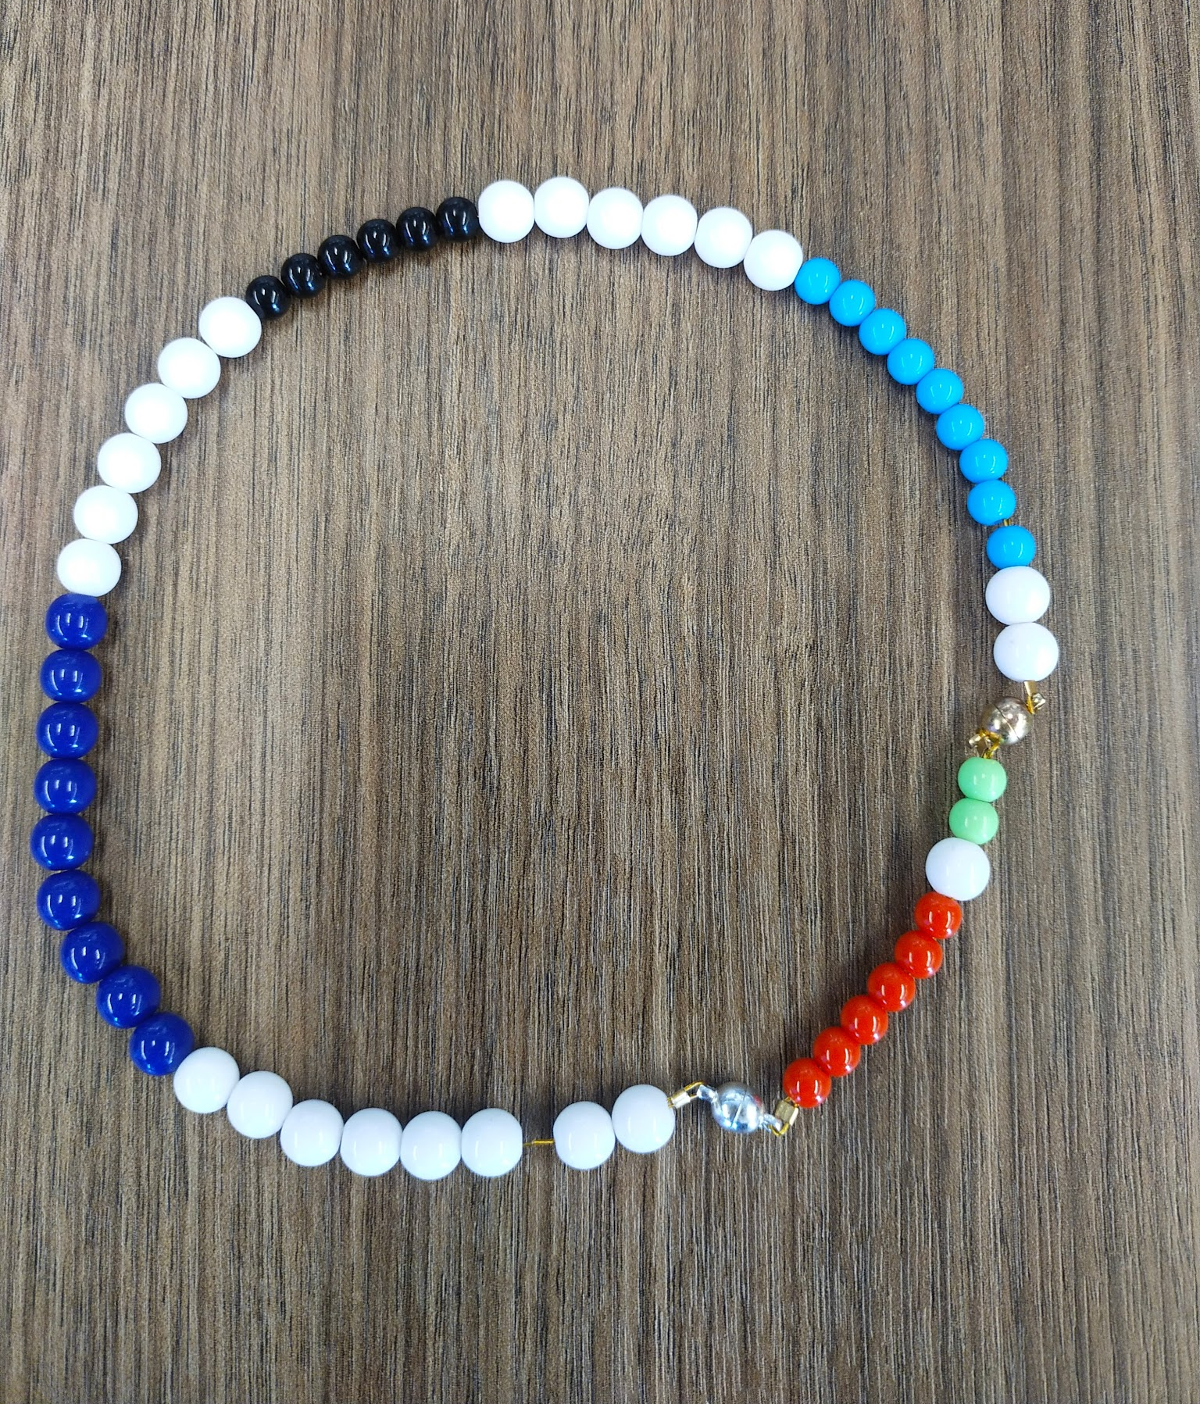
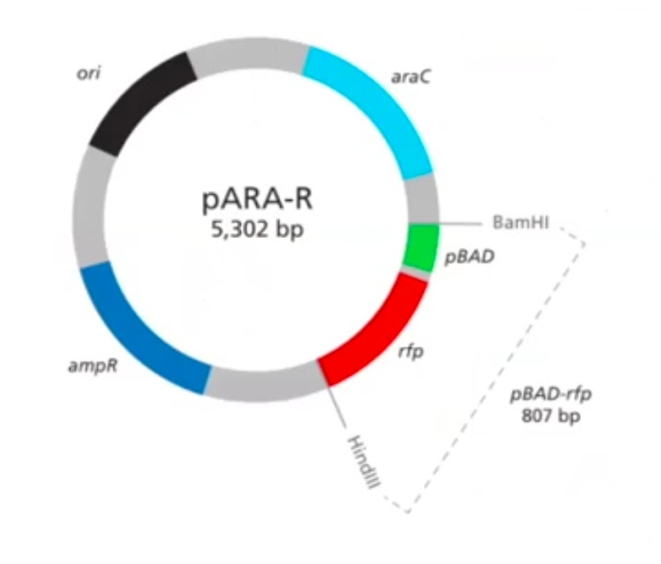
From Biotech…to Beads!

Slide 5
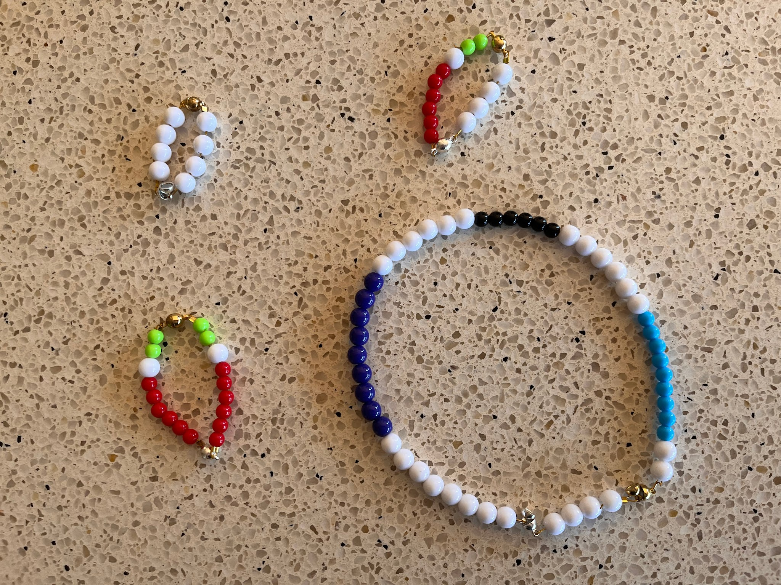
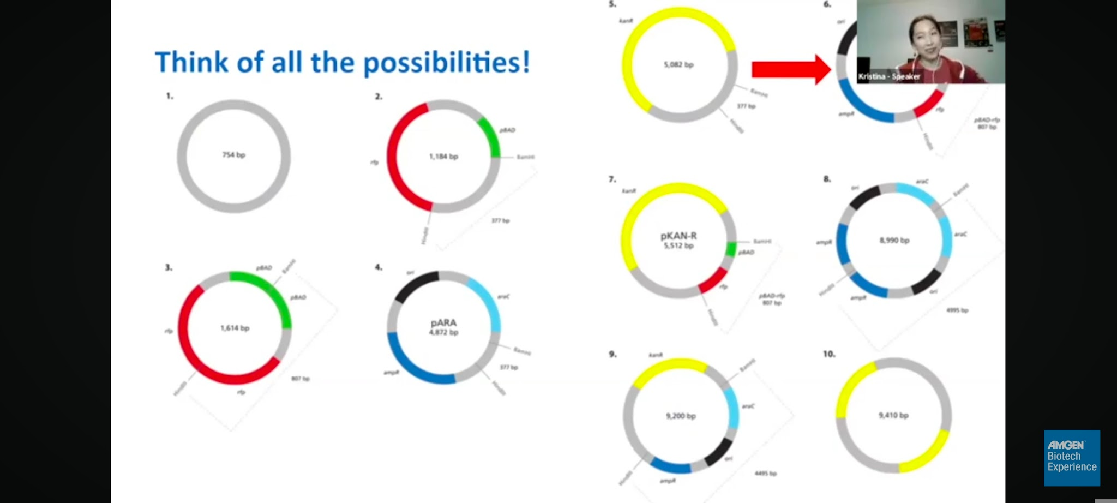
From Biotech…to Beads!

Slide 6
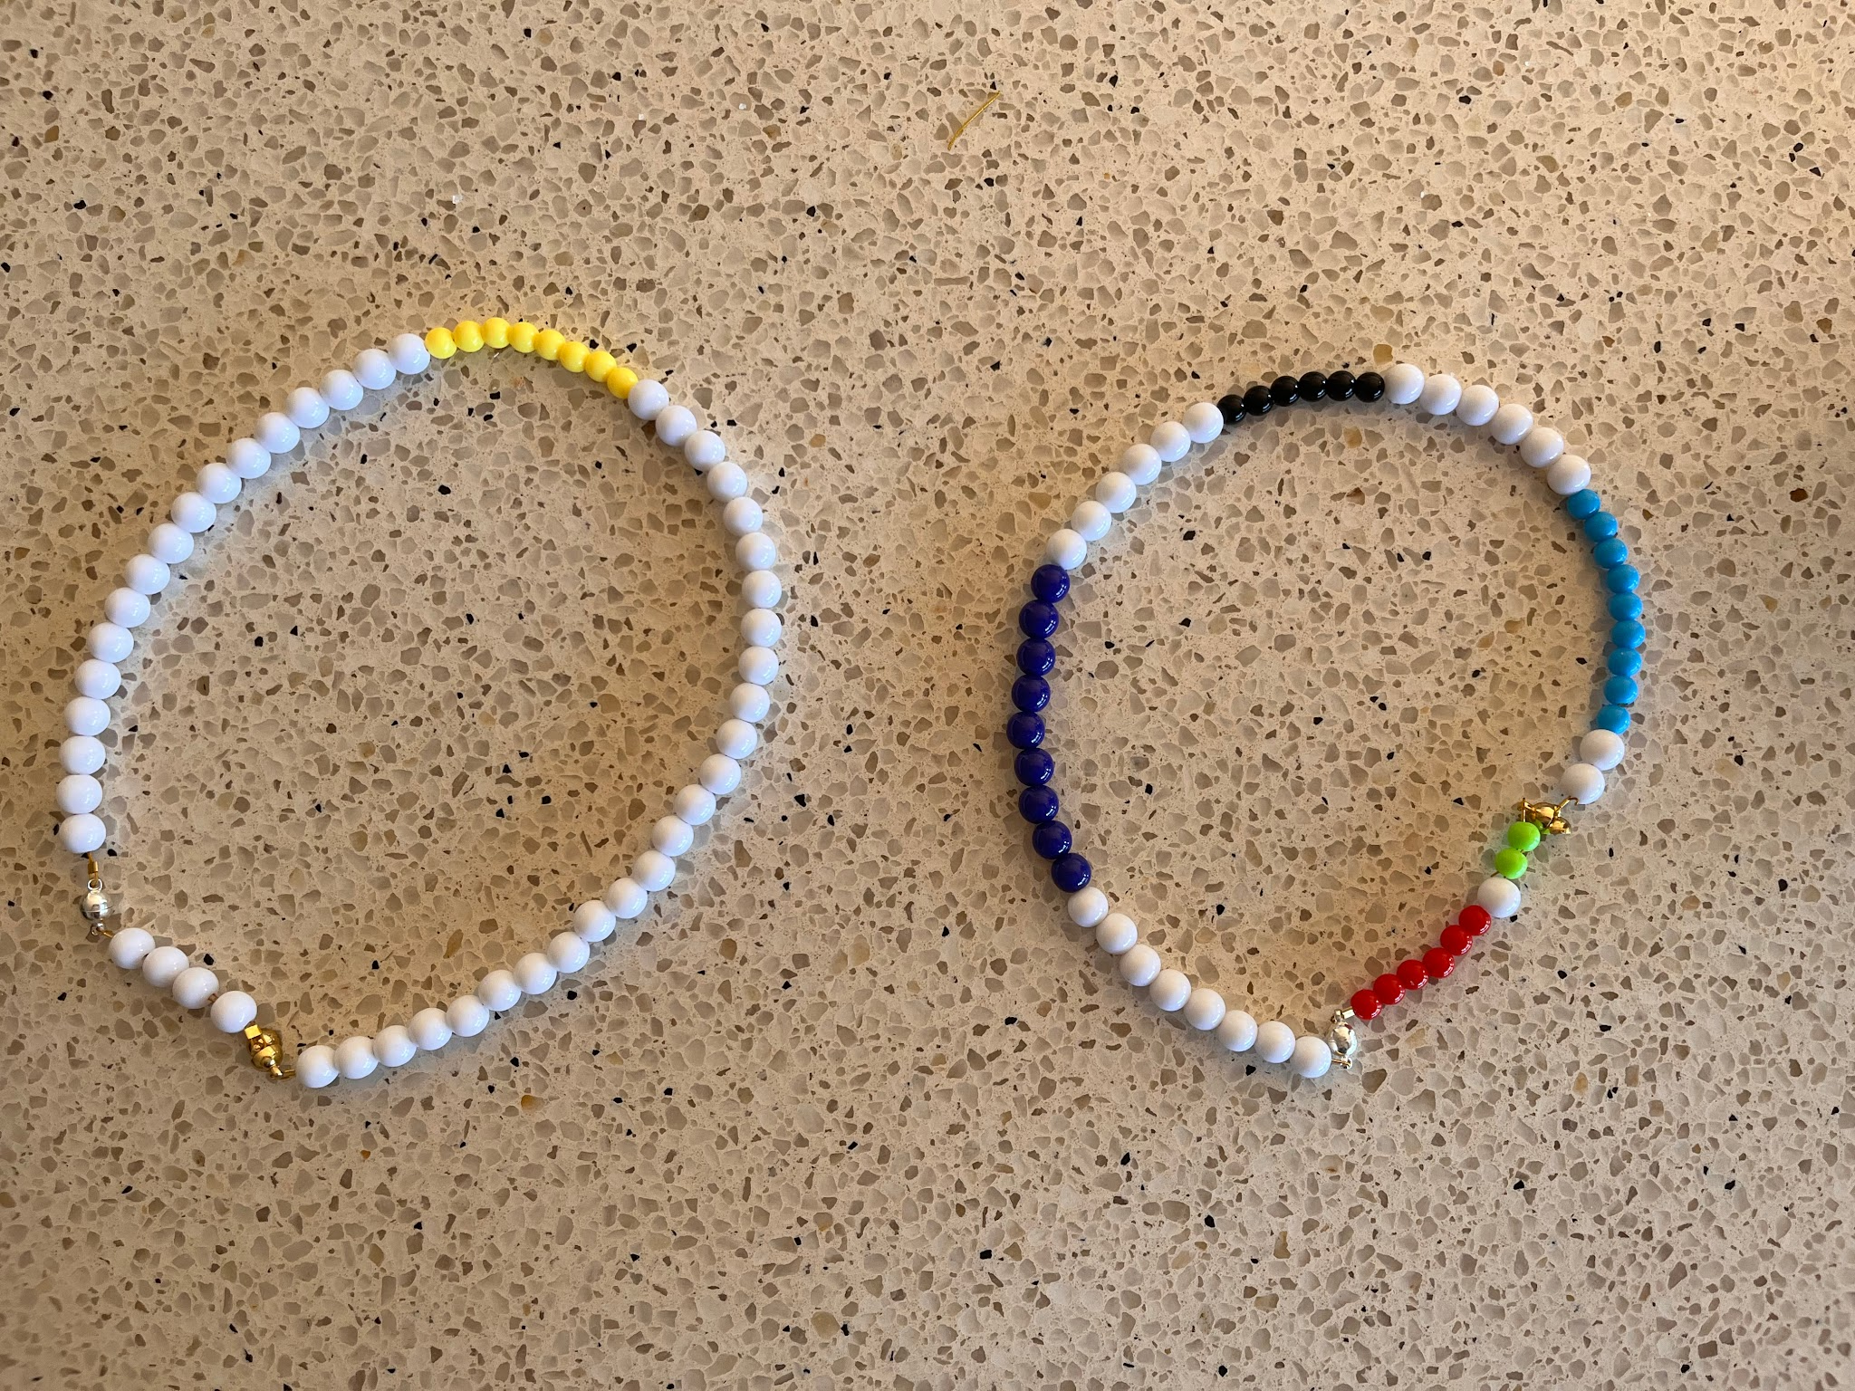
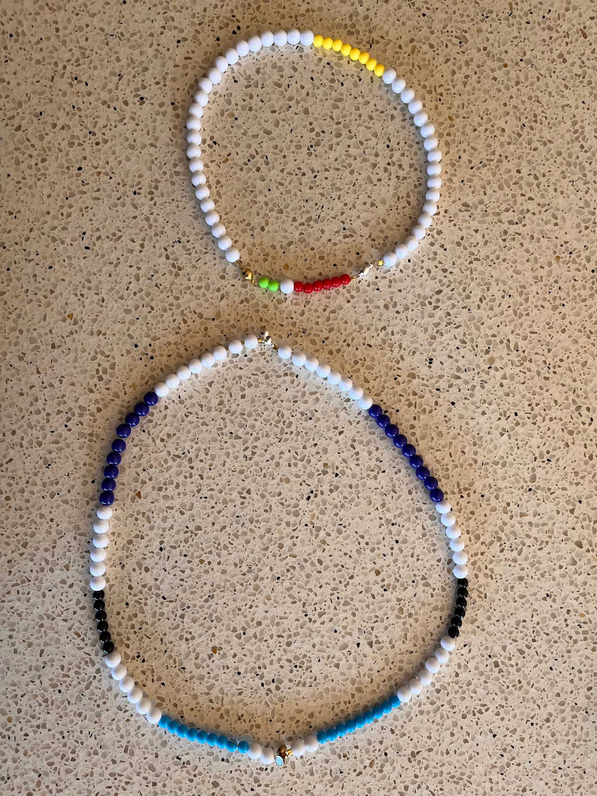
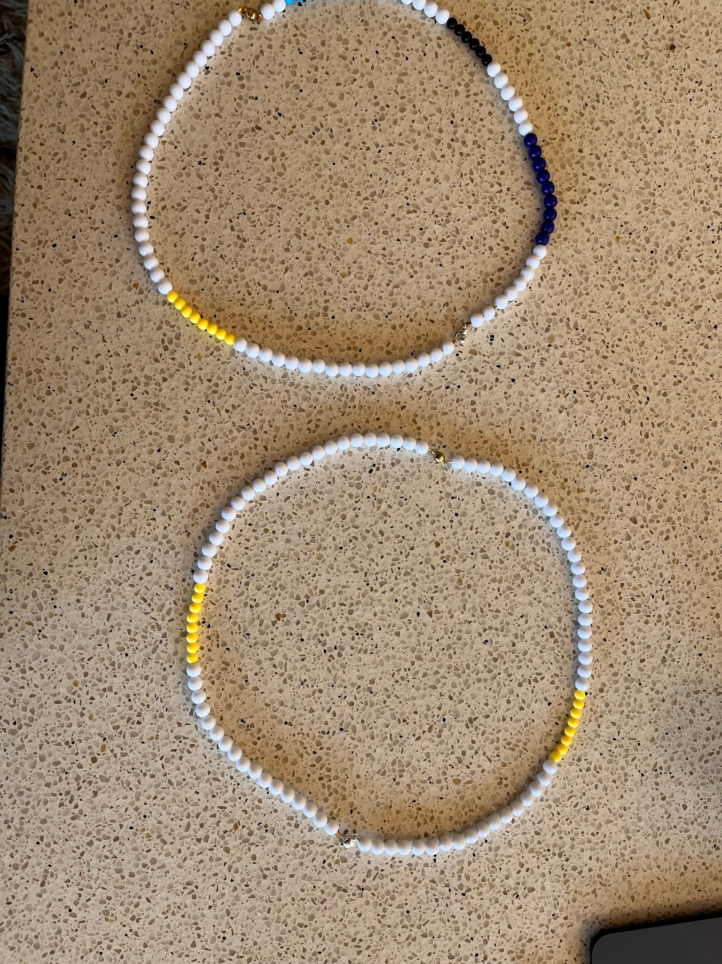
From Biotech…to Beads!

Slide 7
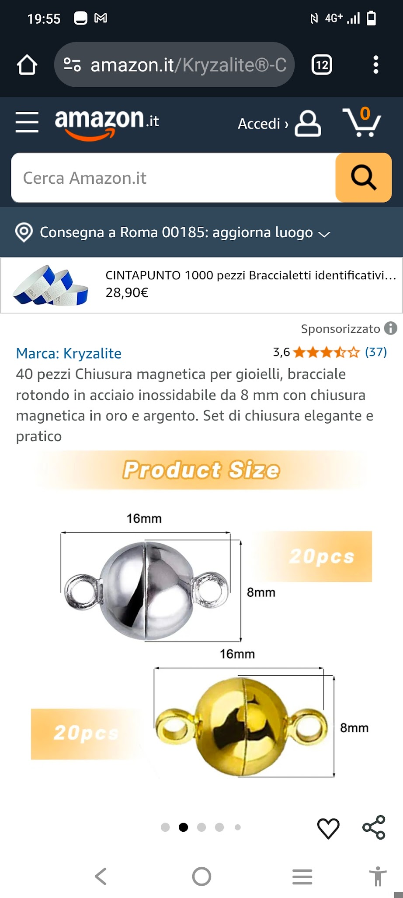
From Biotech…..to Beads!
PLASMIDS_SET 1
Silver(HindIII).
restriction site
Silver(HindIII)
Gold(BamHI)
restriction site
S- pole
N- pole
N- pole
S- pole
Gold(BamHI)
N- pole
Silver(HindIII)
S- pole
S- pole
N- pole
Gold(BamHI)

Slide 8
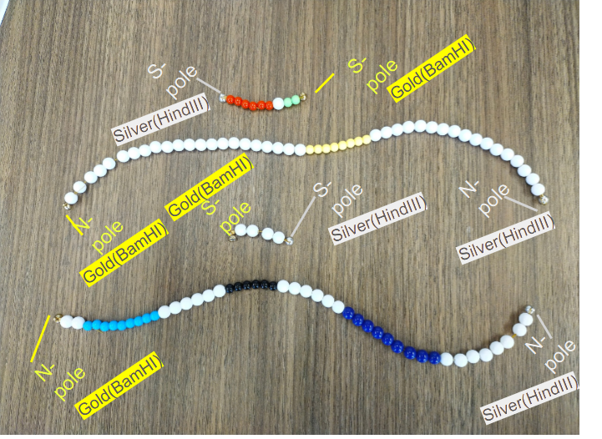
From Biotech ….to Beads!
PLASMIDS_FRAGMENTS_SET 1

Slide 9
From Biotech…..to Beads!
PLASMIDS_SET 2
Silver(HindIII).
restriction site
Silver(HindIII)
Gold(BamHI)
restriction site
N- pole
S- pole
S- pole
N- pole
Gold(BamHI)
S- pole
Silver(HindIII)
N- pole
N- pole
S- pole
Gold(BamHI)

Slide 10

From Biotech ….to Beads!
PLASMIDS_FRAGMENTS_SET 2

Slide 11
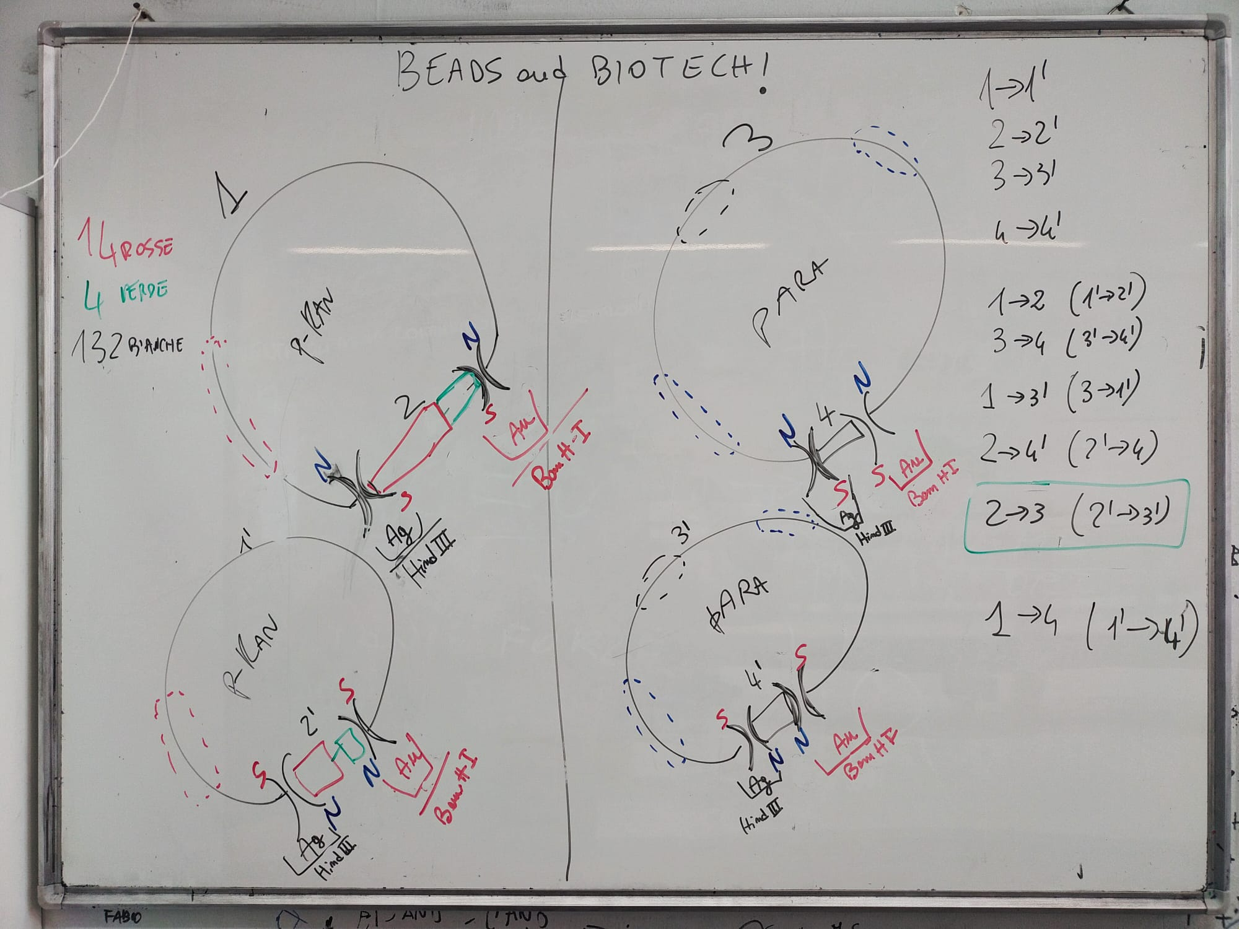
From Biotech…to Beads!

