Slide 1
Exploring Precision Medicine
Chapter 1: What’s the Right Medicine?
Chapter 2: Is My Sense of Taste Controlled by my Genes?
Chapter 3: Exploring Our DNA
Chapter 4: How Is DNA Sequenced, and What Can We Learn?
Chapter 5: Restriction Enzyme Digestion of TAS2R38 PCR Products
Chapter 6: Gel Electrophoresis and Genotyping
Chapter 7: SNPs and Drug Metabolism

Slide 2
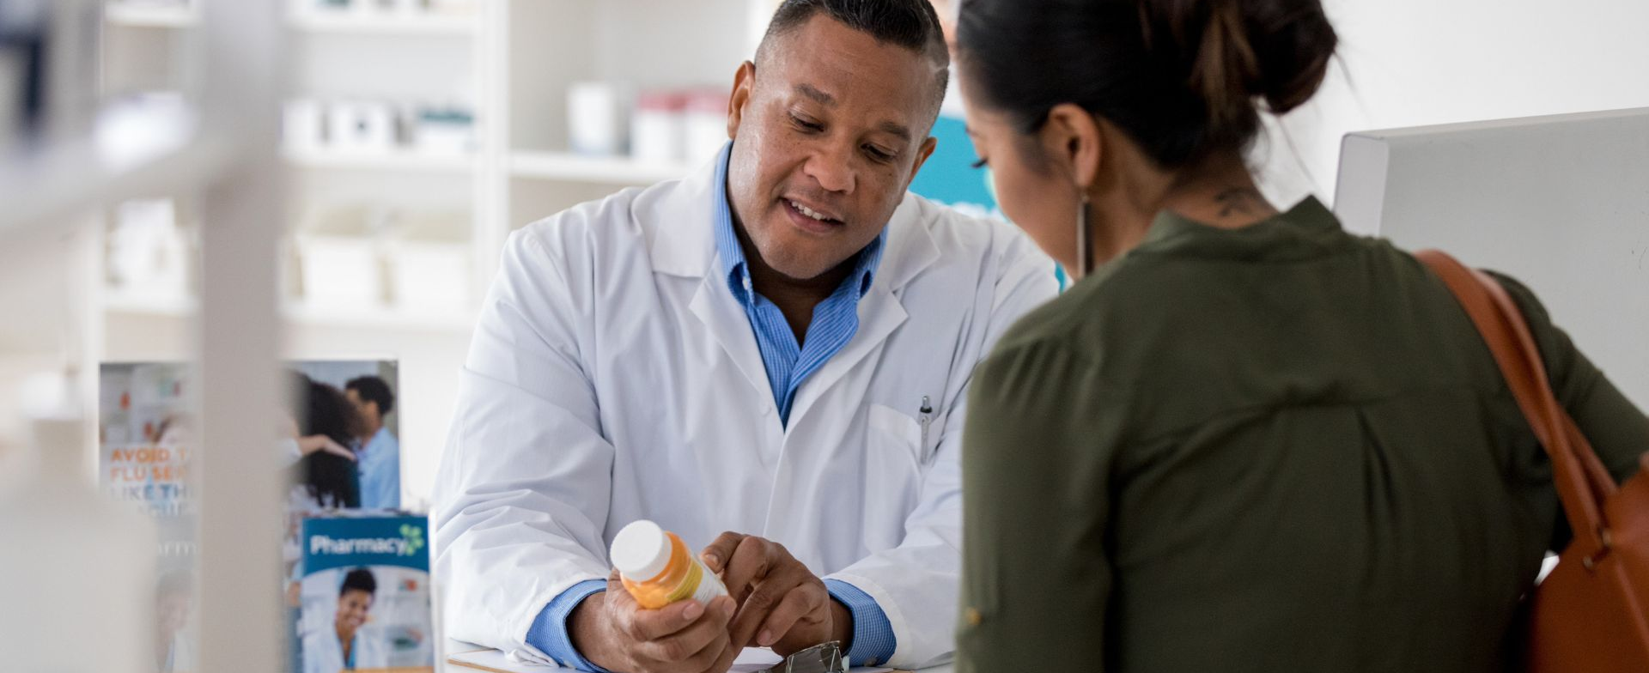
Chapter 1: What’s the right medicine?
Notes:
Image credit: Canva Pro

Slide 3
How and why are people different?
Notes:
Students will probably mention visible, physical characteristics, some of which are inherited (eye color) and others of which have environmental components (e.g. height and weight)

Slide 4
Are there differences you can’t see?
Notes:
Encourage students to contemplate physiological differences

Slide 5
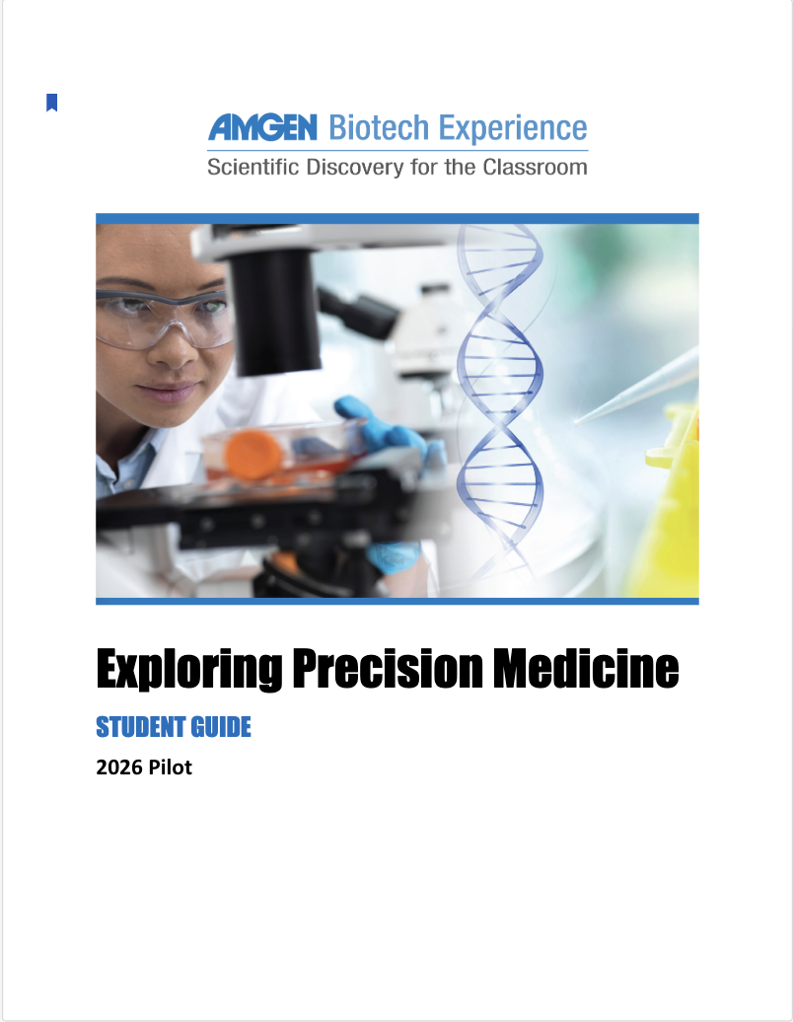
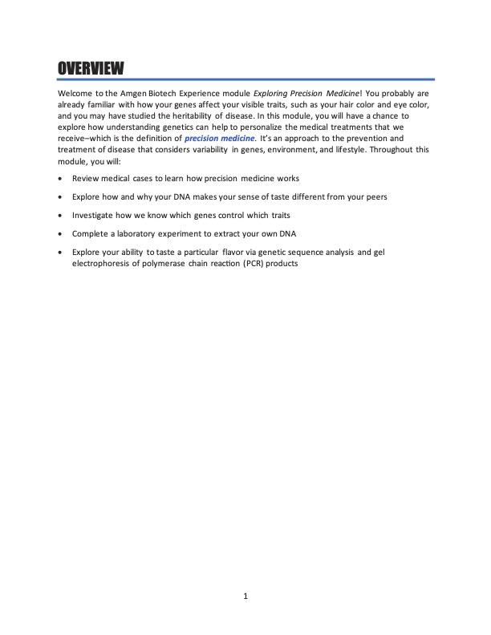
Read the Overview

Slide 6

Video and discussion: What is precision medicine?
VIDEO LINK
Notes:
Discussion questions with time points:
(0:17-0:21) The narrator mentions two sources of DNA mutations. What are they? How do they differ?
Some DNA mutations are passed along from parents to children, meaning they must be present in germ cells (sperm and eggs). These mutations can be spontaneous, occurring during DNA replication or cell division in the process of gametogenesis. Also, DNA can sustain environmental damage to somatic (body) cells, leading to illnesses such as cancer during a person’s lifetime, but such changes are not heritable.
(0:47) What does the narrator cite as one cause of DNA mutations?
UV damage from the sun.
(1:18) How can genomic sequencing help practitioners identify the right medication for particular patients?
Particular genetic mutations are associated with responsiveness to particular drugs, as in the case of certain cancers.
(1:52) Why is precision medicine a diagnostic advance, similar to more detailed imaging methods?
Prior to the sequencing and identification of much of the human genome, it took much longer to identify genetic mutations and to associate them with particular illnesses. Current molecular biology tools speed up this process and permit individualized genotyping.
Have you ever been prescribed a medicine that “didn’t work” for you? Did you think about why it “didn’t work?” If so, what reasons had you thought of?
Student responses may vary. Some students may share that they are allergic to certain medications, such as antibiotics or NSAIDS.

Slide 7
Are all medicines equally effective for everyone?

Slide 8
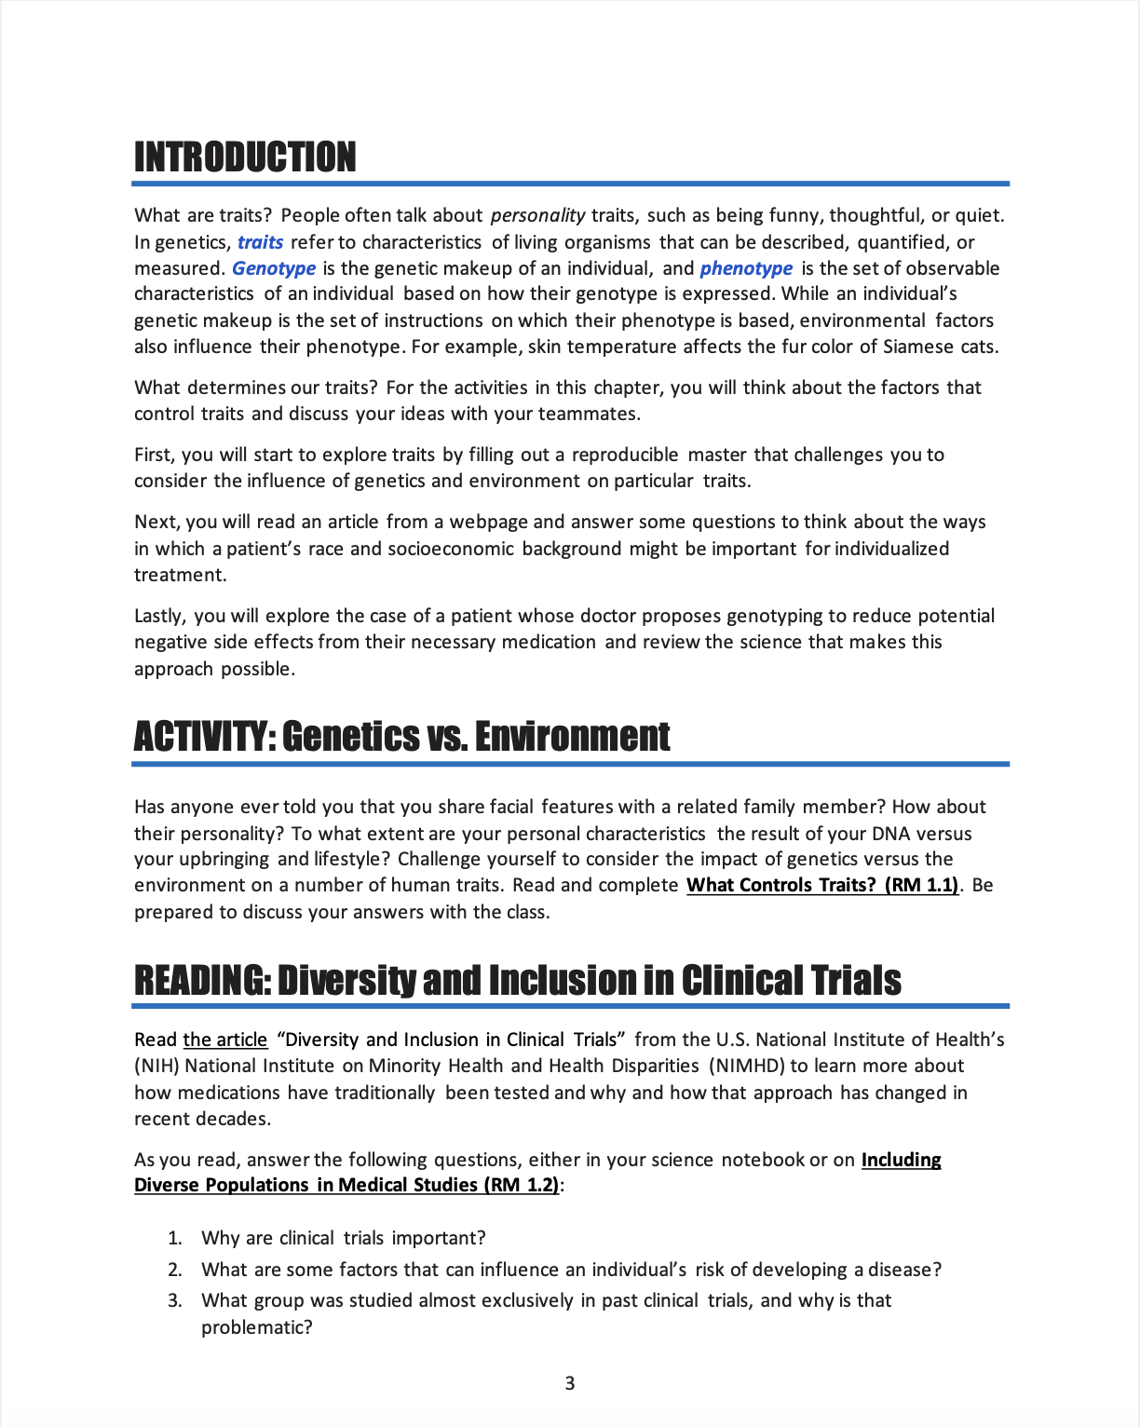

Read the Introduction to Chapter 1, then complete RM 1.1

Slide 9
Discussion: RM 1.1
Which traits were controlled only by genetics?
What traits were controlled solely by the environment?
Were any traits influenced by both genetics and environment?
Notes:
Answers to questions on Worksheet 1.1:
Genetics:
Eye color, hair color, and skin color.
(Note that hair and skin color may be influenced by the environment (for example, hair can get lighter with UV exposure), but the phenotype at birth is genetically determined.)
Environment:
Hair length, scar on abdomen, affinity for cats, enjoyment of hip hop music, ability to speak Spanish and Arabic, and religiosity.
Both genetics and environment:
Height and foot size.

Slide 10
What influences a trait? Can you think of rules?
How the body looks and works: most likely genetic
How people behave: most likely environmental (due to experiences)
Inherited traits can be influenced by the environment
  Adult height has a genetic component (birth parents’ heights) and an environmental component (nutrition, infections, etc.)

Slide 11
Can you think of traits people might have that are related to their health?
Trait related to health | Controlled by genetics only | Controlled by the environment only | Controlled by both
Notes:
Examples from the RM 1.1 Answer Key include:
Celiac disease (inability to process gluten in diet)
Sickle cell anemia
Vitiligo (loss of skin pigmentation)
Asthma
Poison ivy rash
Cystic fibrosis (abnormal mucus, sweat, and digestive juices)
Down syndrome
Lead poisoning

Slide 12
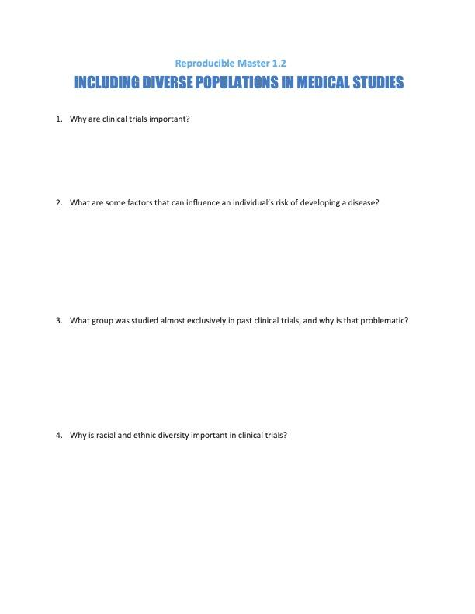
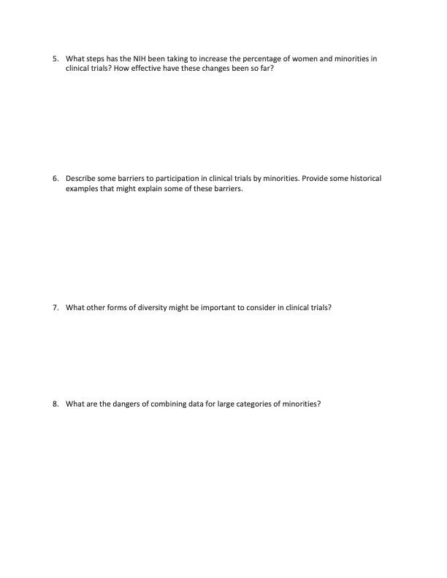
Read “Diversity and Inclusion in Clinical Trials”
Answer the questions on RM 1.2.

Slide 13
Discussion: “Including Diverse Populations in Medical Studies”
Why are clinical trials important?
What are some factors that can influence an individual’s risk of developing a disease?
What group was studied almost exclusively in past clinical trials, and why is that problematic?
Notes:
Answers:
Why are clinical trials important?
Clinical trials can find better, more affordable, and safer ways to diagnose, prevent, and treat disease.
The findings of clinical trials can also improve the quality of life for people living with particular medical conditions.
What are some factors that can influence an individual’s risk of developing a disease?
Age
Biological sex
Pregnancy status
Life experiences, both negative and positive
Unhealthy behaviors such as substance abuse, poor diet, etc.
Health-promoting behaviors including preventative medicine
Environmental conditions such as safety and pollution level of neighborhood
Genetic variation and geographic ancestry
Preexisting conditions
What group was studied almost exclusively in past clinical trials, and why is that problematic?
White men, with higher socioeconomic status.
This is problematic because treatments and interventions are more effective when they take the lived experiences of a larger group into account.

Slide 14
Discussion: “Including Diverse Populations in Medical Studies” (continued)
Why is racial and ethnic diversity important in clinical trials?
What steps has the NIH been taking to increase the percentage of women and minorities in clinical trials?
  How effective have these changes been so far?
Describe some barriers to participation in clinical trials by minorities.
  Provide some historical examples that might explain some of these barriers.
Notes:
Answers:
Why is racial and ethnic diversity important in clinical trials?
To reduce biases, promote social justice and health equity, and produce more innovative science.
What steps has the NIH been taking to increase the percentage of women and minorities in clinical trials? How effective have these changes been so far?
They have issued guidelines requiring the inclusion of, and reporting on data about, women and minorities in clinical trials.
This has resulted in increases in participation in clinical trials among populations historically wary of such efforts, among, for example, African Americans.
Describe some barriers to participation in clinical trials by minorities. Provide some historical examples that might explain some of these barriers.
Barriers:
Lower socioeconomic status means it’s harder to participate in trials which require time off from work as well as transportation and child care.
Cultural bias against participation due to past injustices including the Tuskegee syphilis study in African Americans, and unauthorized misuse of Native American DNA samples for genetic research outside the scope of the original study.

Slide 15
Discussion: “Including Diverse Populations in Medical Studies,” continued
What other forms of diversity might be important to consider in clinical trials?
What are the dangers of combining data for large categories of minorities?
Notes:
Answers:
What other forms of diversity might be important to consider in clinical trials?
Sexual/gender minorities and socioeconomic status (SES), in addition to biological sex and minority/ethnic status.
What are the dangers of combining data for large categories of minorities?
It’s not always advisable to aggregate data for individuals in study populations. For example, “Asian Americans” are hardly a monolithic group, given the number of different countries from which such participants could originate. There may be health disparities among these populations due to differing ethnic backgrounds, SES, etc.

Slide 16
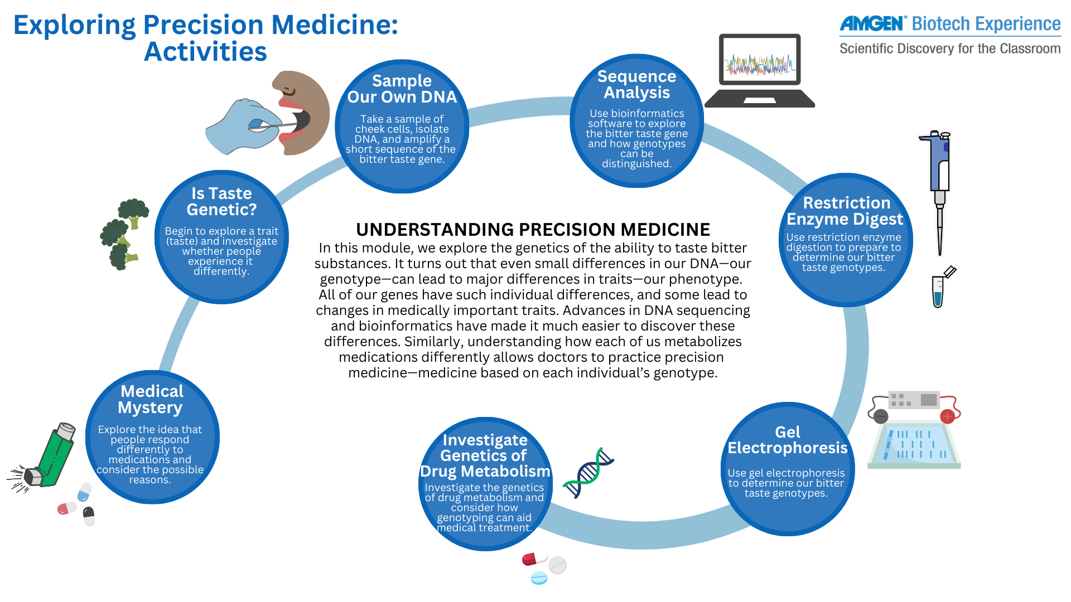

Slide 1.14

Slide 17
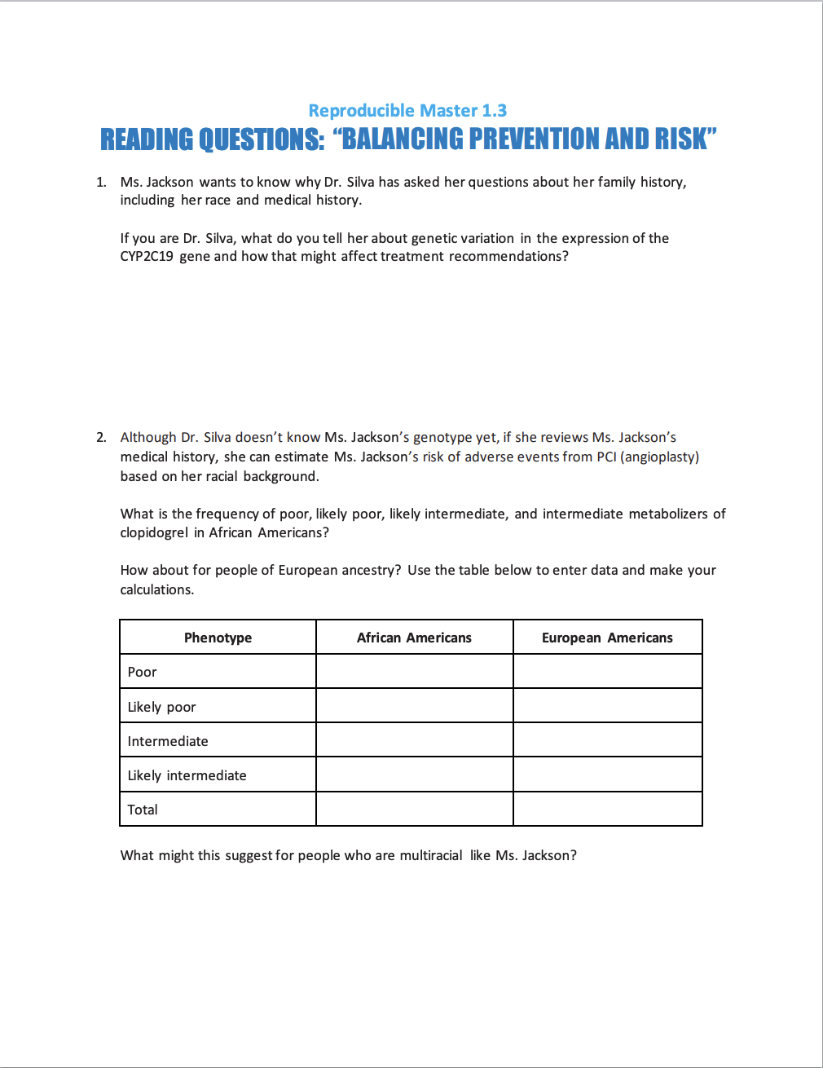
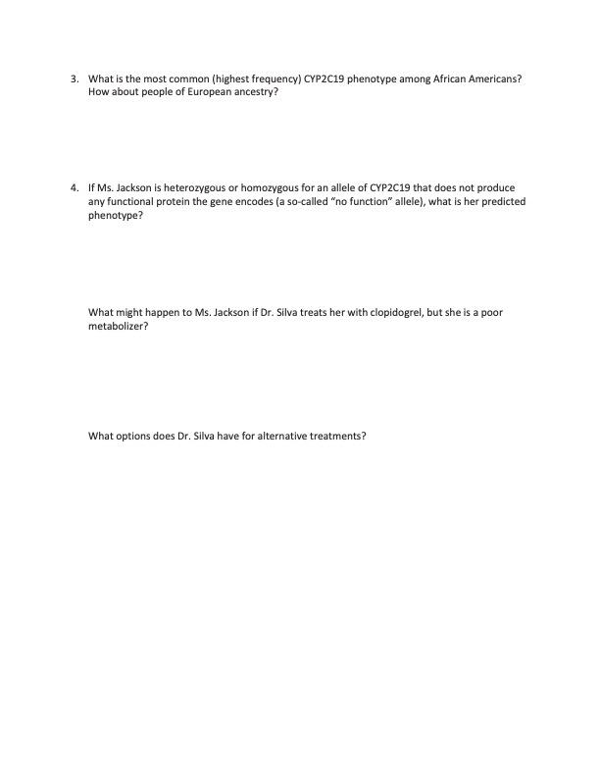
Reading: “Balancing Prevention and Risk”
Use the data tables after the reading to answer the questions on RM 1.3

Slide 18
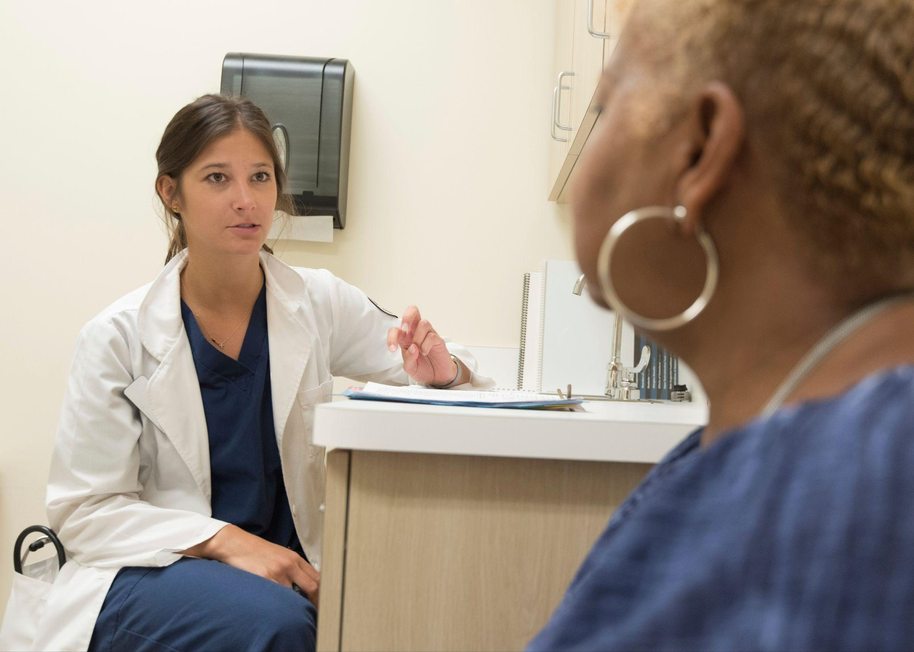
Review: Renee Jackson’s medical history
Age: 64
Race: Mixed-race (Black and White).
Family history: Her father (Black) had heart disease and diabetes, and his ancestry was West African. Her mom (White) had high cholesterol and metabolic syndrome, and her ancestry was European (British Isles).
Health conditions: Metabolic syndrome, arthritis, glaucoma, angina, high cholesterol
Notes:
Doctor image: https://www.pexels.com/photo/woman-in-white-scrub-suit-wearing-black-stethoscope-8376277/

Slide 19
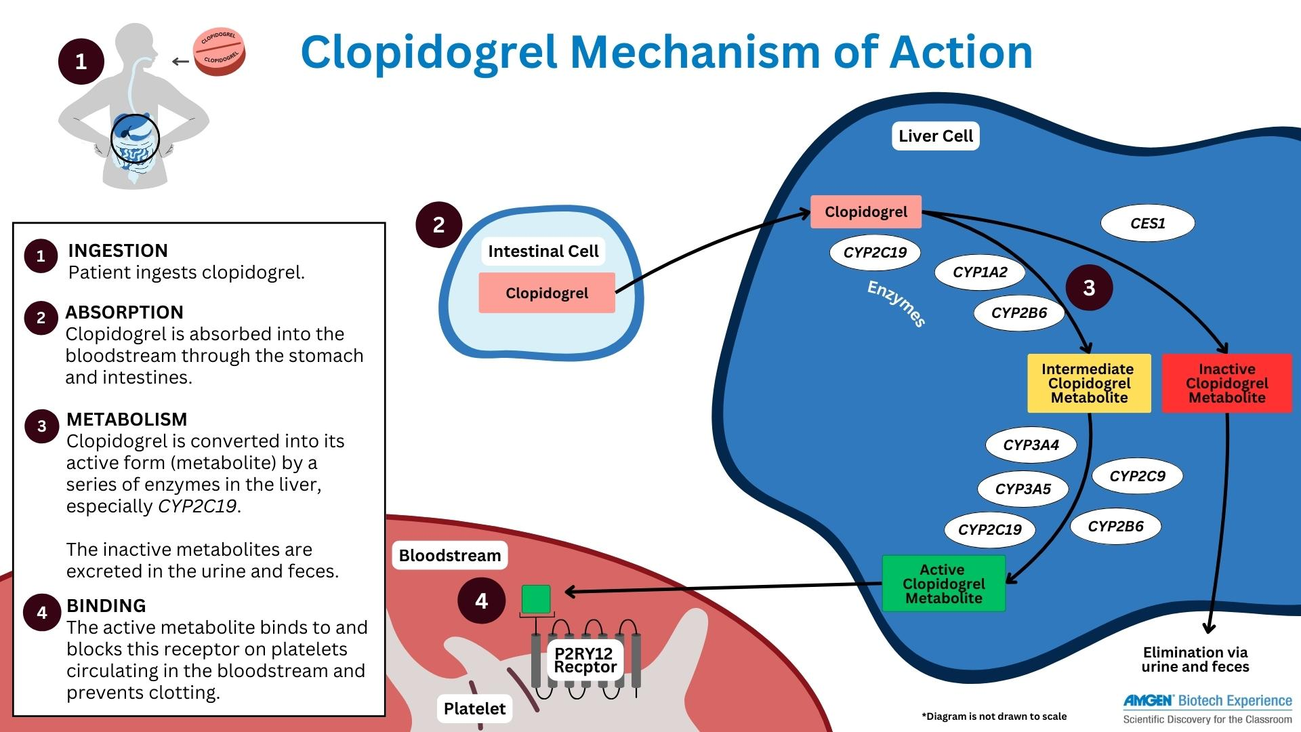
How Plavix works
1.19

Slide 20

Discussion: “Balancing Prevention and Risk”
Ms. Jackson wants to know why Dr. Silva has asked her questions about her family history, including her race and medical history.
If you are Dr. Silva, what do you tell her about genetic variation in the expression of the CYP2C19 gene and how that might affect treatment recommendations?
Notes:
Worksheet answers:
You tell her that not everyone metabolizes Plavix the same way, due to variation in how people’s livers process medications (in this case, specifically due to alleles of the CYP2C19 gene, which encodes one of the Cytochrome P450 enzymes).
Some people actually metabolize Plavix very fast; others metabolize it poorly.
The goal of Plavix is to reduce blood clotting. If people metabolize it poorly and have a procedure that might cause clots, they will be at increased risk of sustaining a clot and suffering a heart attack or stroke as a result.
Image: https://www.rawpixel.com/image/2288498/free-photo-image-doctor-patient-healthcare, A doctor providing consult for a patient. Original image sourced from US Government department: Public Health Image Library, Centers for Disease Control and Prevention. Under US law this image is copyright free, please credit the government department whenever you can, CC0

Slide 21
Discussion: “Balancing Prevention and Risk,” continued
Although Dr. Silva doesn’t know Ms. Jackson’s genotype yet, if she reviews her medical history, she can estimate Ms. Jackson’s risk of adverse events from PCI (angioplasty) based on her racial background.
What is the frequency of likely intermediate, intermediate, likely poor, and poor metabolizers of clopidogrel in African Americans?
How about for people of European ancestry (this includes White Americans)?
Notes:
Answers:
See the Answer Key for specifics.
Overall frequency of abnormal metabolizers of clopidogrel: 0.389377906 in African-Americans, 0.28628508 in European-Americans

Slide 22
Discussion: “Balancing Prevention and Risk,” continued
Phenotype frequency: metabolism of clopidogrel
Phenotype | African-Americans | Europeans
Likely intermediate | 0.02779 | 0.00112
Intermediate | 0.31399 | 0.26109
Likely poor | 0.00709 | 0.00020
Poor | 0.04051 | 0.02388
Total | 0.38938 | 0.28629
Due to the higher likelihood of poor/intermediate metabolizer alleles in African Americans, Ms. Jackson may be at higher risk of adverse outcomes than if both her parents were of White background.
Notes:
Reminder: a frequency is a percentage of a population. So students can think about percentages

Slide 23
Discussion: “Balancing Prevention and Risk,” continued
What is the most common (highest frequency) CYP2C19 phenotype among African Americans?
How about people of European ancestry?
What does this suggest for people who are multiracial like Ms. Jackson?
Notes:
Answers:
Most common metabolizer phenotype:
African Americans: Normal metabolizer (almost 33%)
Europeans: Normal metabolizer (almost 40%)
Why does race matter in this case?
Reviewing data from the table in the Student Guide entitled “Frequencies of CYP2C19 phenotypes in biogeographical groups,” people of African-American heritage are 1.36 times more likely than people of European heritage to be poor or intermediate metabolizers of Plavix (clopidogrel), the drug Dr. Silva wants to prescribe to Ms. Jackson for her unstable angina.
Due to the higher likelihood of poor/intermediate metabolizer alleles in African Americans, Ms. Jackson may be at higher risk of adverse outcomes than if she had two parents of White background.

Slide 24
Discussion: “Balancing Prevention and Risk,” continued
If Ms. Jackson is heterozygous for an allele of CYP2C19 that does not produce any functional protein the gene encodes (a so-called “no function” allele), what is her predicted phenotype?
What if she is homozygous for that no-function allele?
What might happen to Ms. Jackson if Dr. Silva treats her with clopidogrel, but she is a poor metabolizer?
What options does Dr. Silva have for alternative treatments?
Notes:
Answers:
If Ms. Jackson is heterozygous or homozygous for an allele of CYP2C19 which does not produce any functional protein the gene encodes (a so-called “no function” allele), what is her predicted phenotype?
Heterozygous: Intermediate metabolizer
Homozygous: Poor metabolizer
What might happen to Ms. Jackson if Dr. Silva treats her with clopidogrel, but she is a poor metabolizer?
She might suffer a heart attack or stroke due to clopidogrel not preventing blood clotting sufficiently.
What options does Dr. Silva have for alternative treatments?
Other medications are available: prasugrel or ticagrelor.

