Slide 1
Exploring Precision Medicine
Chapter 1: What’s the Right Medicine?
Chapter 2: Is My Sense of Taste Controlled by My Genes?
Chapter 3: Exploring Our DNA
Chapter 4: How Is DNA Sequenced, and What Can We Learn?
Chapter 5: Restriction Enzyme Digestion of TAS2R38 PCR Products
Chapter 6: Gel Electrophoresis and Genotyping
Chapter 7: SNPs and Drug Metabolism

Slide 2
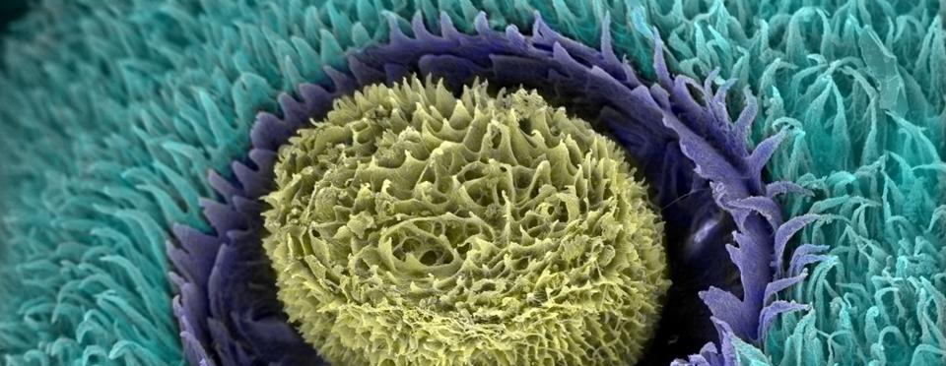
Chapter 2: Is my sense of taste controlled by my genes?
Notes:
Image credits: An electron micrograph of a lingual papilla of a deer tongue, showing the collagen. Hanna Jackowiak, CC BY 4.0, https://commons.wikimedia.org/w/index.php?curid=84589634

Slide 3
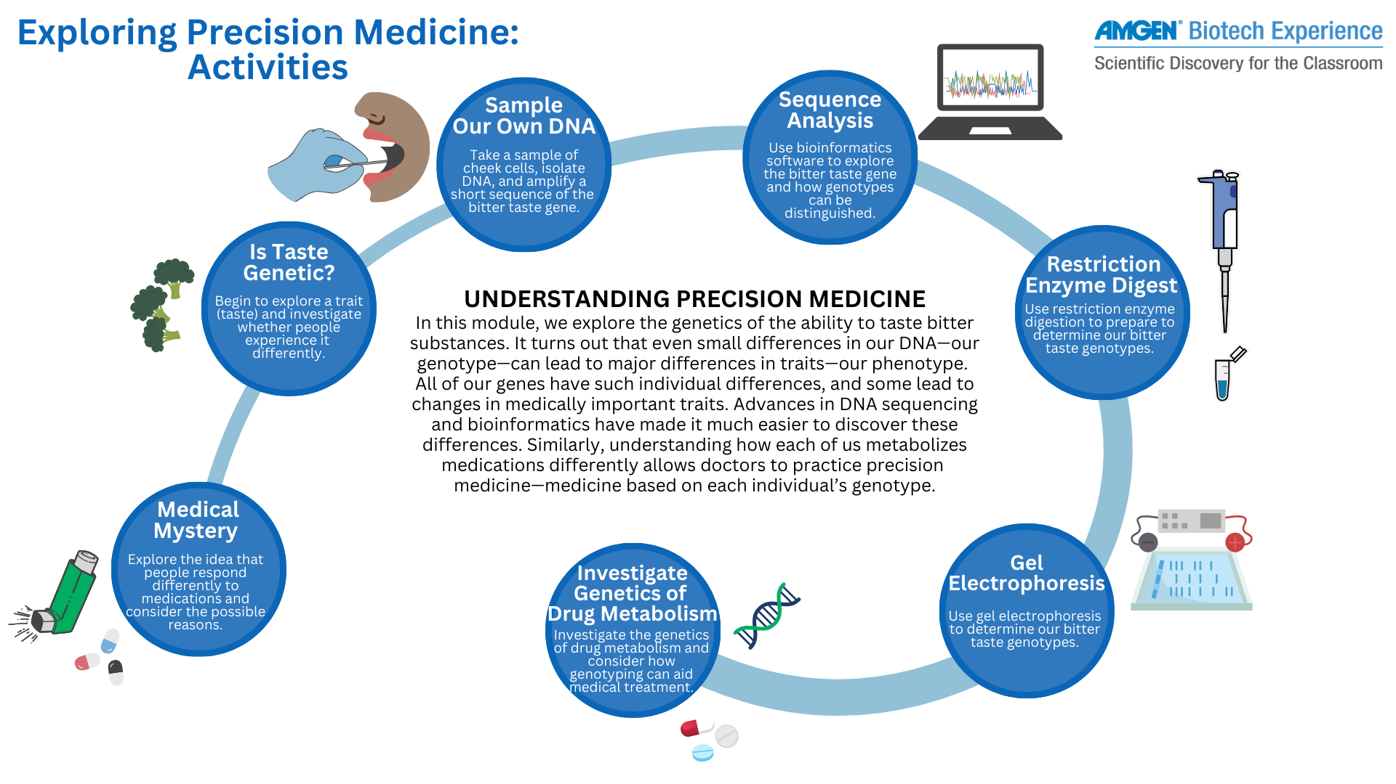


Slide 4

Video and discussion: How Do We Taste?
Notes:
“How do we taste” video
https://www.youtube.com/watch?v=-QUphgFZE3s
Time points for discussion:
How does the sense of taste work? (0:34)
It breaks down and interprets chemical signals. There are taste receptor cells on the taste buds of your tongue, which are triggered by the chemicals in the food you eat.
How many types of taste receptors are there? (0:53)
There are two types: Type 1, the sweet family, and Type 2, the bitter family.
How do signals from the taste receptors get to the brain? (4:16)
The molecule enters the taste receptor cell, then binds to a receptor protein of the correct type. Then the cell depolarizes and sends a signal to the brain, allowing you to recognize the taste.

Slide 5
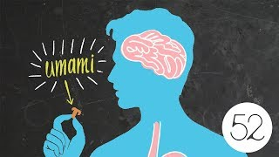
Video: Umami: The 5th Taste, Explained

Slide 6
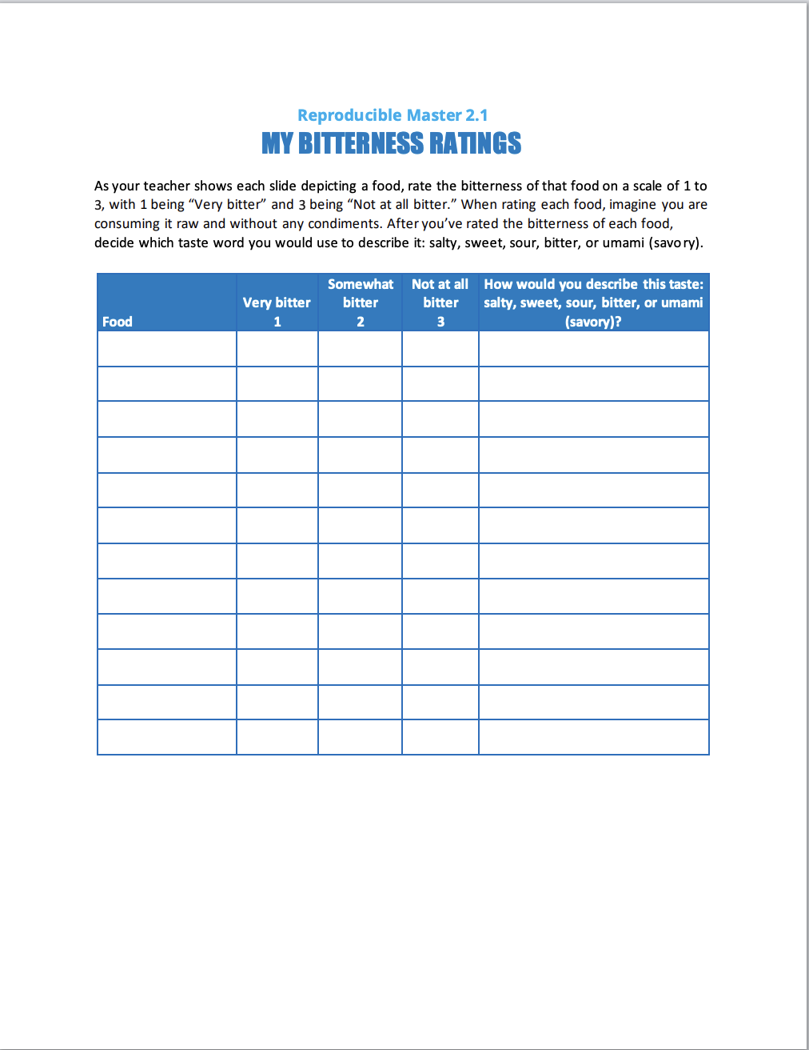

Activity: Rate the bitterness of these foods
Survey directions for RM 2.1:
As your teacher shows each slide depicting a food, use the table on My Bitterness Ratings (RM 2.1) to rate the bitterness of that food on a scale of 1 to 3, with 1 being “Very bitter” and 3 being “Not at all bitter.” When rating each food, imagine you are consuming it raw and without any condiments. After you’ve rated the bitterness of each food, decide which taste word you would use to describe it: salty, sweet, sour, bitter, or umami (savory). ​
If you’ve never tasted the food, mark the box “N/A.”​
Note which foods you described the same way.​

Slide 7

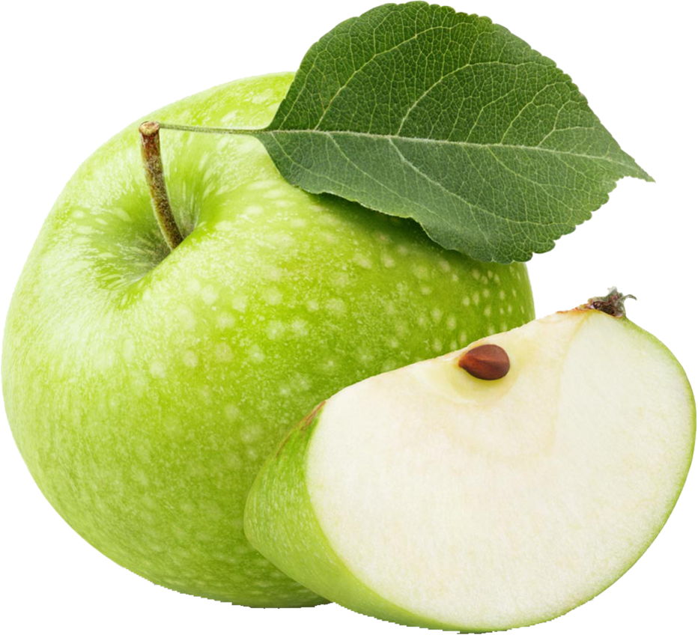
My bitterness ratings
For each food, rate its bitterness on a scale of 1 (very bitter) to 3 (not bitter)
Apples

Slide 8
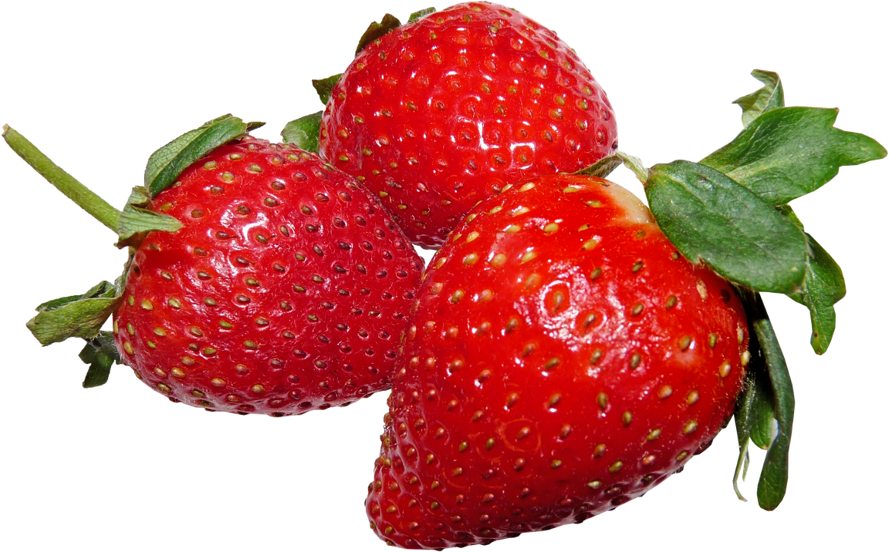
My bitterness ratings, continued
Strawberries

Slide 9
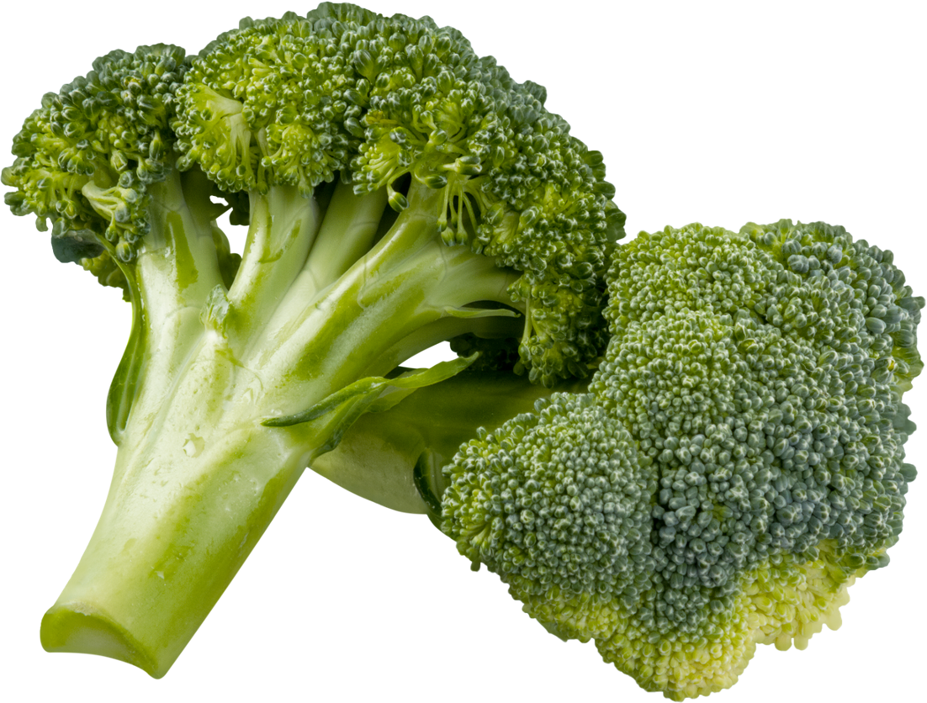
My bitterness ratings, continued
Broccoli

Slide 10
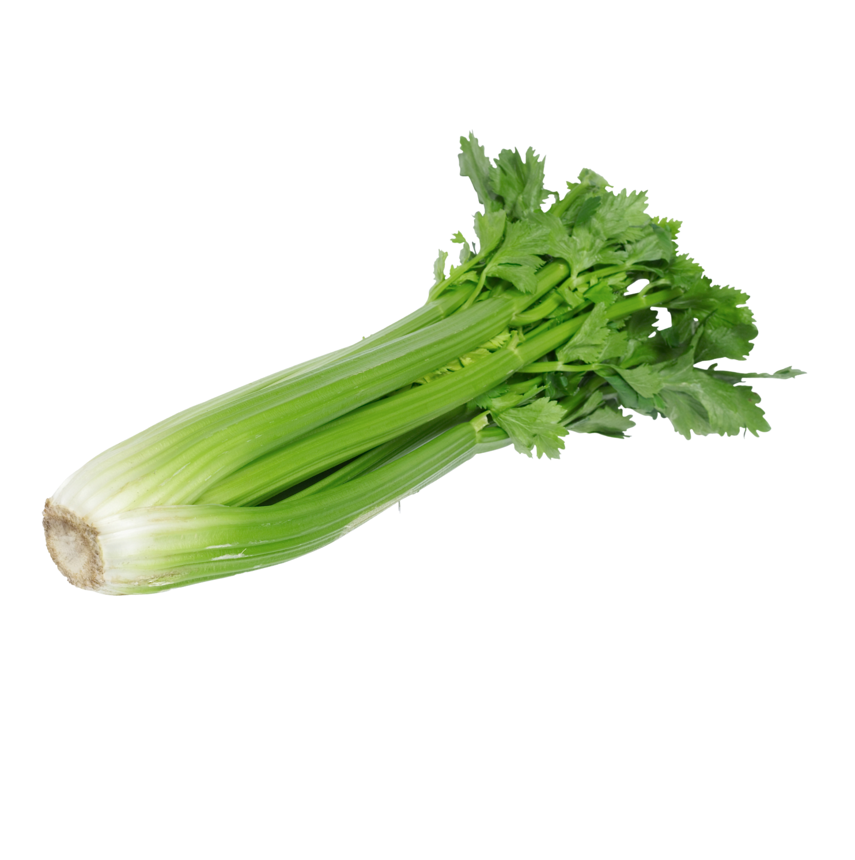
My bitterness ratings, continued
Celery

Slide 11
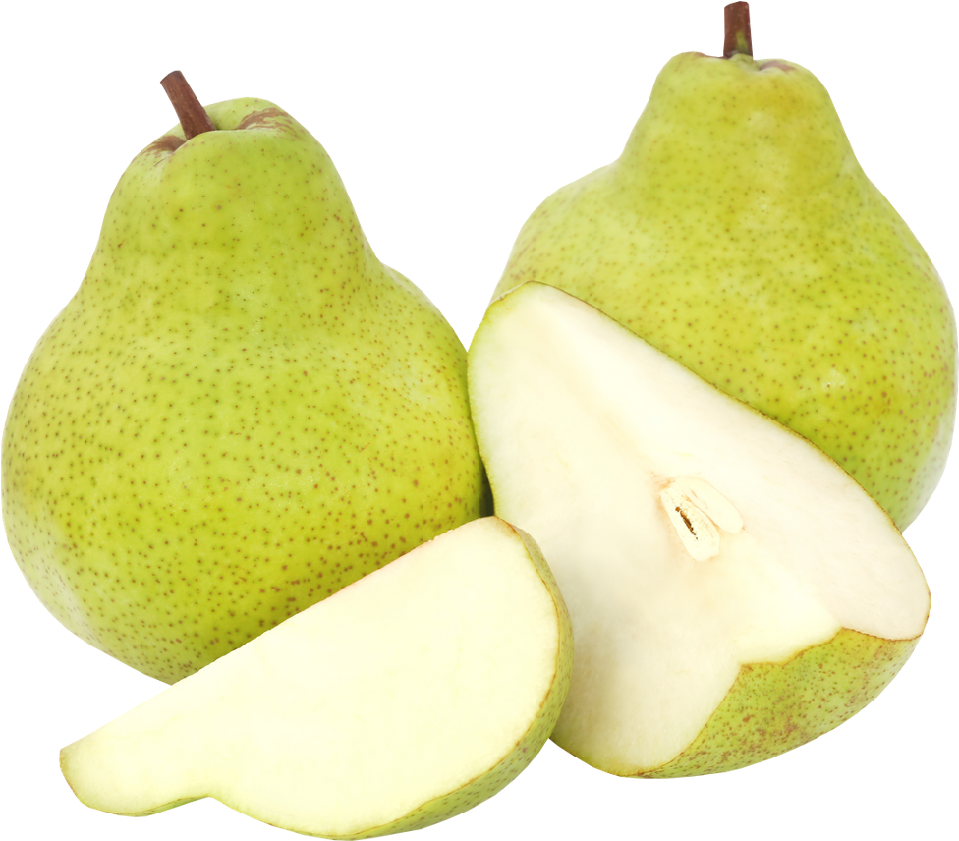
My bitterness ratings, continued
Pears

Slide 12
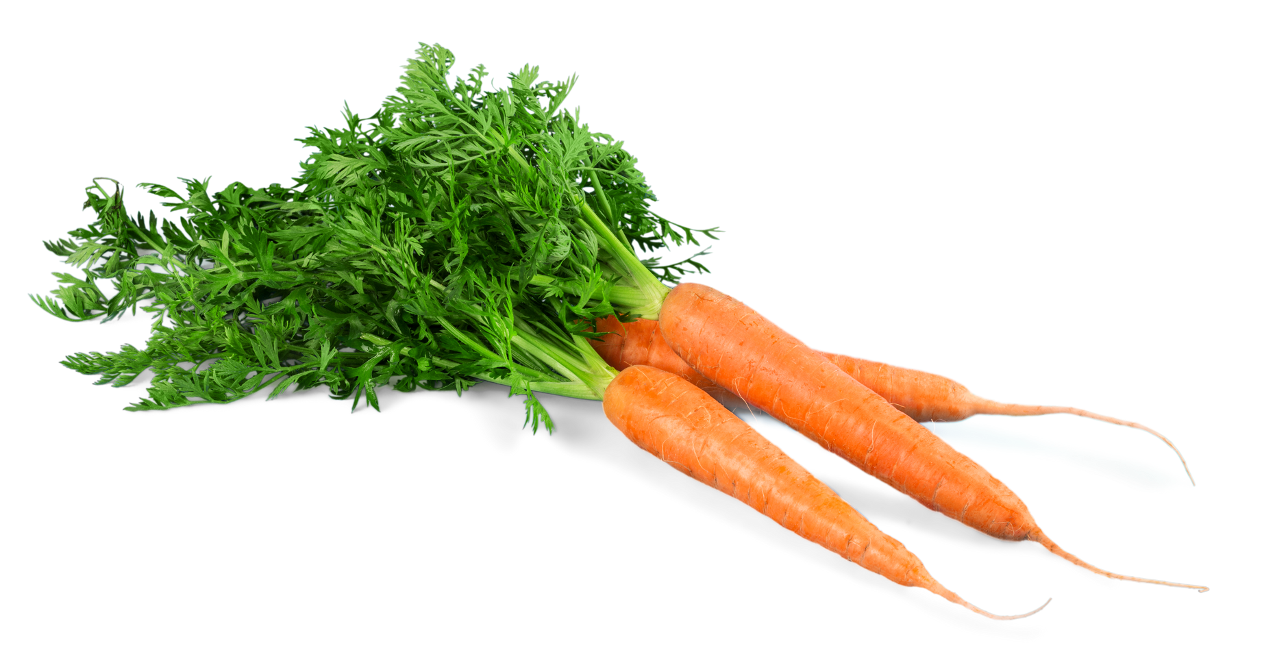
My bitterness ratings, continued
Carrots

Slide 13
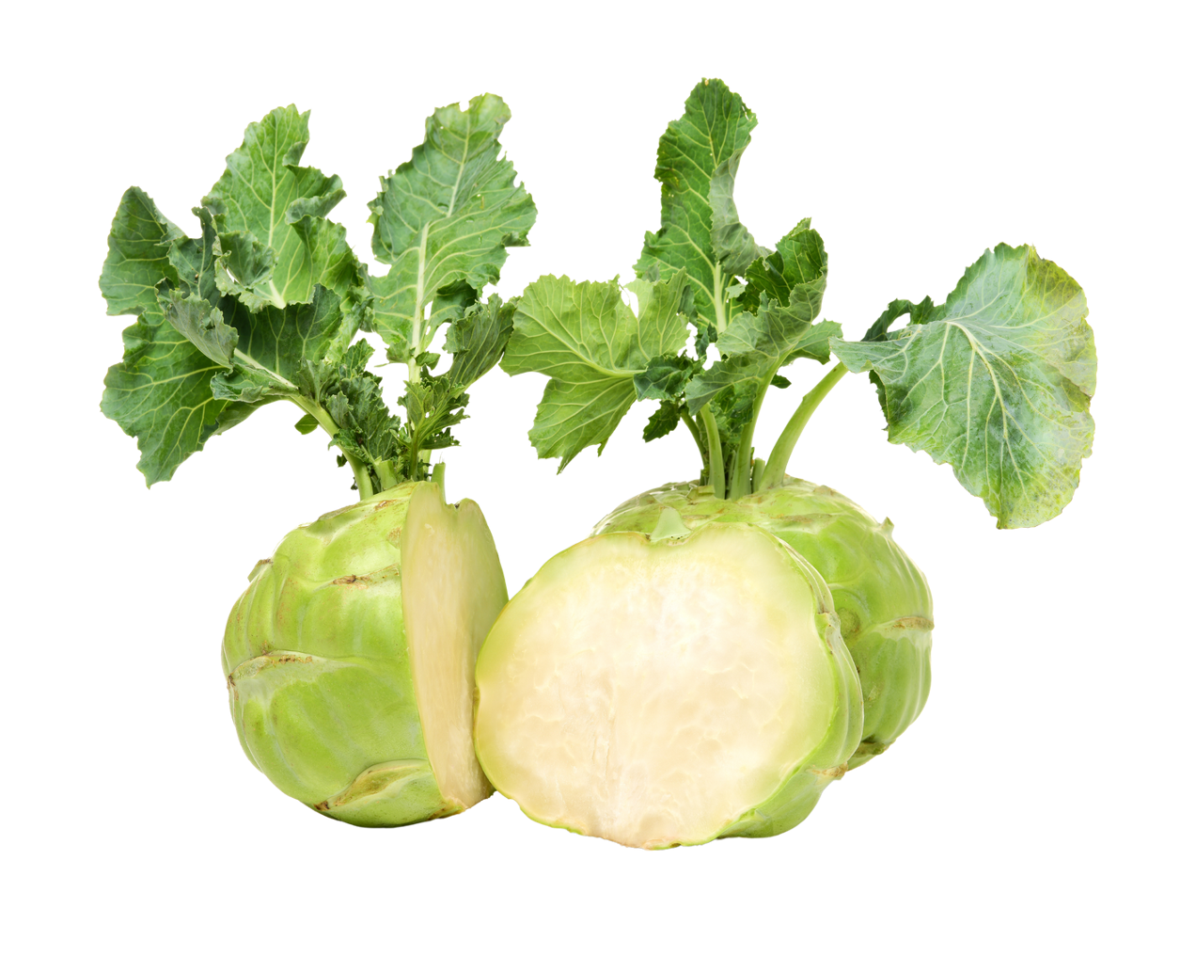
My bitterness ratings, continued
Kohlrabi

Slide 14
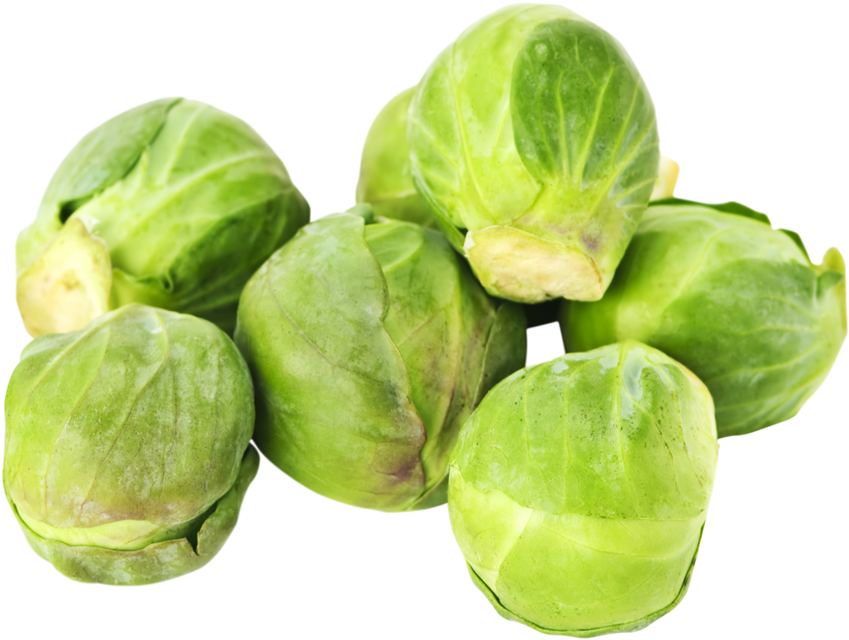
My bitterness ratings, continued
Brussels Sprouts

Slide 15
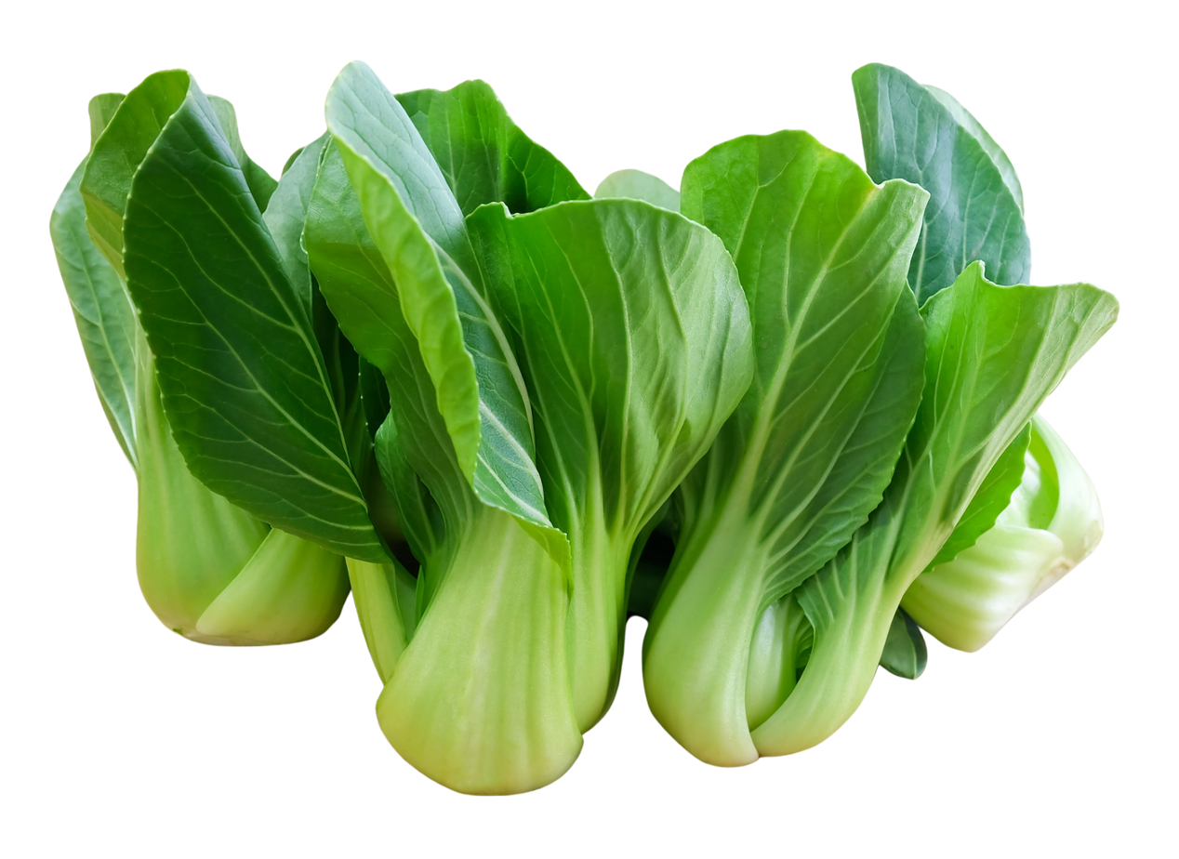
My bitterness ratings, continued
Bok Choy/Pak Choy

Slide 16
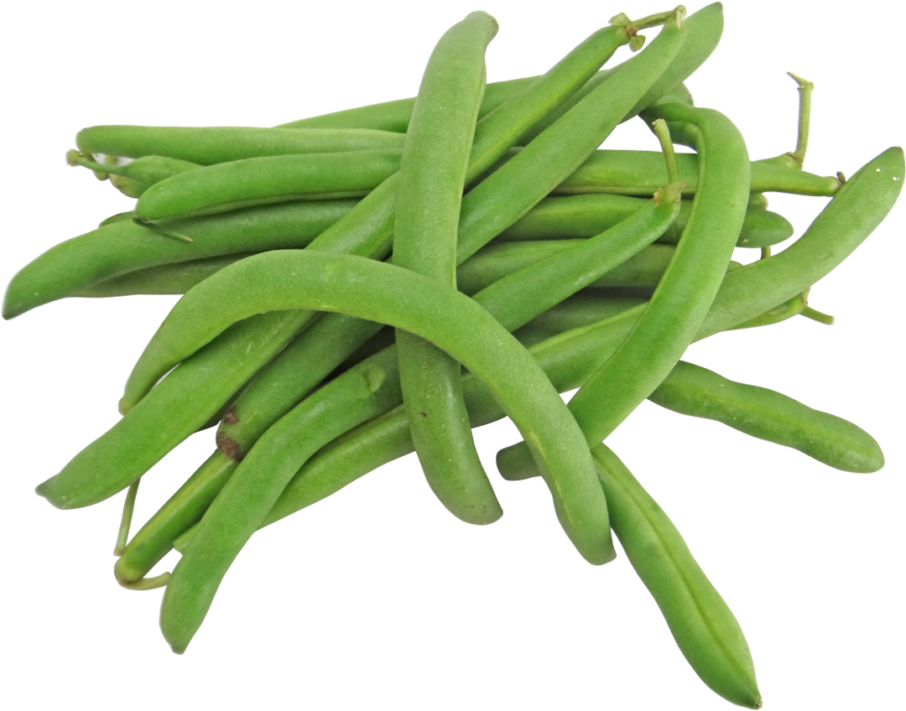
My bitterness ratings, continued
Beans

Slide 17
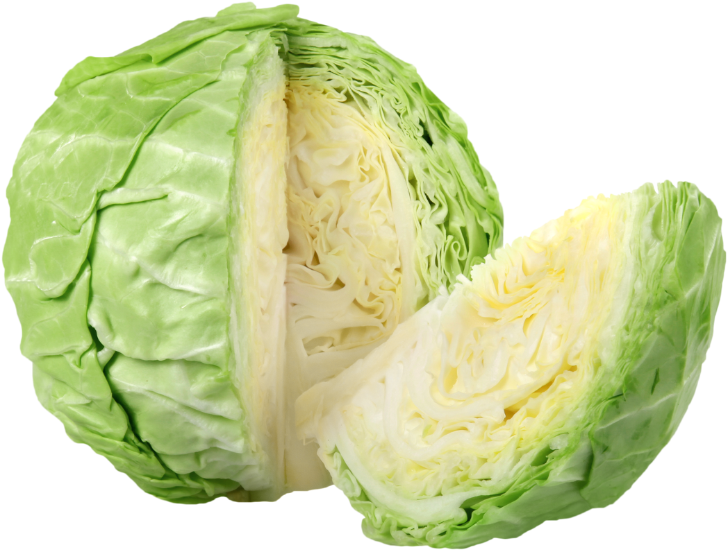
My bitterness ratings, continued
Cabbage

Slide 18
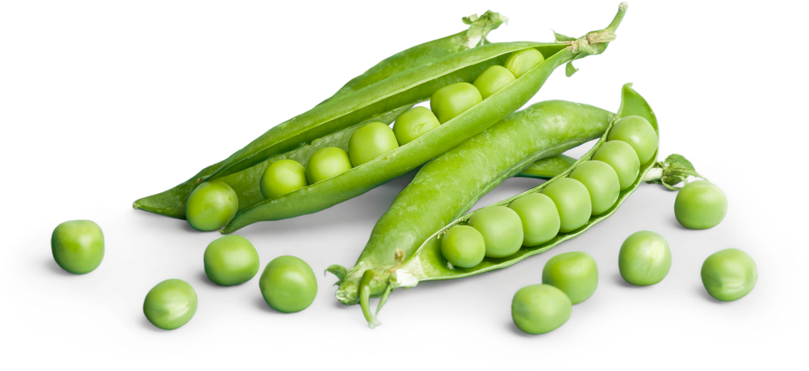
My bitterness ratings, continued
Peas

Slide 19
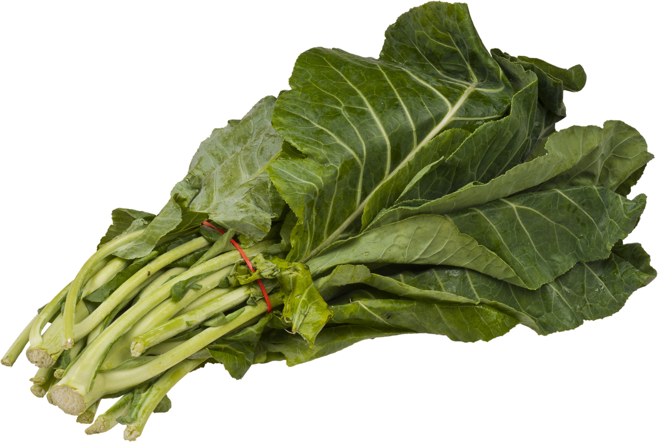
My bitterness ratings, continued
Collards

Slide 20
Discussion: My bitterness ratings
Are there any patterns in your personal results?
Did you give similar types of foods similar ratings?
Have foods always tasted the same way to you? Have you always liked or hated the foods that you like or hate today?

Slide 21
Discussion: My bitterness ratings, continued
Brassica vegetables All of these vegetables belong to the Brassica genus. What patterns do you notice in your rating of bitter taste for these vegetables?

Slide 22
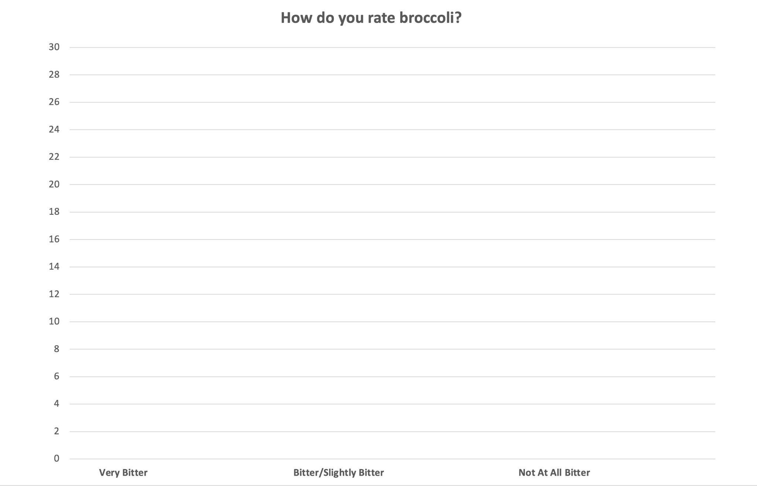
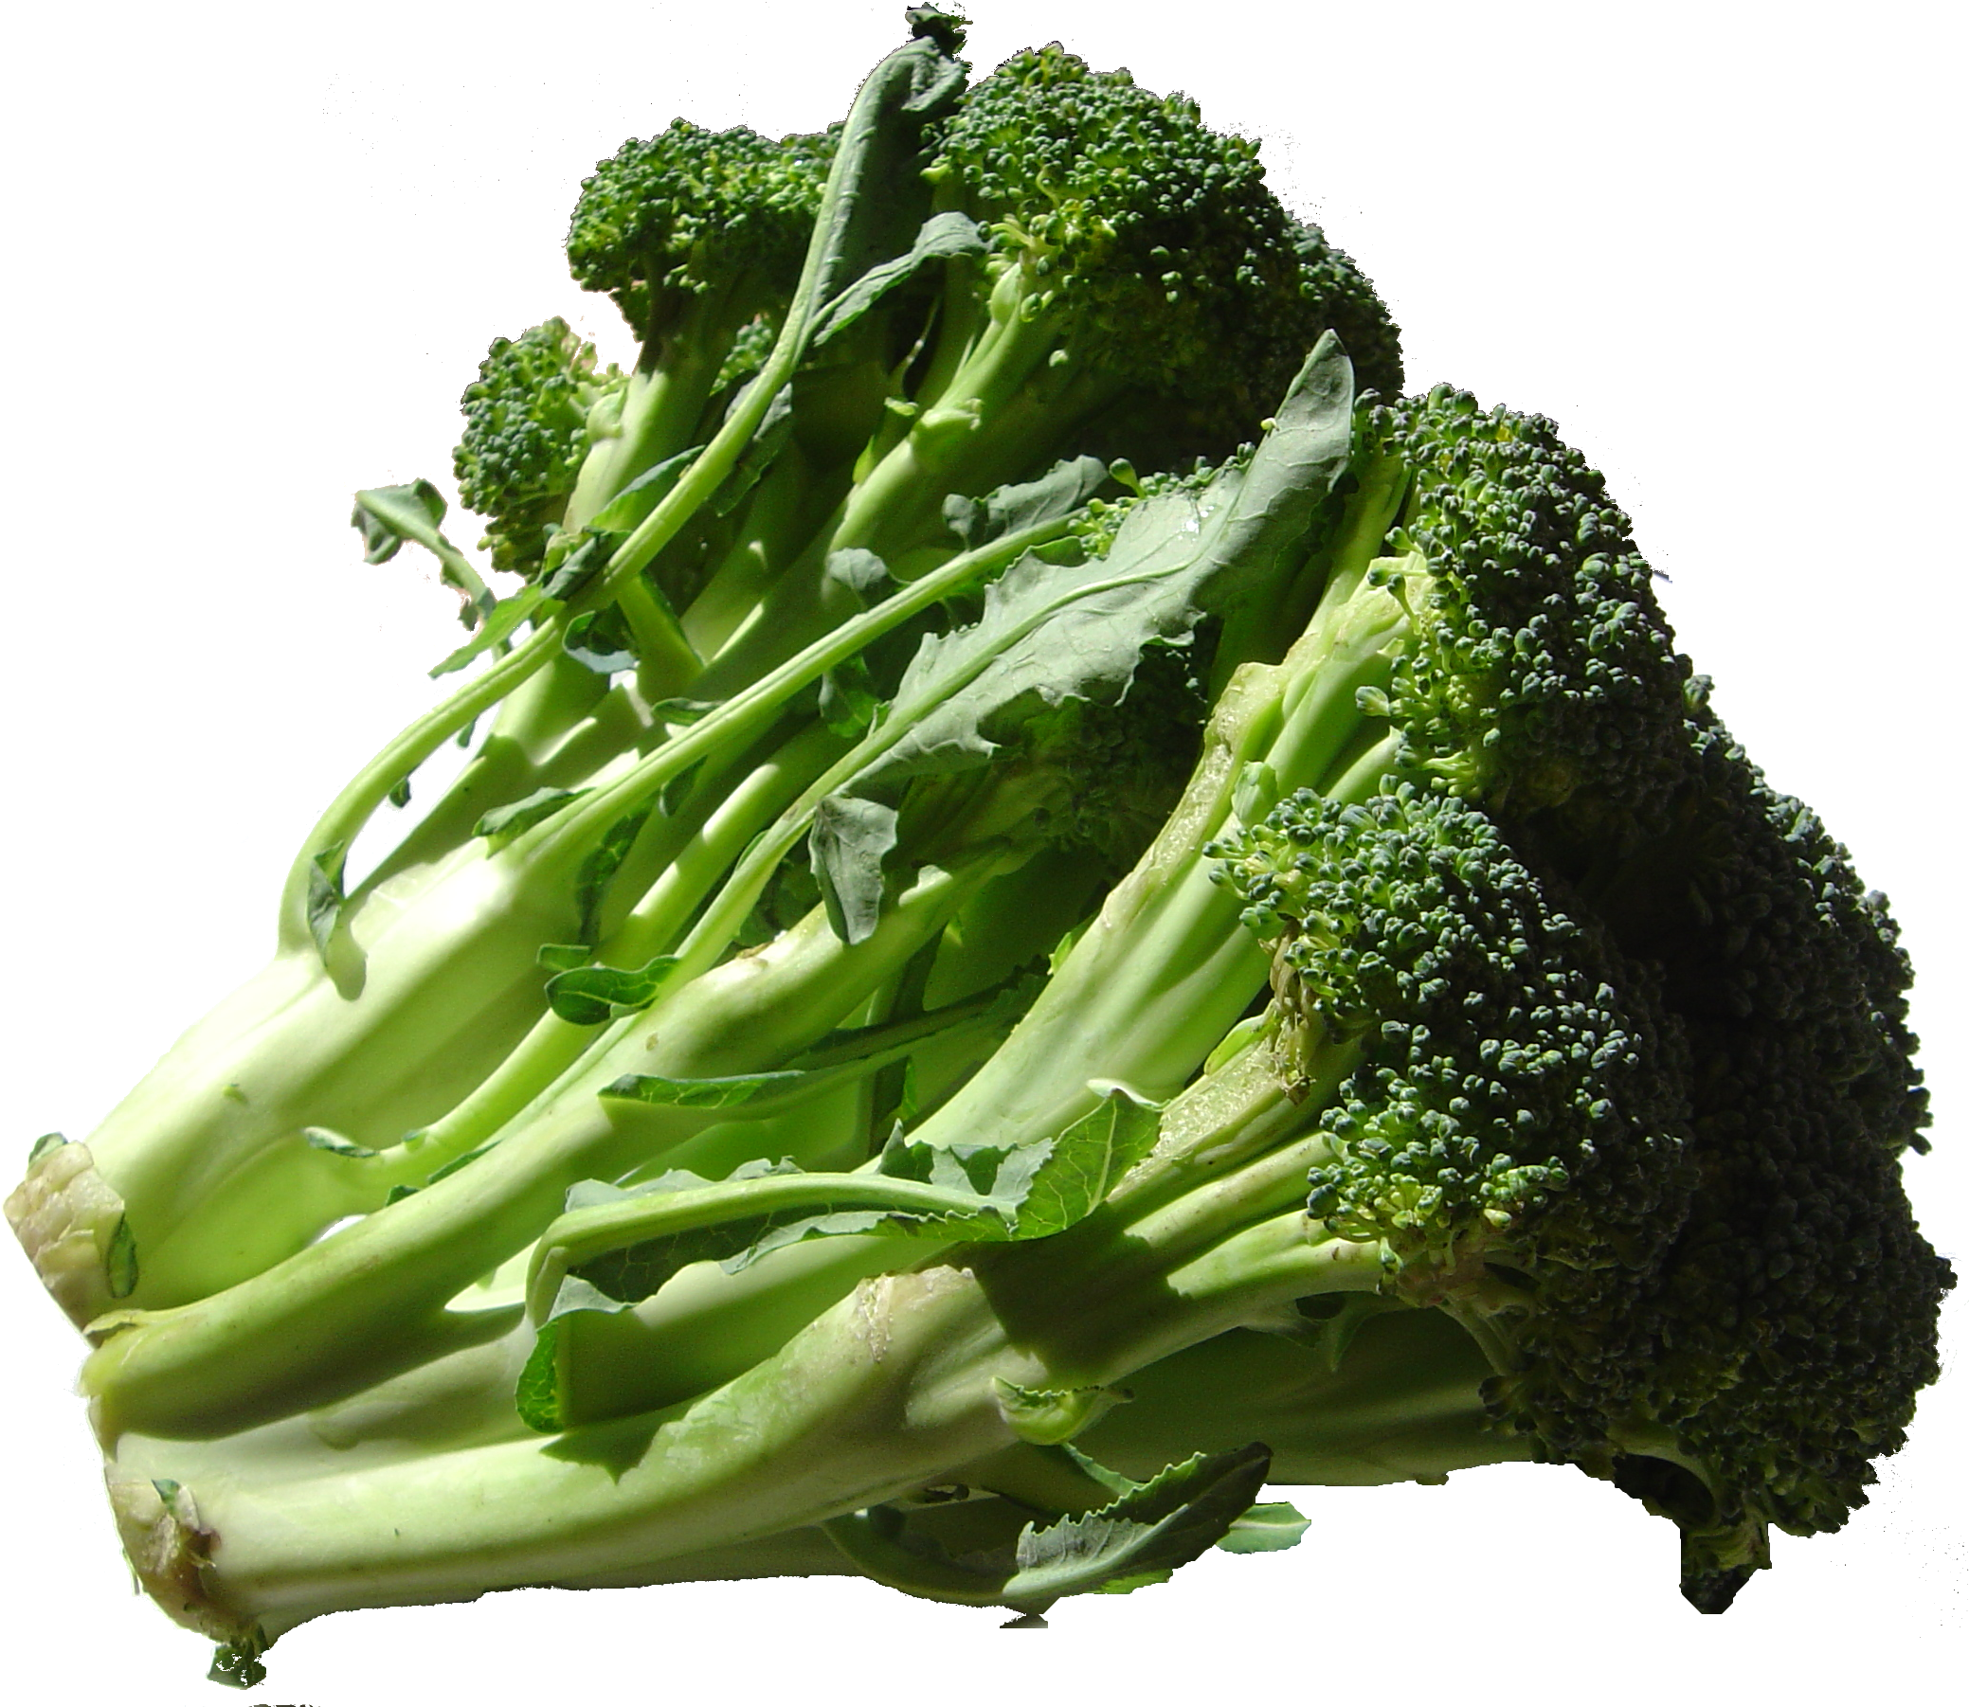
What do you think of broccoli?
Very Bitter (1)
Somewhat Bitter (2)
Not at all bitter (3)
Notes:
Discussion question:
What trends do you notice in this bar chart?
Students may find that there are few people in the middle of the scale. They may find that a large cluster of people say that raw broccoli tastes really bitter to them.
Do you think there might be any evolutionary advantage to being able to tolerate bitter-tasting foods? Or a disadvantage?
This is a good time to review the concept of evolution by natural selection. Traits are adaptive if they confer a reproductive advantage, either directly (for example, in allowing an organism to find and attract a mate) or indirectly (such as living long enough and being healthy enough to mate). But not all traits have to be adaptive! Some traits are maladaptive, but not to such a great extent that they prevent an organism from reproducing; some are linked to nearby genes under strong selective pressure, which maintains them in a population even though they may not be adaptive (for example, red hair and freckled skin in humans). The jury is out as to whether an enhanced ability to taste bitter foods has any real evolutionary advantage.

Slide 23
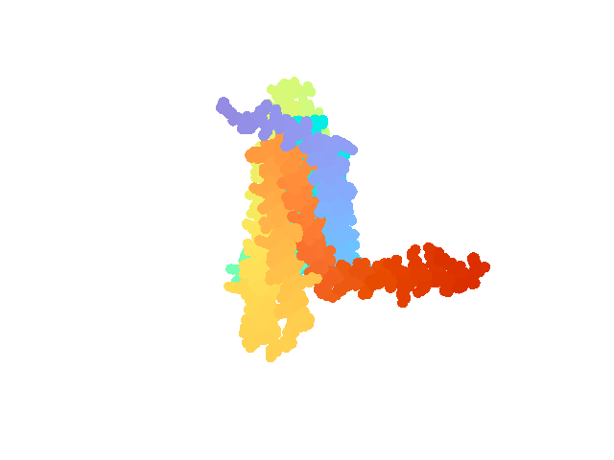
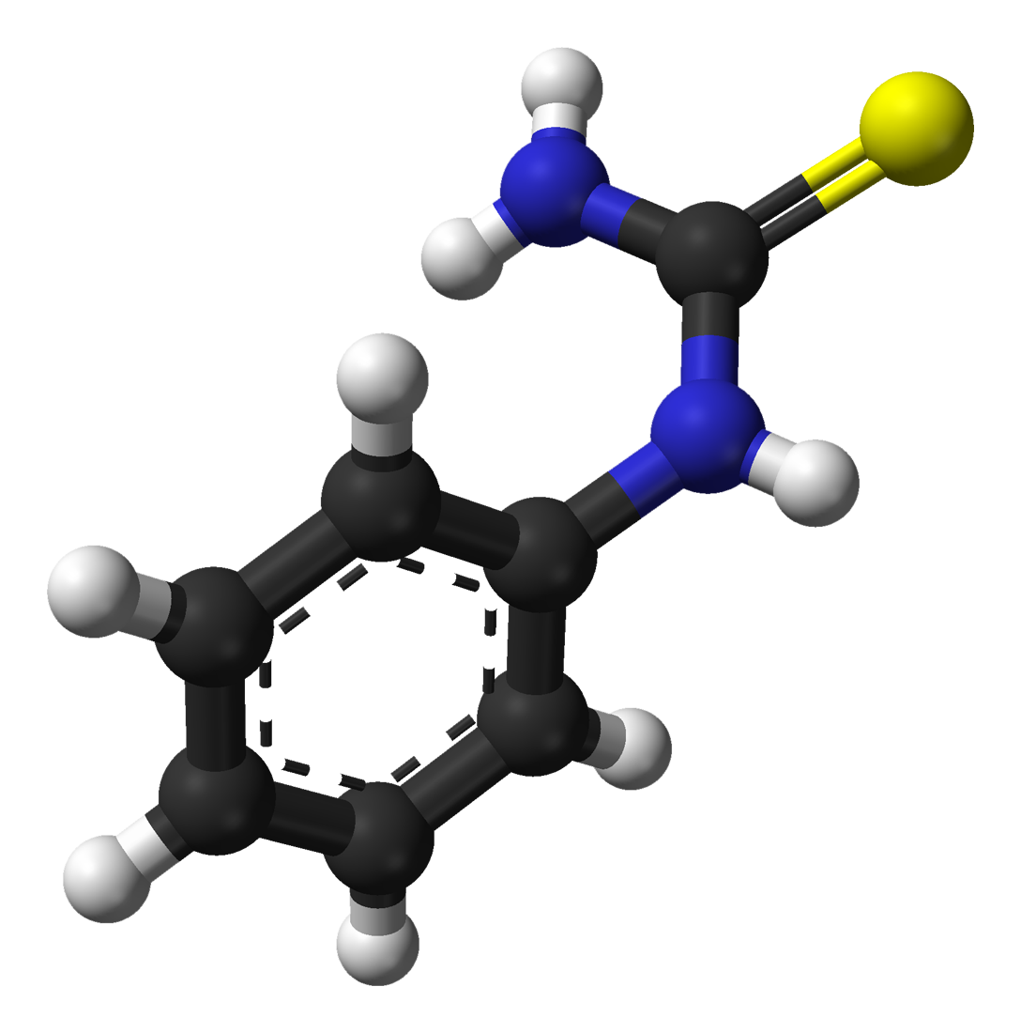
Our bitter-tasting ability is genetic!
Human gene: Taster Receptor 2 Member 38, or TAS2R38
It’s a bitter-taste receptor at the cell membrane of taste cells in the tongue.
When it binds to PTC (phenylthiocarbamide), gustatory (taste) neurons send a signal to the brain.
Not everyone can taste PTC.
PTC 3D structure
TAS2R38
Notes:
TAS2R38 protein model: https://alphafold.ebi.ac.uk/entry/P59533, CC BY 4.0

Slide 24
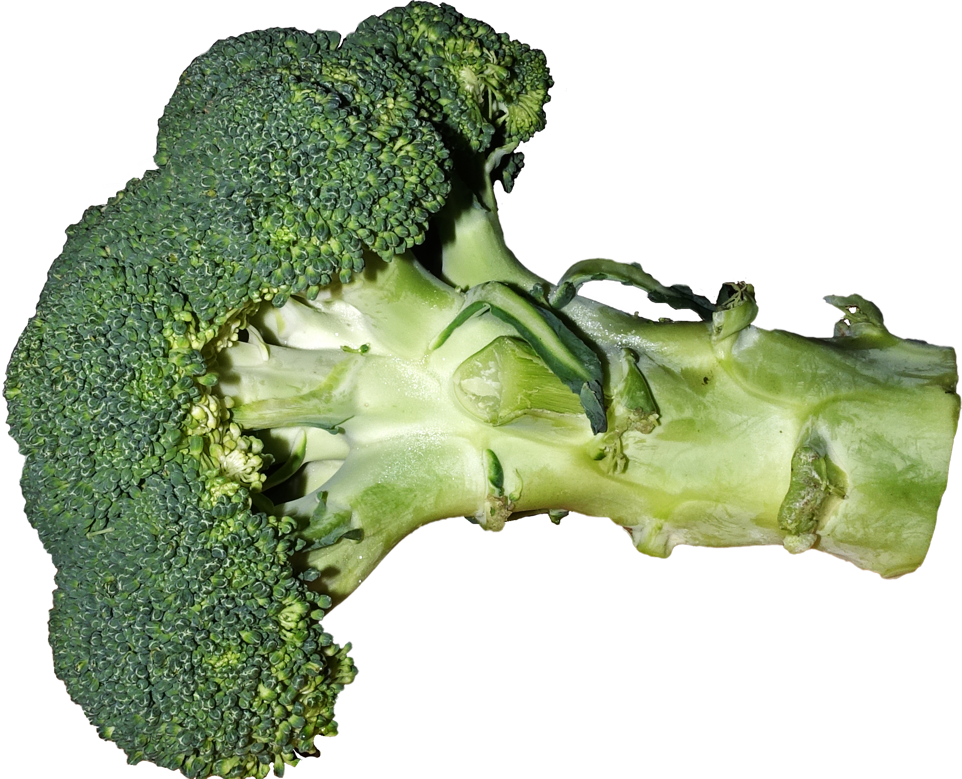
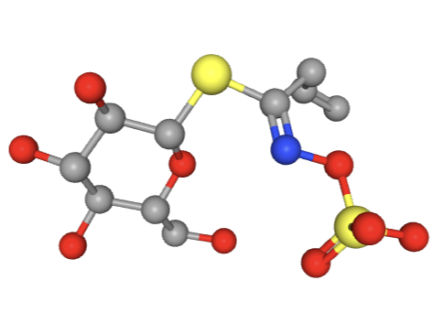
PTC is not found in nature, but . . .
The ability to taste PTC is correlated with the ability to taste other bitter compounds.
Brassicaceae are loaded with bitter compounds: glucosinolates.
People who can taste PTC often dislike broccoli and other Brassicas!
Sinigrin, a bitter glucosinolate in Brussels sprouts and cauliflower
Notes:
Broccoli: https://commons.wikimedia.org/wiki/File:Broccoli.png
Sinigrin: NIH: https://pubchem.ncbi.nlm.nih.gov/compound/Sinigrin#section=3D-Conformer&fullscreen=true

Slide 25
How easily do you think you could taste PTC?
Would you be a strong taster, a weak taster, or a nontaster?

Slide 26
Review: define genotype and phenotype
Genotype:
Phenotype:
Your genetic makeup
How your genotype is expressed

Slide 27
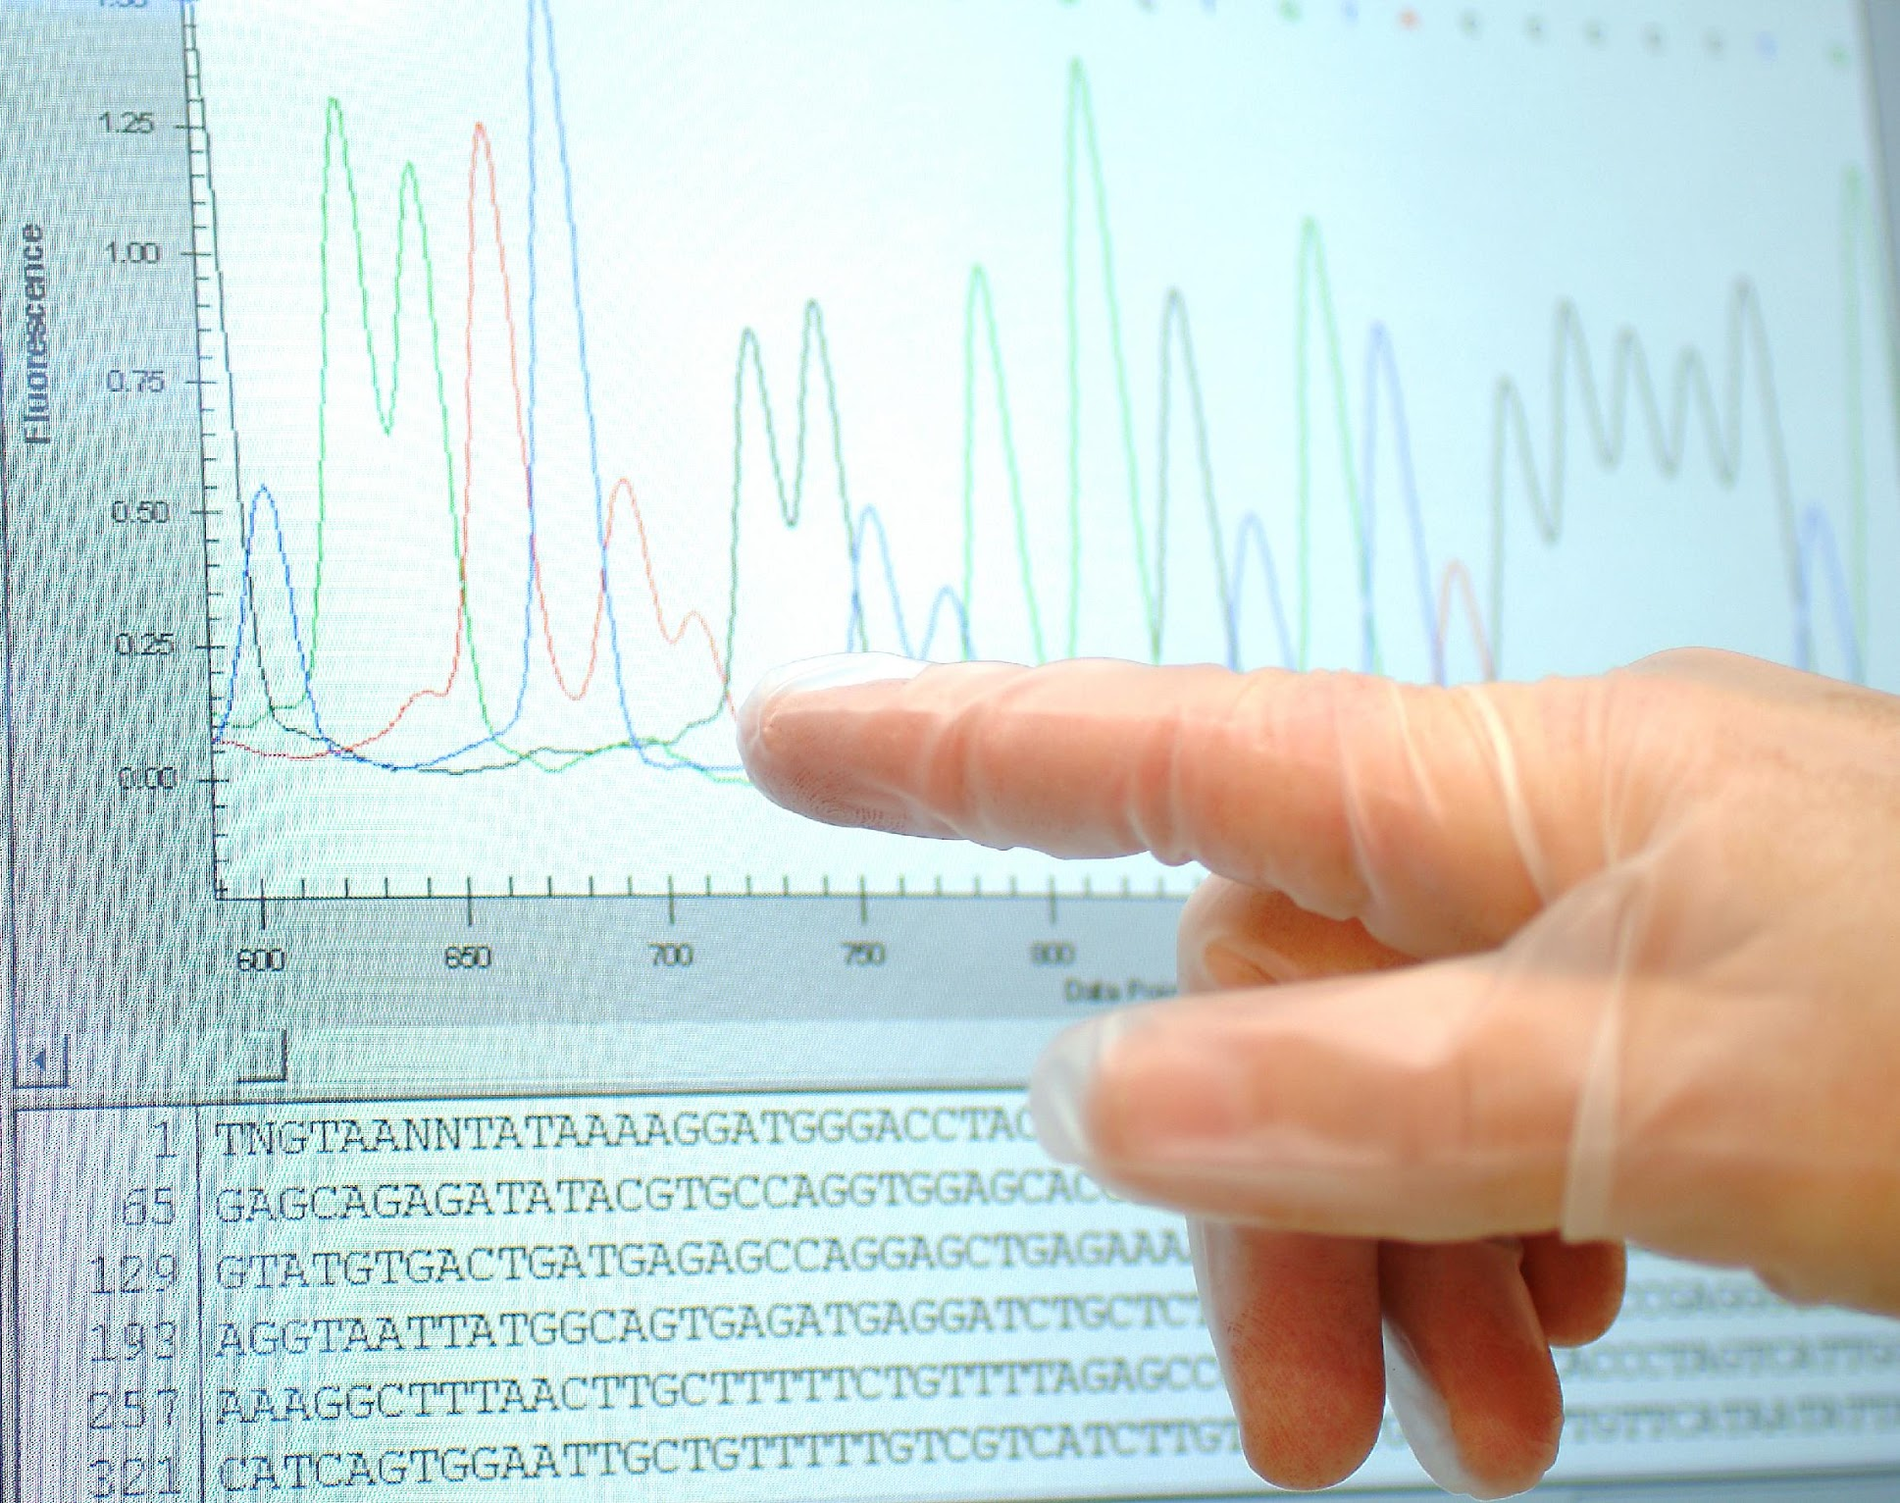
Connecting genotype and phenotype
You will...
In medicine, doctors might use sequencing data (genotype) to predict a patient’s drug metabolism (phenotype).
Determine your bitter-tasting phenotype by tasting PTC paper & control paper.
Infer your genotype, which will be confirmed by PCR, restriction enzyme digestion, and gel electrophoresis.

Slide 28
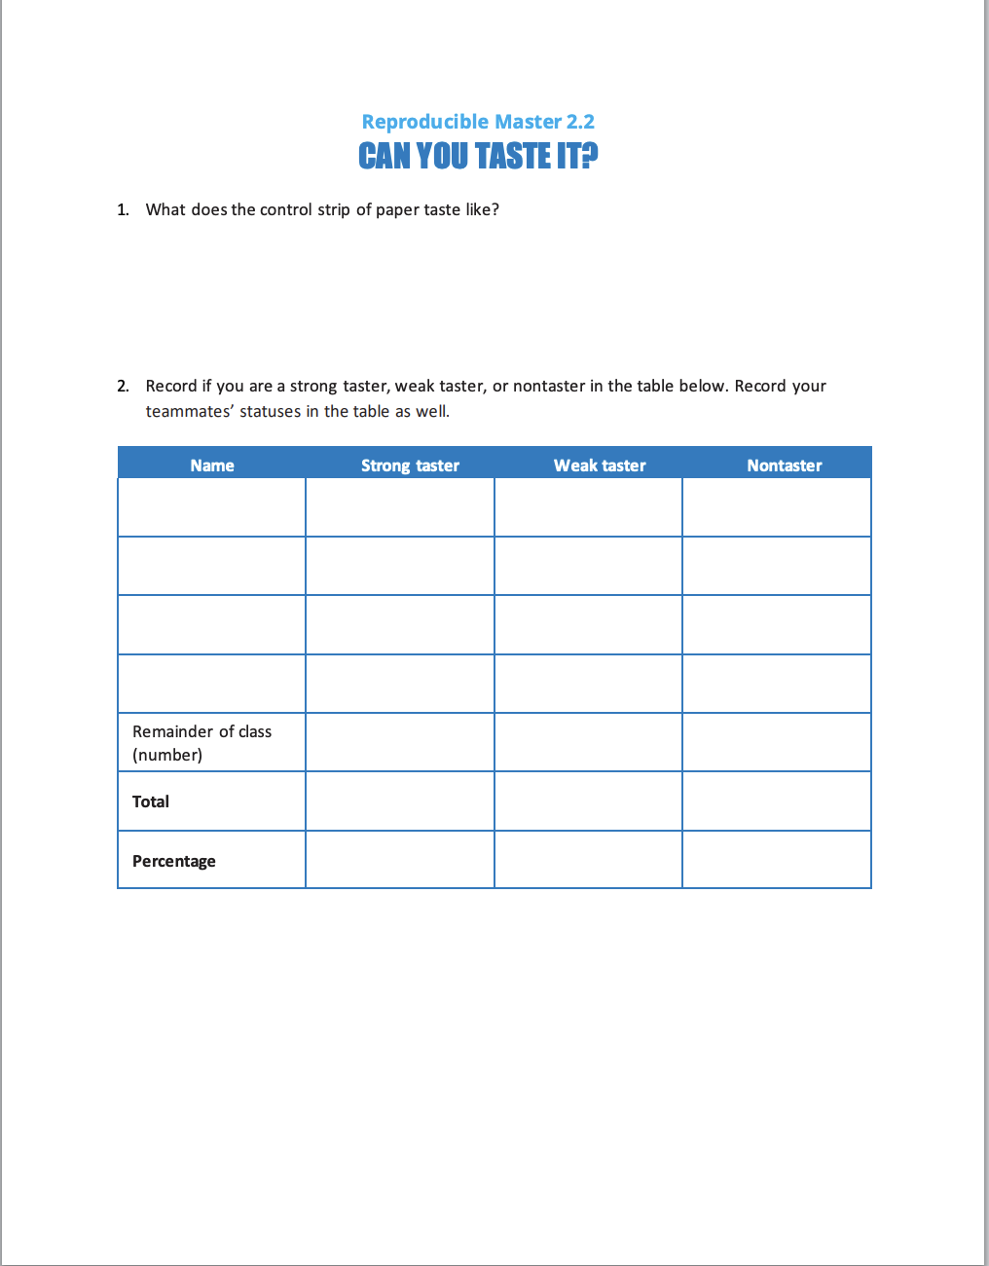
What’s your PTC taster phenotype?
Time for a taste test!
Directions:
Taste the control strip. (Don’t swallow it!!)
Rinse your mouth with water.
Taste the PTC paper. (Don’t swallow it!!)
Record your taste level on RM 2.2.
Record your teammates’ responses on page 2.
Hint: If you are a strong taster, the PTC paper will taste terribly bitter!

Slide 29
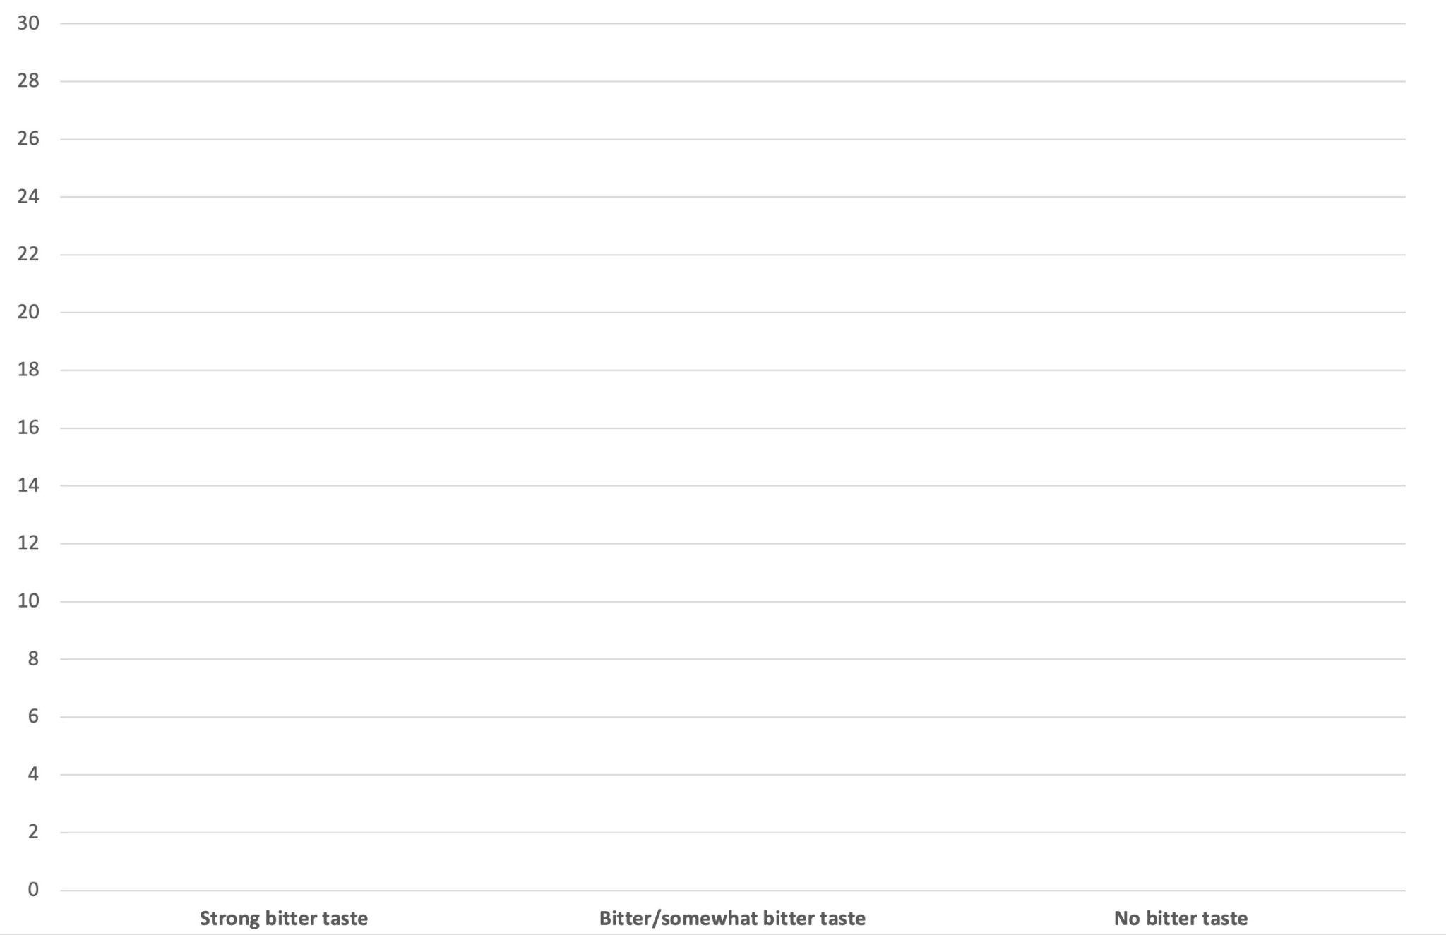
How easily could you taste PTC?
Strong Tasters
Weak Tasters
Nontasters
Notes:
Compare this bar graph to the broccoli bitterness data collected earlier.
Discussion questions:
Are the bar charts of broccoli’s bitterness (or lack thereof) and taster status similar or different?
Students may find that the bar charts are similar, perhaps due to the bitter molecule in broccoli and the PTC molecule being similar.
Do you notice any other patterns or similarities? What might account for this?
Do you think there’s a correlation between tasting broccoli as bitter–or not–and whether or not you could taste PTC?
Students may report that they saw significant overlap between PTC tasters and people who find broccoli to be bitter.

Slide 30
Before the next lab:
Watch the video What Is a Gene?
If your teacher assigns it: Read the article “Mamas, Don’t Let Your Babies Grow Up to Be Broccoli-Haters.”
Complete RM 2.3.
Read in your Student Guide about how PCR works.
Complete RM 2.4.

Slide 31
Discussion: “Genetic Taste Markers and Food Preferences”

Slide 32
Before the next lab:
Read in your Student Guide about how PCR works
Complete RM 2.4

