Slide 1
Exploring Precision Medicine
Chapter 1: What’s the Right Medicine?
Chapter 2: Is My Sense of Taste Controlled by my Genes?
Chapter 3: Exploring Our DNA
Chapter 4: How Is DNA Sequenced, and What Can We Learn?
Chapter 5: Restriction Enzyme Digestion of TAS2R38 PCR Products
Chapter 6: Gel Electrophoresis and Genotyping
Chapter 7: SNPs and Drug Metabolism

Slide 2
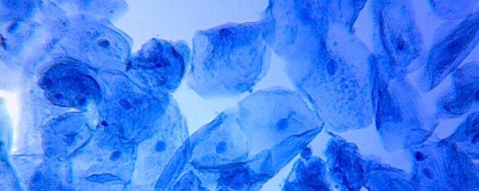
Chapter 3: Exploring our DNA
Notes:
Human cheek cells. Image attribution: By Joseph Elsbernd - https://www.flickr.com/photos/codonaug/6936088946/in/album-72157629826384173/, CC BY-SA 2.0, https://commons.wikimedia.org/w/index.php?curid=56696923

Slide 3
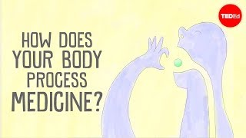
Video: How Does Your Body Process Medicine?
Notes:
Questions to ask your students, with time points from the video:
Do you think all medicines work like ibuprofen does? (2:54)
Not all medicines work like ibuprofen does, because each medicine is a different molecule with a different mode of action. Also, some medicines are inhaled, injected, or applied to the skin, so not all of them enter the bloodstream the same way as ibuprofen.
What factors control how medicines work? (3:40)
The video explains that genetics, age, diet, disease, and pregnancy can all affect the way that medicines work.
If a patient’s body contained large amounts of enzymes that broke down medications, how might this change the patient’s outcomes?
The medications would likely be less effective.
If a patient’s body contained small amounts of enzymes that broke down medications, how might this change the patient’s outcomes?
The medications could remain in the patient’s body long enough to become toxic.

Slide 4
Why are we extracting our DNA and what are we looking for?
Precision medicine studies variation in genes associated with particular phenotypes.
We will look at a receptor gene associated with the ability to taste bitter foods.
The bitter-taste phenotype is easy to test.
This gene is a stand-in for medically relevant genes.

Slide 5
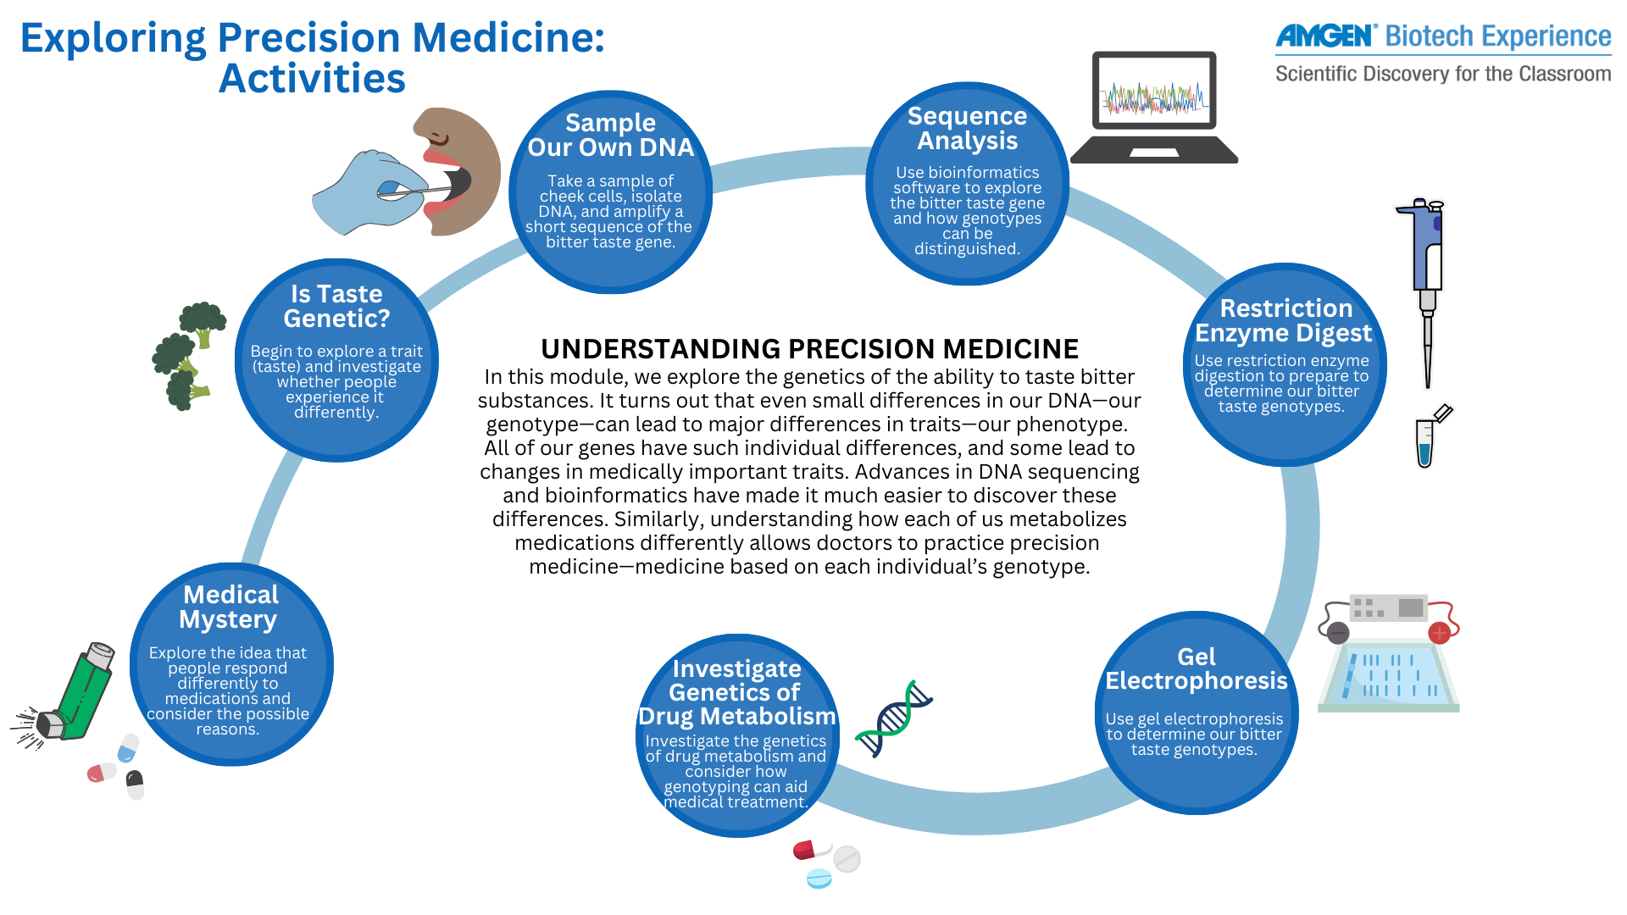


Slide 6
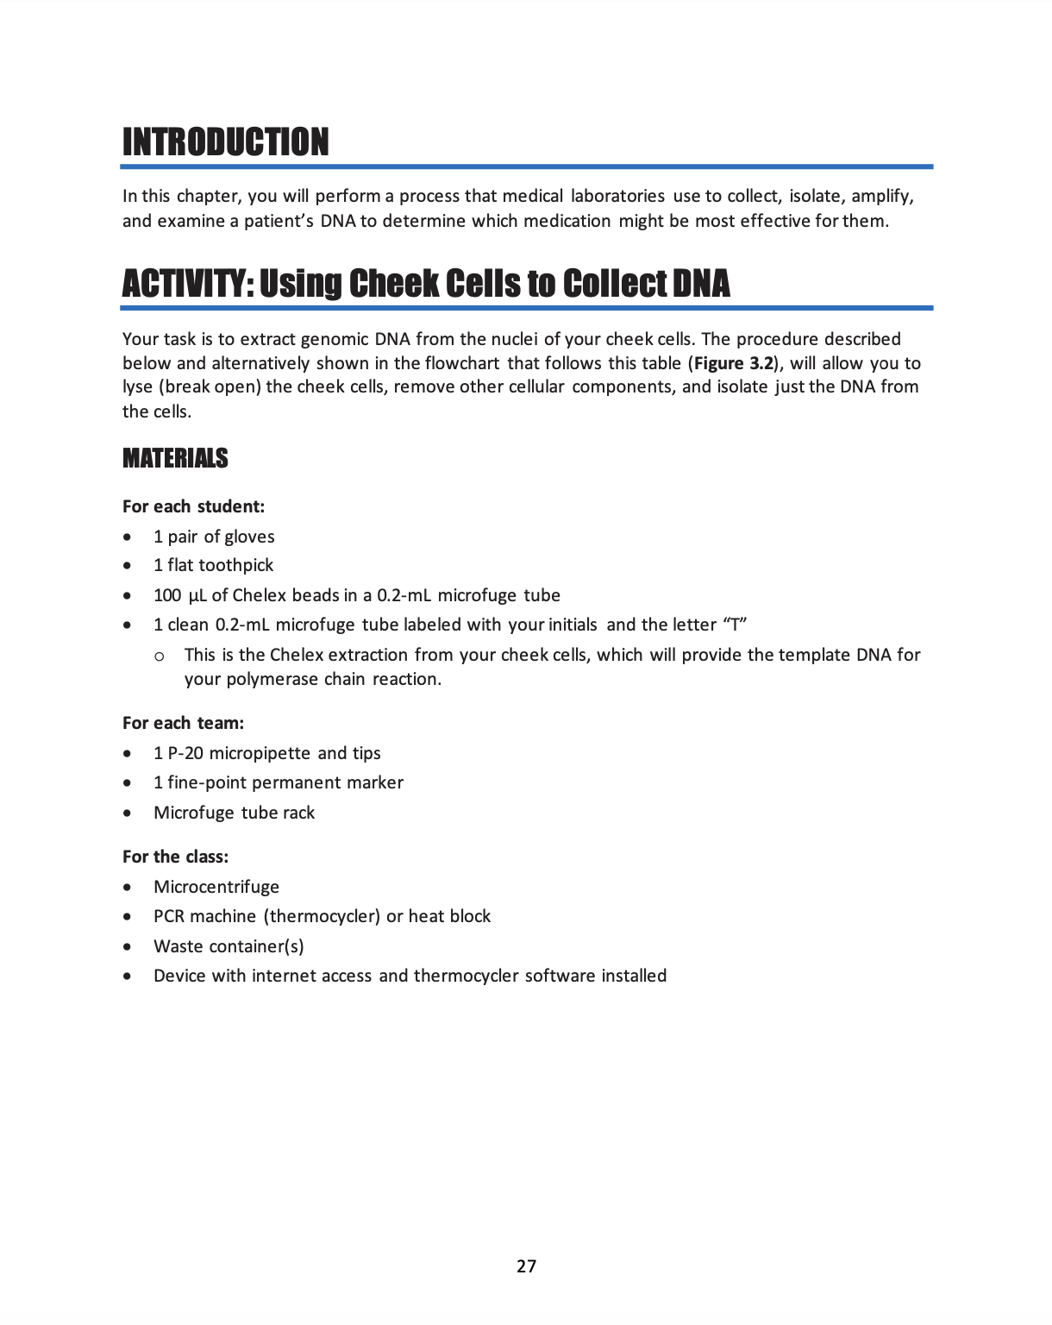
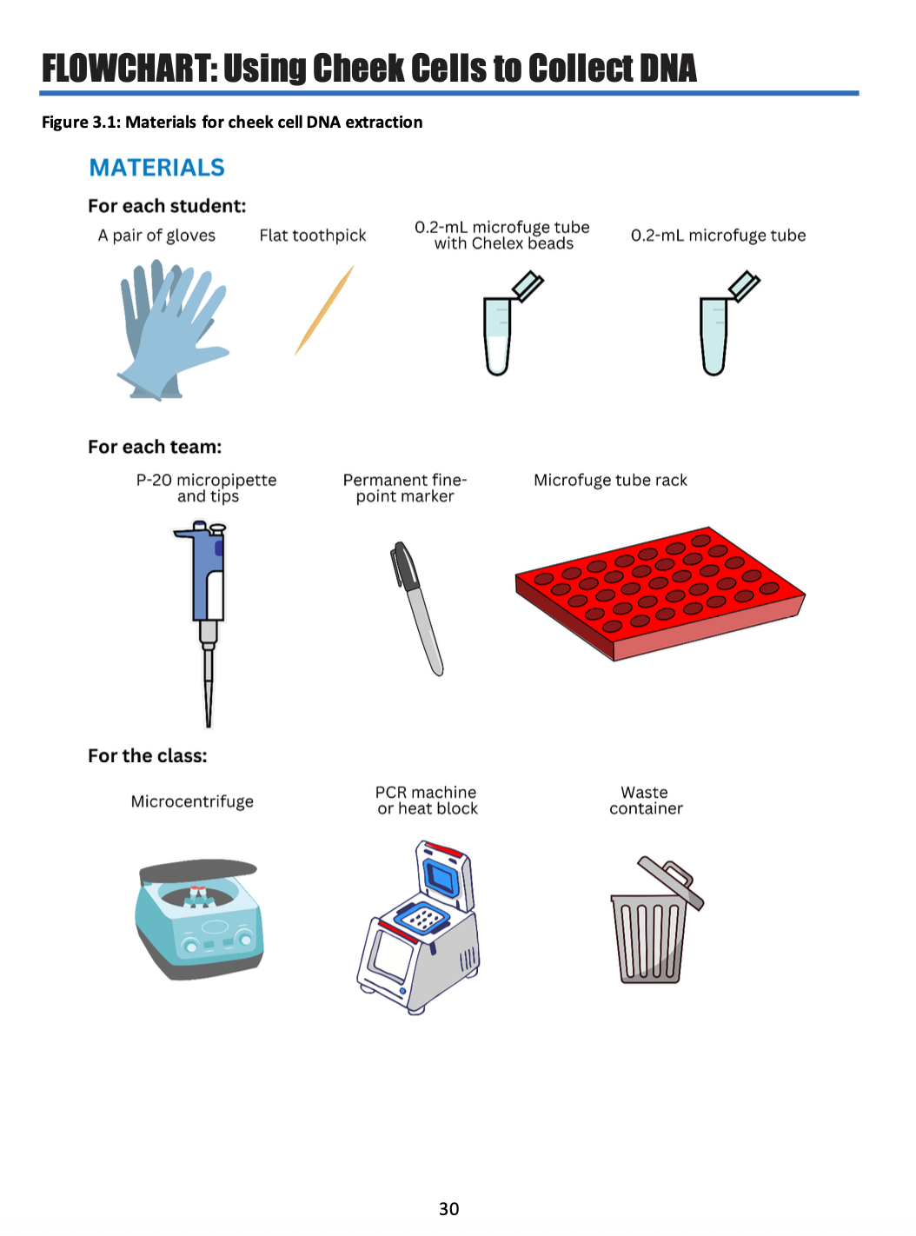
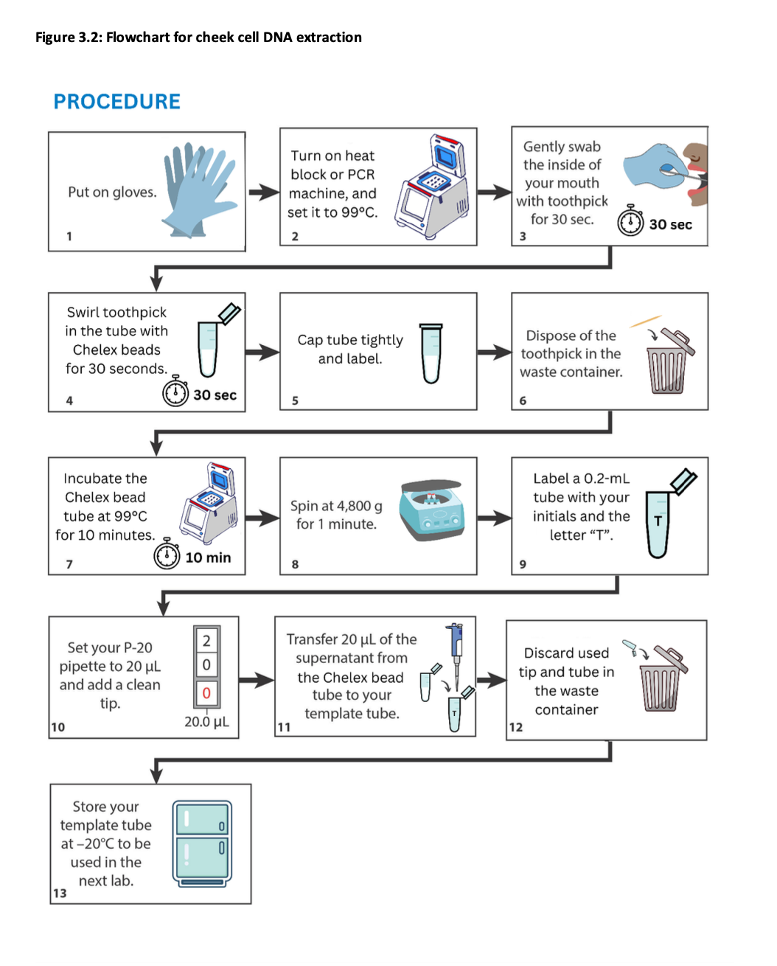
Read “Using Cheek Cells to Collect DNA” in your Student Guide

Slide 7
Discussion questions: “Using cheek cells to collect DNA”
What happens when you heat up your sample?
  Heating the sample breaks open the cells’ nuclei and lets the DNA out
What does the Chelex do?
  The Chelex binds metal ions which allow DNAses to degrade damaged DNA. We want our DNA whole!
Why do you centrifuge the sample after incubating?
  Spinning the sample collects all the “garbage” at the bottom of the tube (broken-down cell components, etc.)
Notes:
Heating the sample breaks open the cells’ nuclei and lets the DNA out.
The Chelex binds, or chelates, cofactors (metallic ions which allow DNAses to degrade damaged DNA). We want our DNA whole!
Spinning the sample collects all the “garbage” at the bottom of the tube (broken-down cell components, etc.).

Slide 8
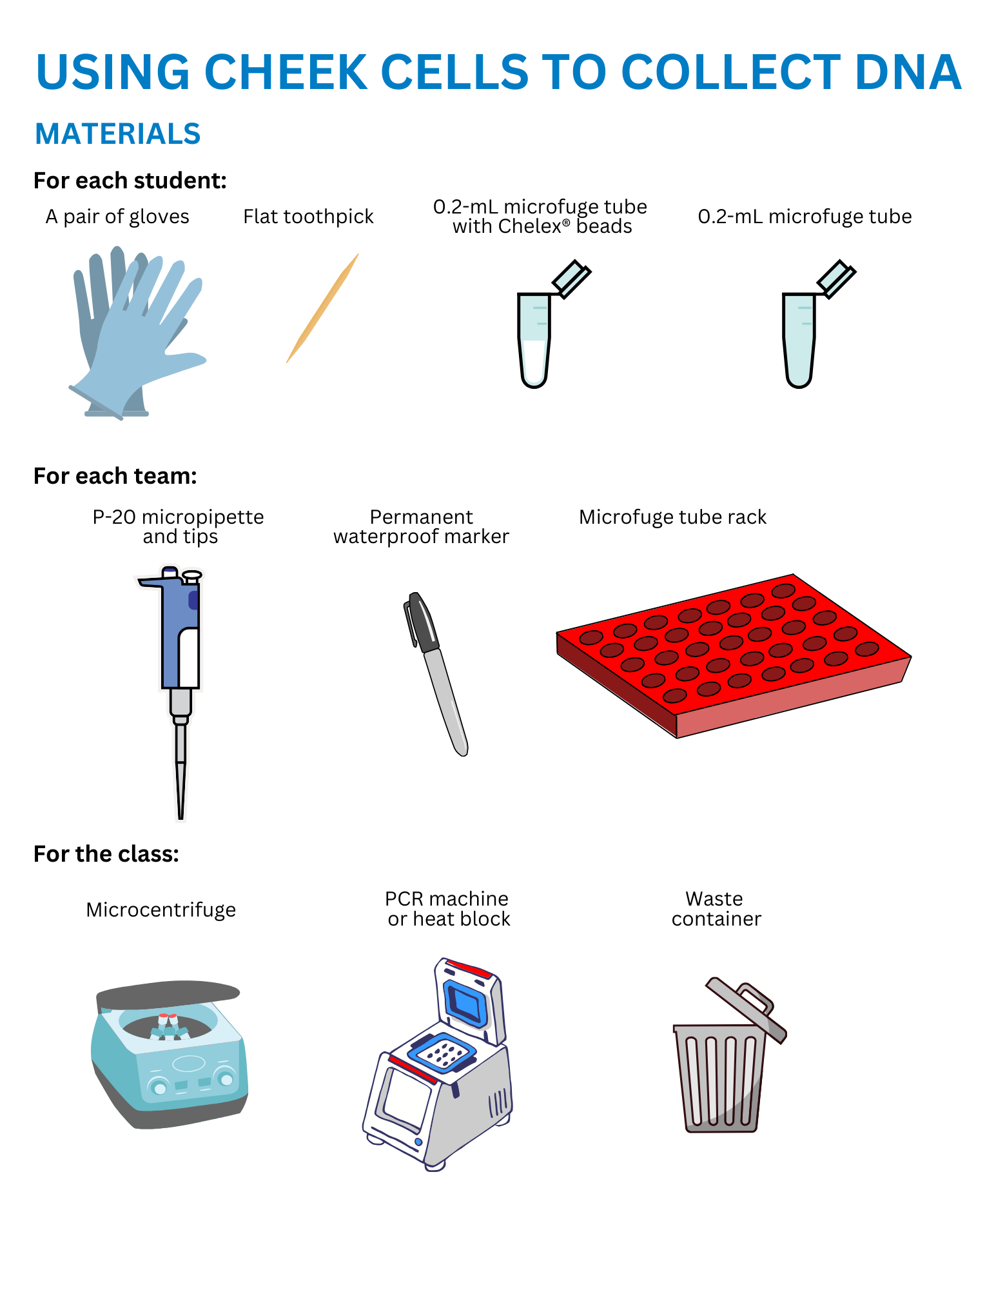
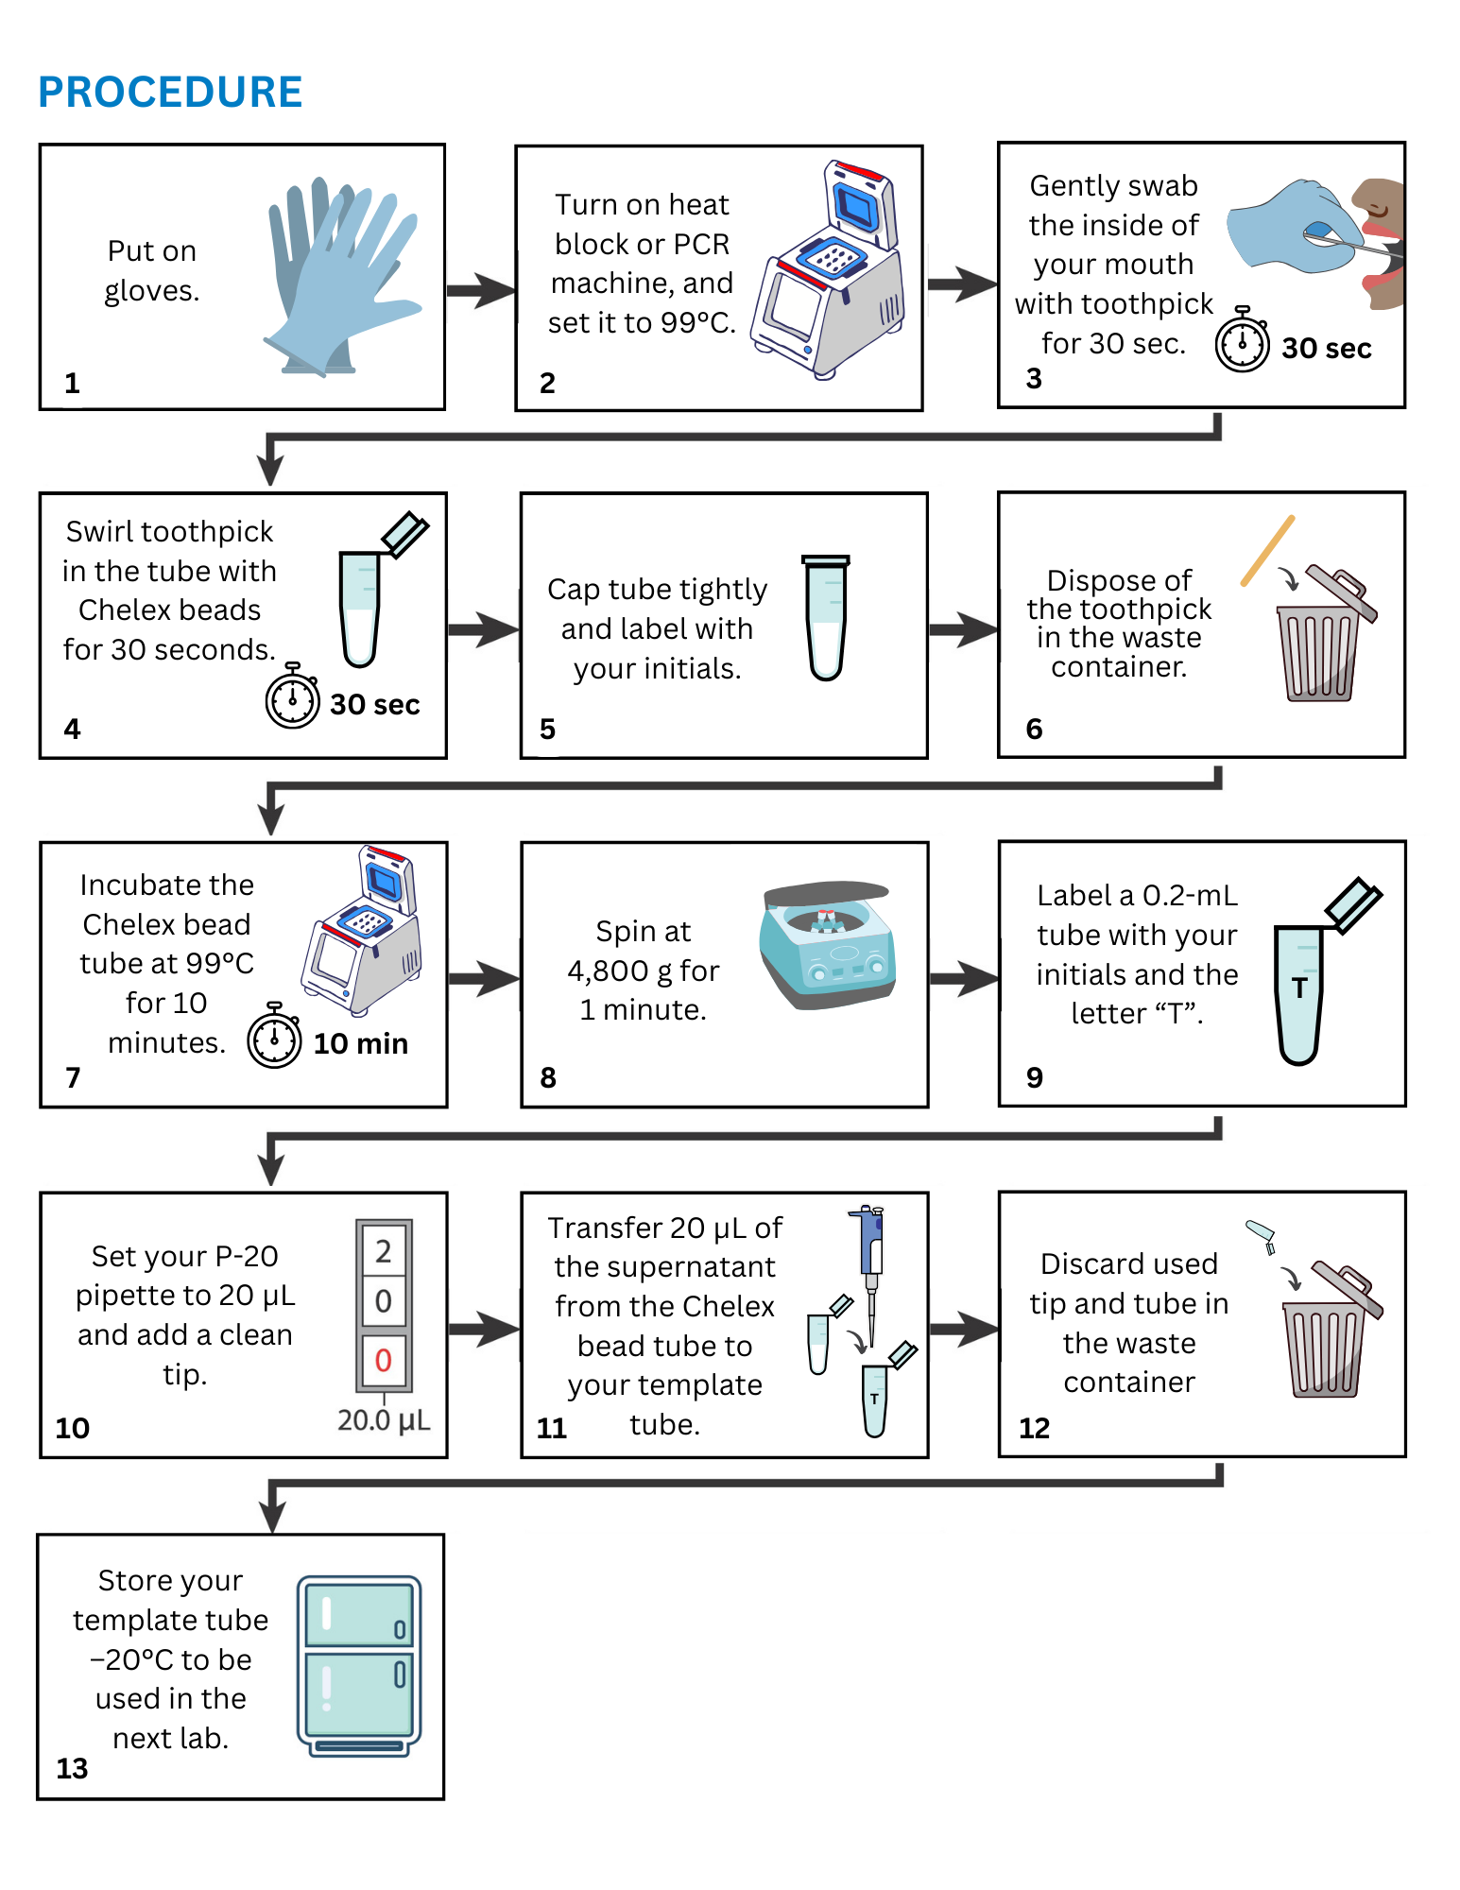
Collecting cheek cells: What you’ll need

Slide 9
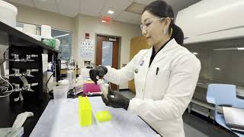
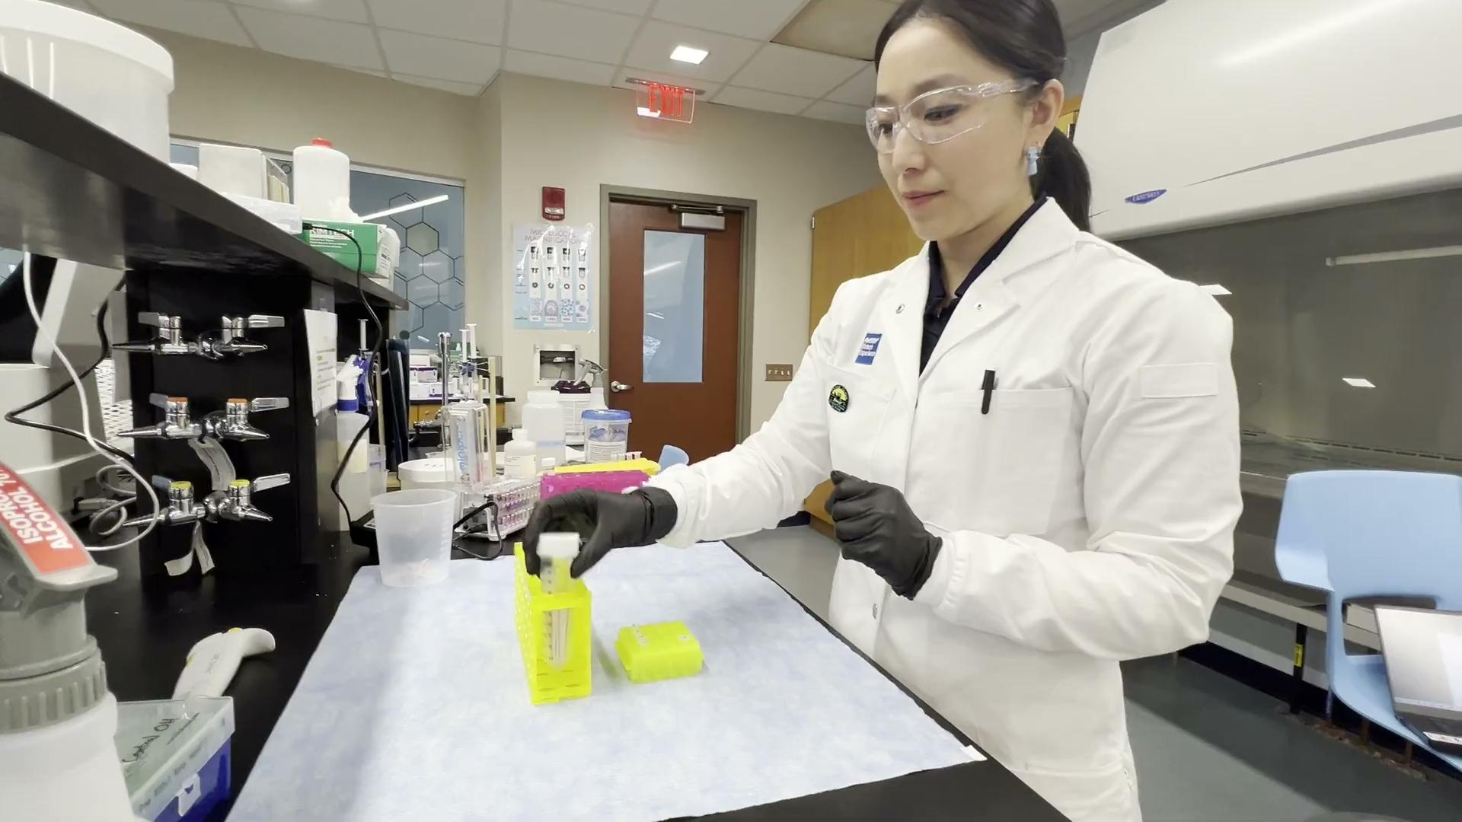
Video: Collecting your cheek cells
Notes:
Demonstrate the process of collecting a sample of cells from the inside of the cheek using this video and/or demonstrating the process yourself.
Updated video: https://drive.google.com/file/d/1MwwCD0RjyV_bCHau4ZunA7ibxy2YUbLe/view?usp=drive_link
Note for Libby: Kristina’s video is on her own YouTube channel here: https://urldefense.com/v3/__https://youtu.be/wNROIYJO_Jc__;!!Azzr!ZiwP6lhIOXHKsQl2RWrHc9Rr9jH-C4s2oEXTYBYDFJ5WcMYHrJf0Bq1akrC0szJS_Z2x5eq86CA_xN-cnUBb_g$
but could you please save it to the ABE YouTube channel so I can embed the video in these slides properly?

Slide 10
Collecting and Extracting DNA (Figure 3.2, Steps 1–6)

Slide 11
Collecting and Extracting DNA (Figure 3.2, Steps 7–13)

Slide 12
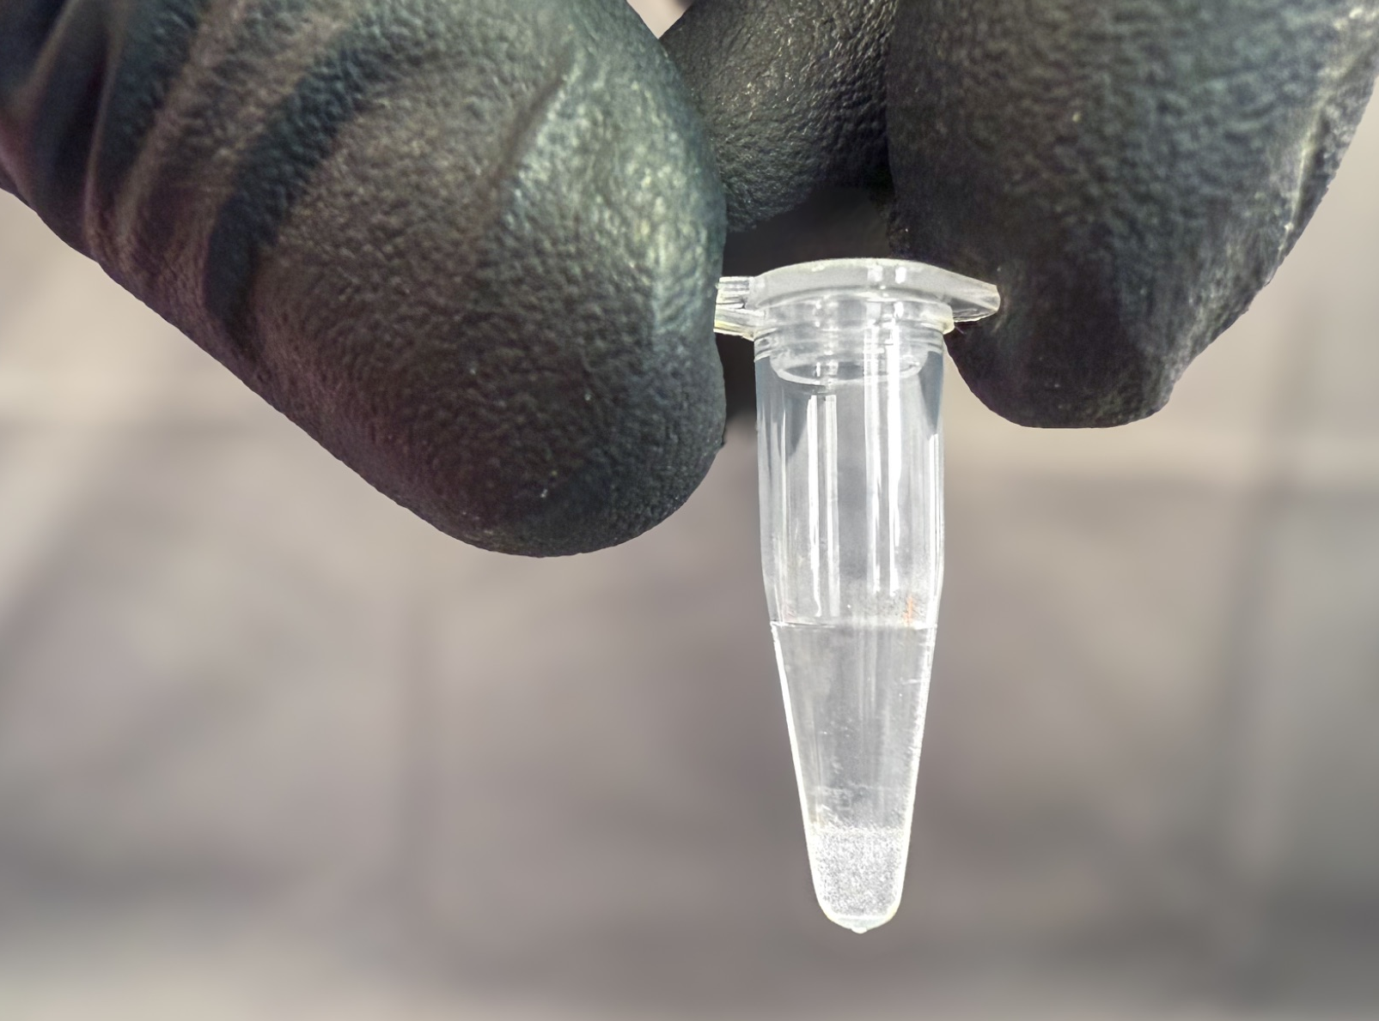
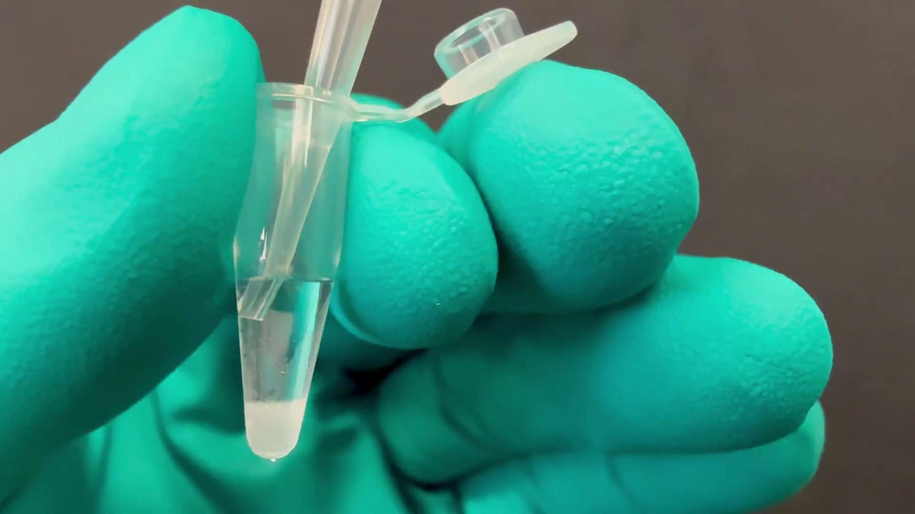
Make sure to pipette the supernatant without disturbing the Chelex beads at the bottom of the tube!
Supernatant, containing the DNA
Chelex
Notes:
Images by Drew Spacht

Slide 13
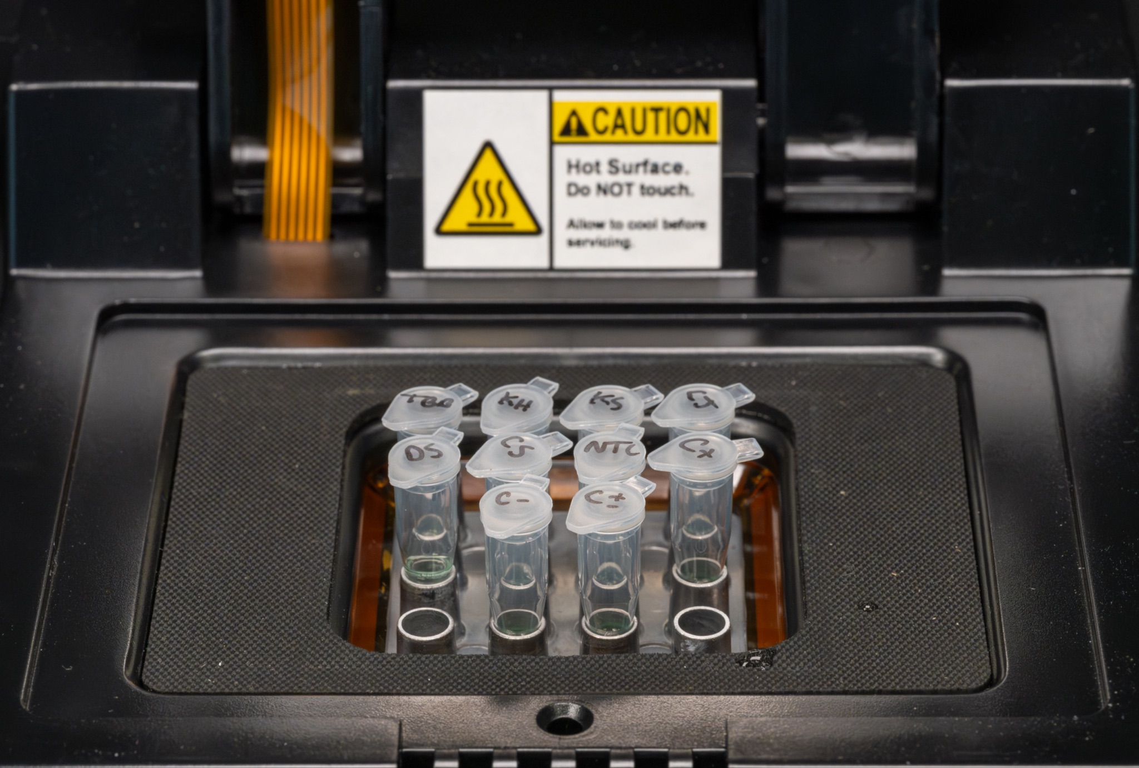
Program your thermocycler
“Copy That DNA” Program for thermocycler
Step | Number of cycles | Temperature | Time (s)
Initial Denaturation | 1 | 94°C | 300
Denaturation | 35 | 94°C | 30
Annealing |  | 64°C | 30
Extension |  | 72°C | 30
Final Extension | 1 | 72°C | 60
Notes:
Image credit for the miniPCR photo?

Slide 14
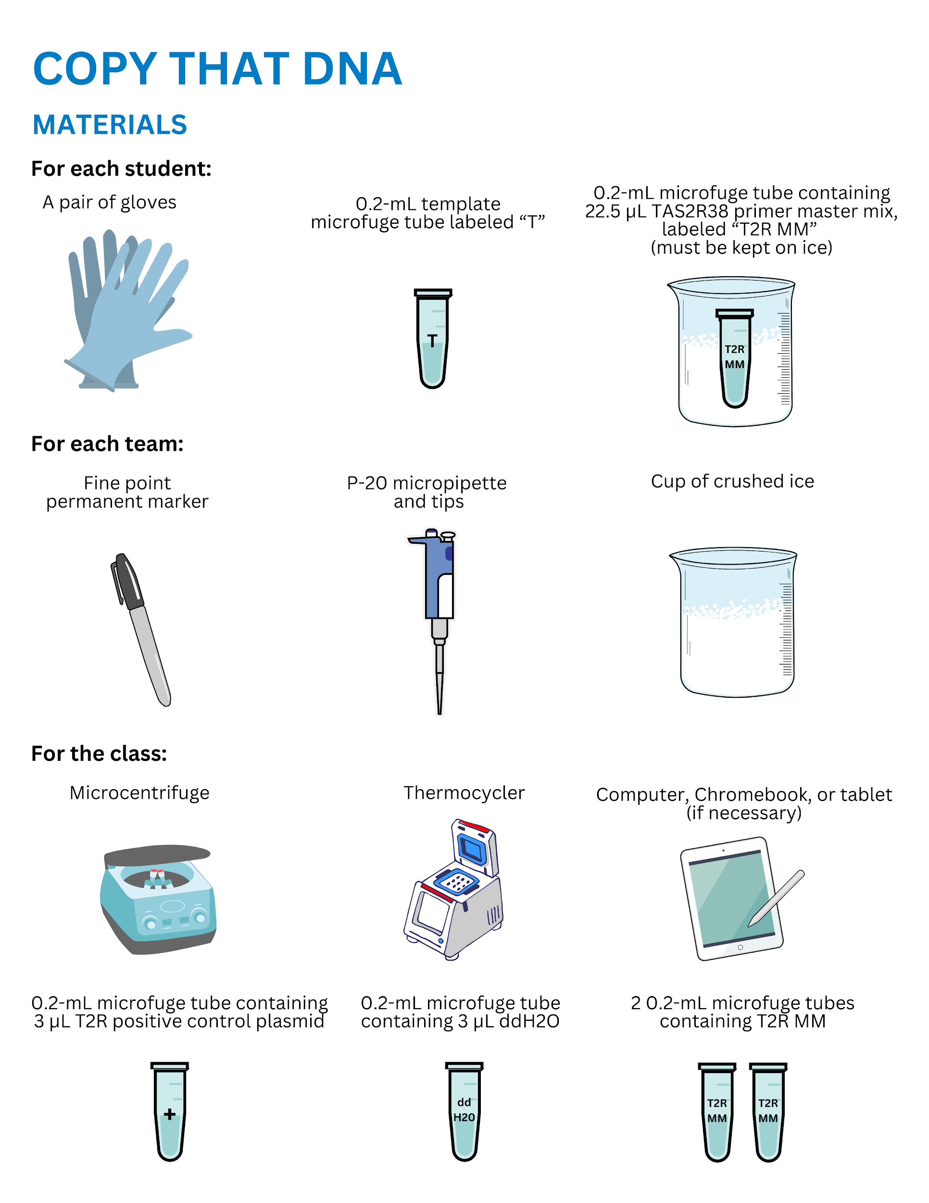
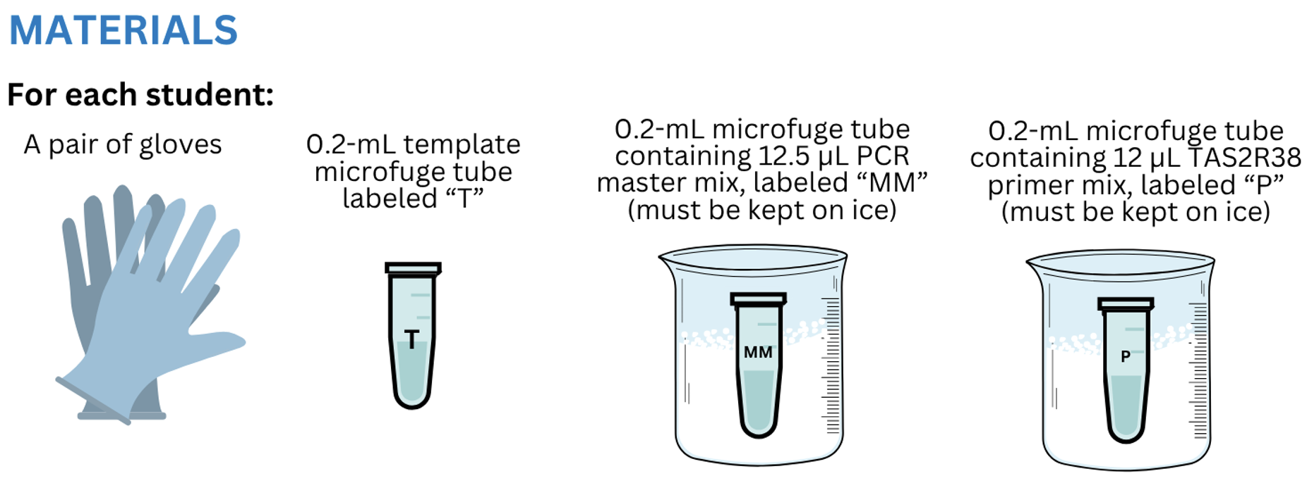
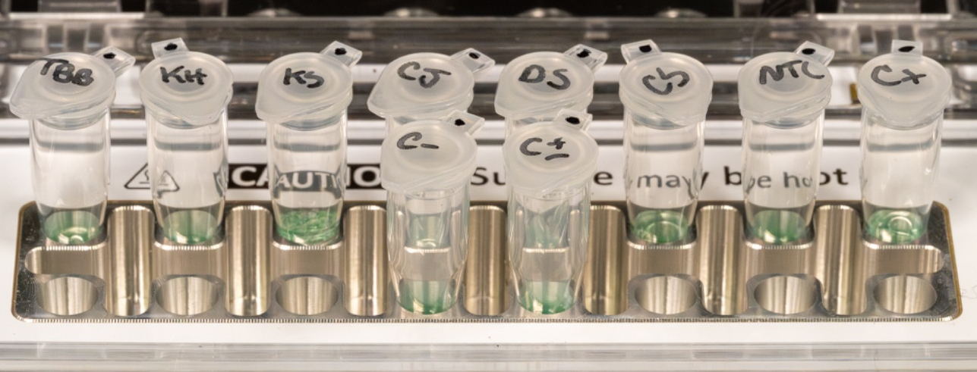
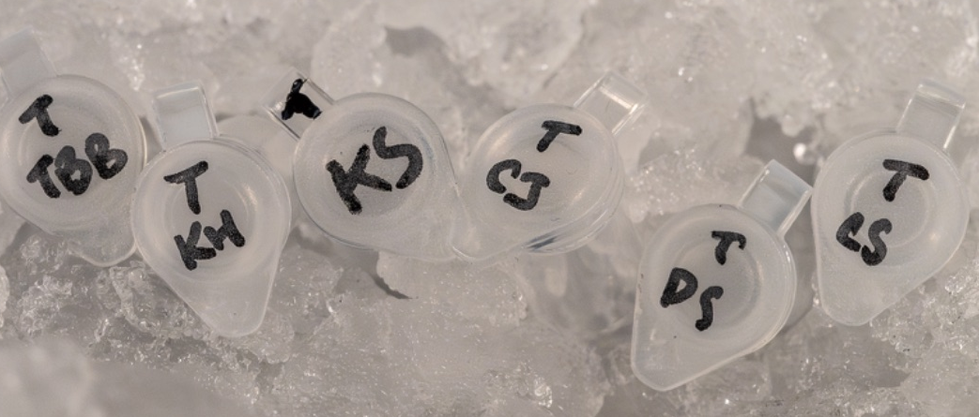
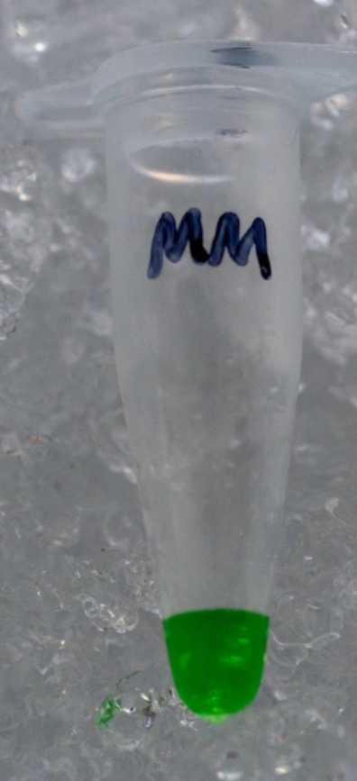
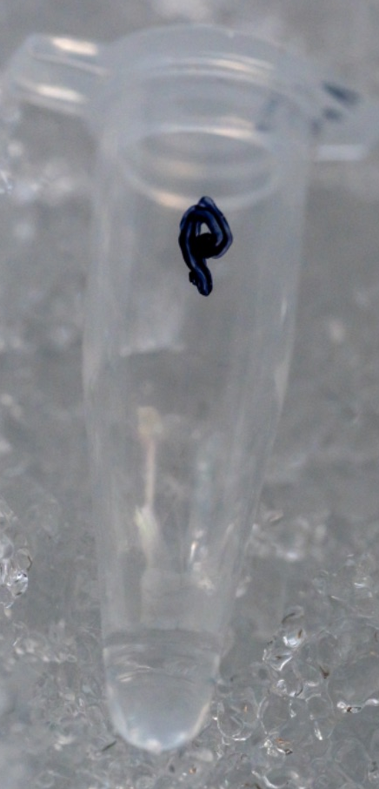
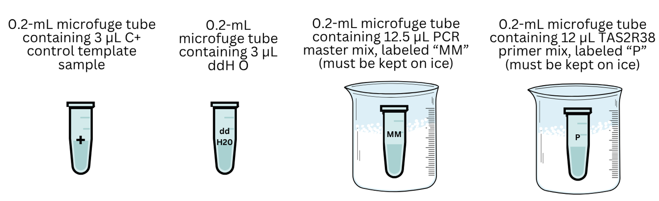
What you need to set up your PCR
In thermocycler,
ready for PCR
Your template DNA, labeled with your initials
PCR Master Mix
Primer mix

Slide 15
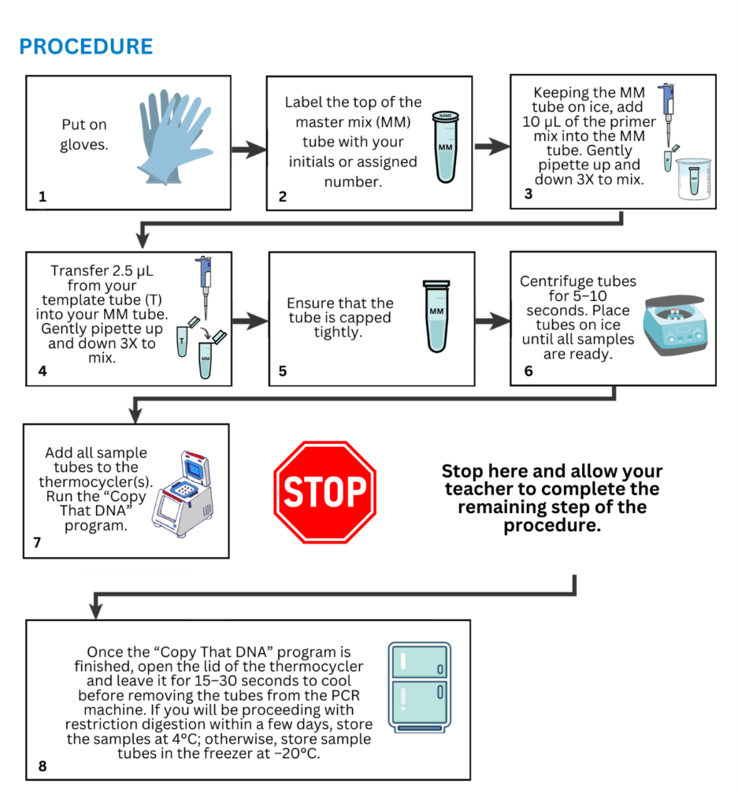
Procedure for PCR amplification

Slide 16
While the PCR is running . . .
What reagents are required for PCR?
  Template DNA
  Primers
  Nucleotides
  DNA Polymerase
  Buffer
What are the 3 main stages of PCR?
  Denaturation
  Annealing
  Extension
Why is PCR necessary?
  To make numerous copies of a DNA sequence of interest
Notes:
Slide answers:
What reagents are required for PCR?
Template DNA
Primers
Nucleotides
DNA polymerase
Buffer
What are the 3 main stages of PCR?
Denaturation
Annealing
Extension
Why is PCR necessary?
To make numerous copies of a DNA sequence of interest

Slide 17
While the PCR is running . . . , continued
How many cells did you scrape from your mouth?
  Thousands
How can PCR “find” the right DNA sequence in a sample of genomic DNA?
  Primers hybridize only to that exact DNA sequence.
Can you use cells from just any human tissue to extract your template genomic DNA for PCR?
  The cells must have a nucleus (diploid).
Notes:
Slide answers:
How many cells did you scrape from your mouth?
The number of cheek cells was likely in the hundreds or thousands.
Each cheek cell carries a complete set of a person’s chromosomes (their genomic DNA) and therefore the sample contains two complete genomes for each cell collected. (It’s two because one copy of the genome is inherited from each parent!)
How can PCR "find" the right DNA sequence in a sample of genomic DNA?
The primers you select are tailored to a specific stretch of DNA sequence and will bind only to an exact match
Can you use cells from just any human tissue to extract your template genomic DNA for PCR?
Almost every cell contains the complete genome in its nucleus, except in vertebrates, where mature red blood cells lack a nucleus, and gametes, which possess only half of the genome due to meiosis.

Slide 18
While the PCR is running . . . , continued
Why did we use PCR controls C+ and C-?
  C+ contains template DNA. It shows that the PCR worked.
  C- is only water. Nothing should show up except “primer dimers.” It demonstrates that the Master Mix is not contaminated with DNA.

Slide 19
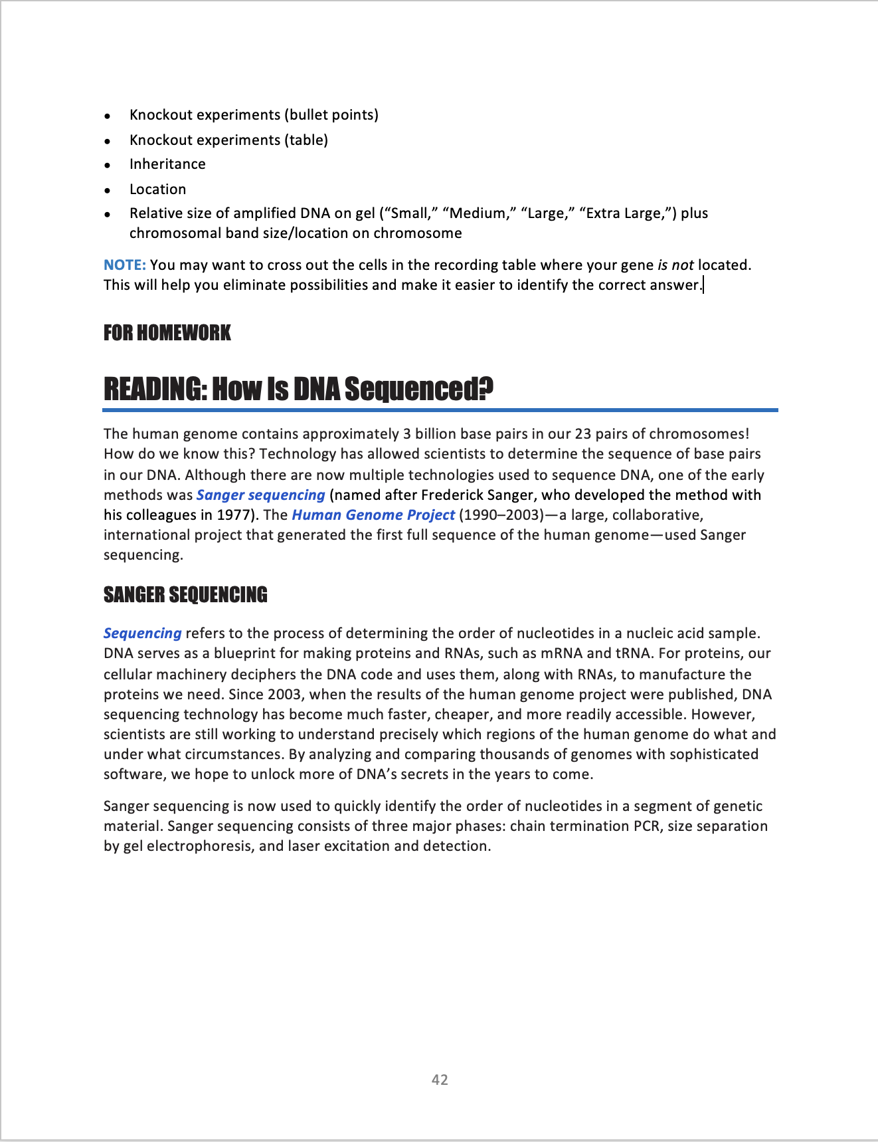
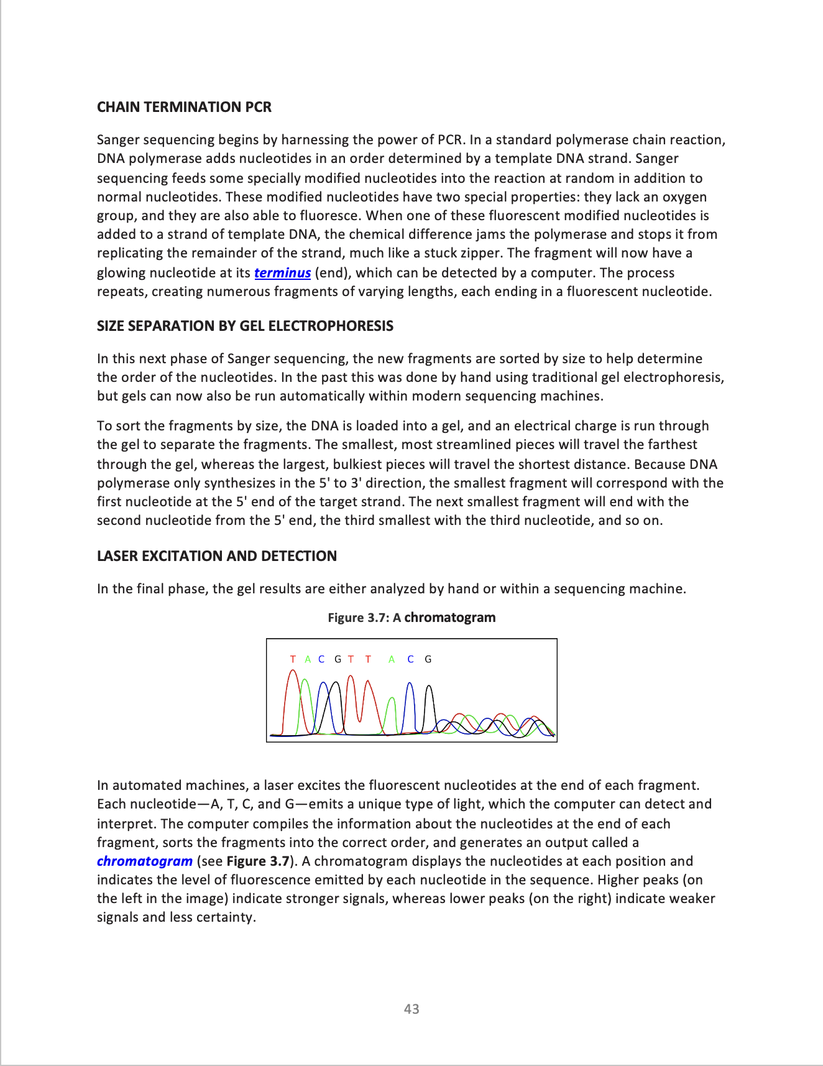
Read “How Is DNA Sequenced?” in your Student Guide

