Slide 1
Exploring Precision Medicine
Chapter 1: What’s the Right Medicine?
Chapter 2: Is My Sense of Taste Controlled by my Genes?
Chapter 3: Exploring Our DNA
Chapter 4: How Is DNA Sequenced, and What Can We Learn?
Chapter 5: Restriction Enzyme Digestion of TAS2R38 PCR Products
Chapter 6: Gel Electrophoresis and Genotyping
Chapter 7: SNPs and Drug Metabolism

Slide 2
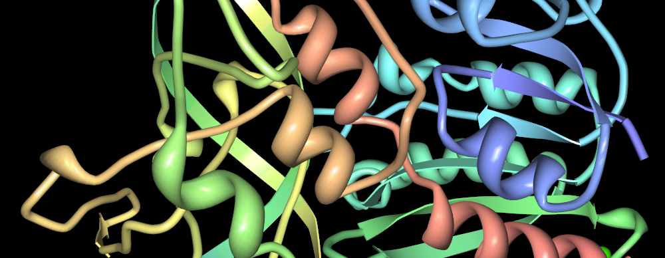
Chapter 5: Restriction enzyme digestion of TAS2R38 PCR products
Notes:
Jslipscomb, CC BY-SA 3.0, https://commons.wikimedia.org/w/index.php?curid=14417964

Slide 3
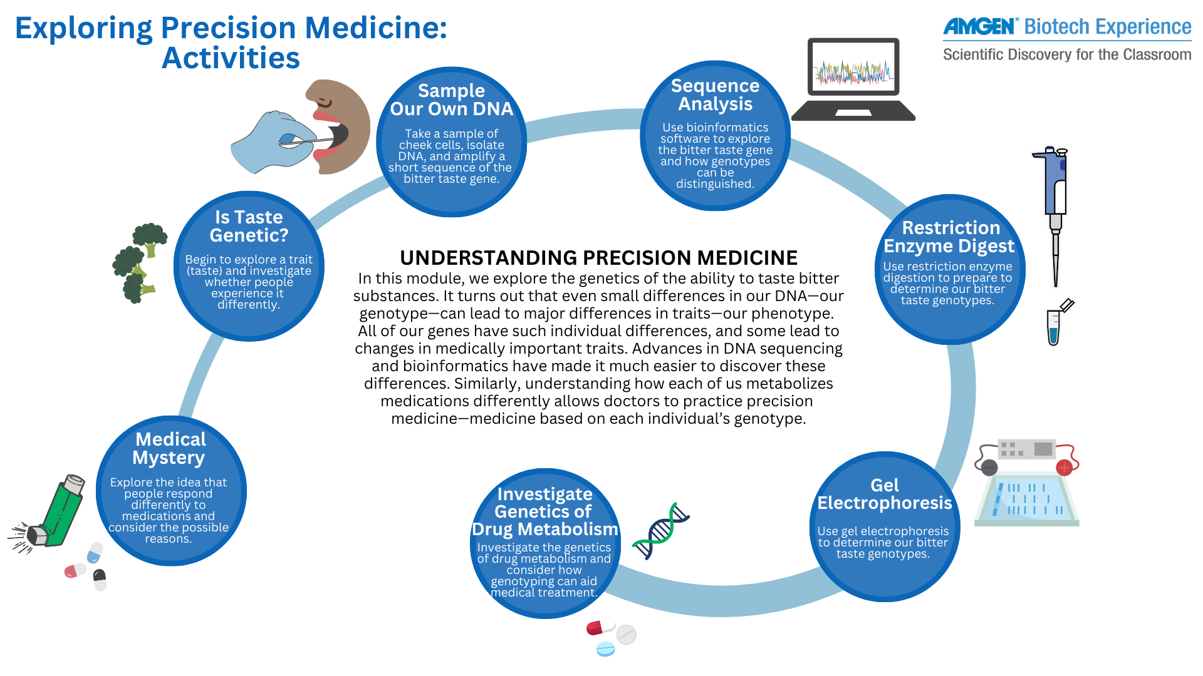

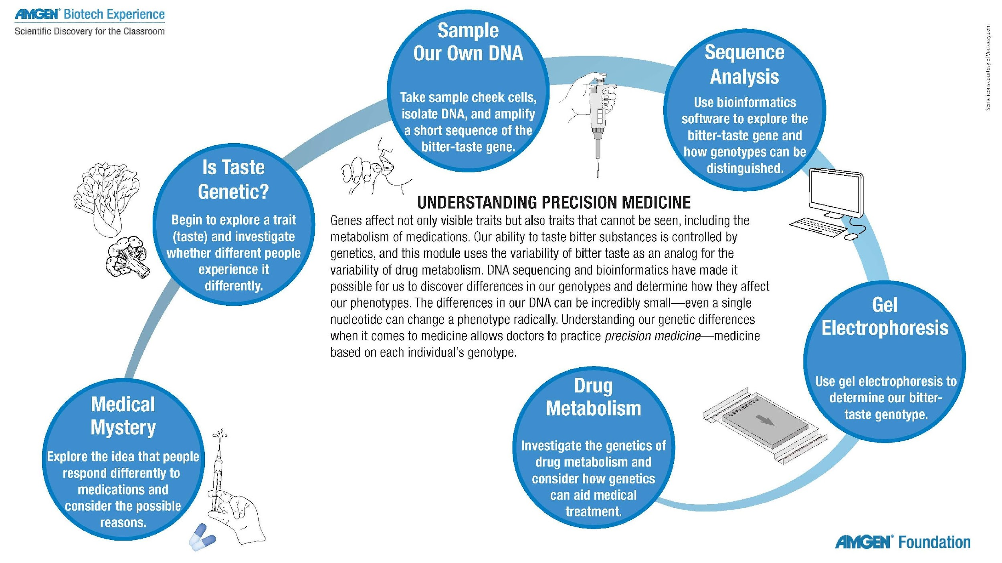
Notes:
Explain where this lab falls in the storyline. This lab is in Chapter 3 of Exploring Precision Medicine, and students will already have been introduced to a medical mystery in which a patient does not respond as expected to a medication and will have considered variations in bitter-tasting ability by exploring their own response to bitter tastes. In this chapter, students will be examining their own DNA to determine whether their taster genotype matches their phenotype. Before doing that, however, they need to extract the DNA, isolate the TAS2R38 gene, and amplify it so that it may be analyzed.

Slide 4
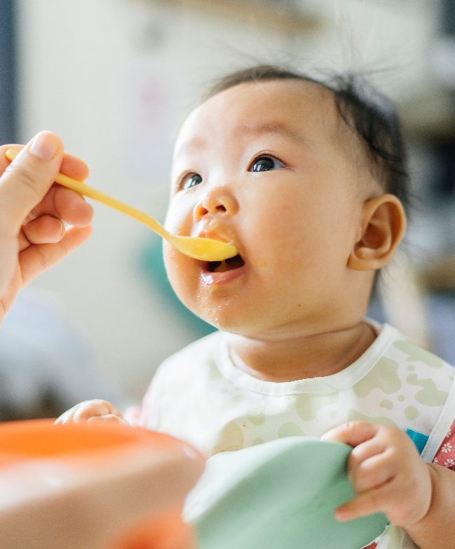
We have amplified part of our TAS2R38 DNA
We know our phenotypes now
How can we distinguish between taster and nontaster alleles?
Use restriction digestion and gel electrophoresis!

Slide 5
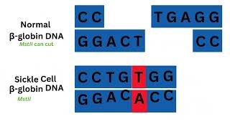
Video: Restriction enzymes in DNA testing
Notes:
Link to video online: https://youtu.be/sR4cSHsVlGw

Slide 6
Discussion: genotyping sickle cell anemia
How did scientists isolate the patient’s ꞵ-hemoglobin DNA?
PCR of genomic DNA, with primers specific to the human hemoglobin ꞵ gene
Which restriction enzyme cuts normal ꞵ-globin DNA, but not the sickle cell allele?
MstII
What was the patient’s genotype, and how could you tell?
They are a carrier (heterozygous) because their restriction digest produced 3 bands

Slide 7
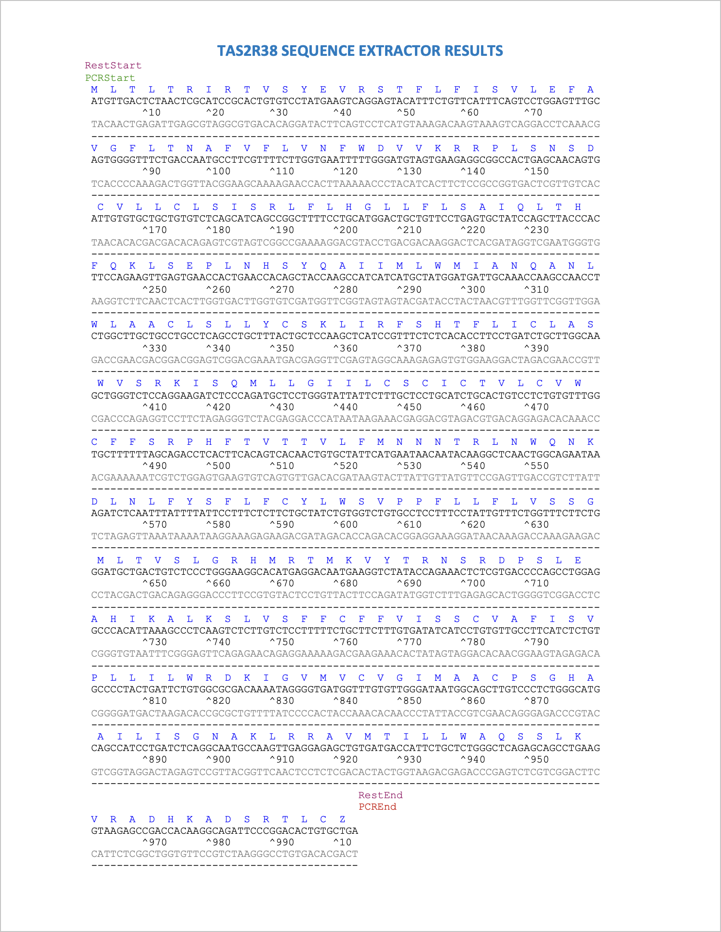
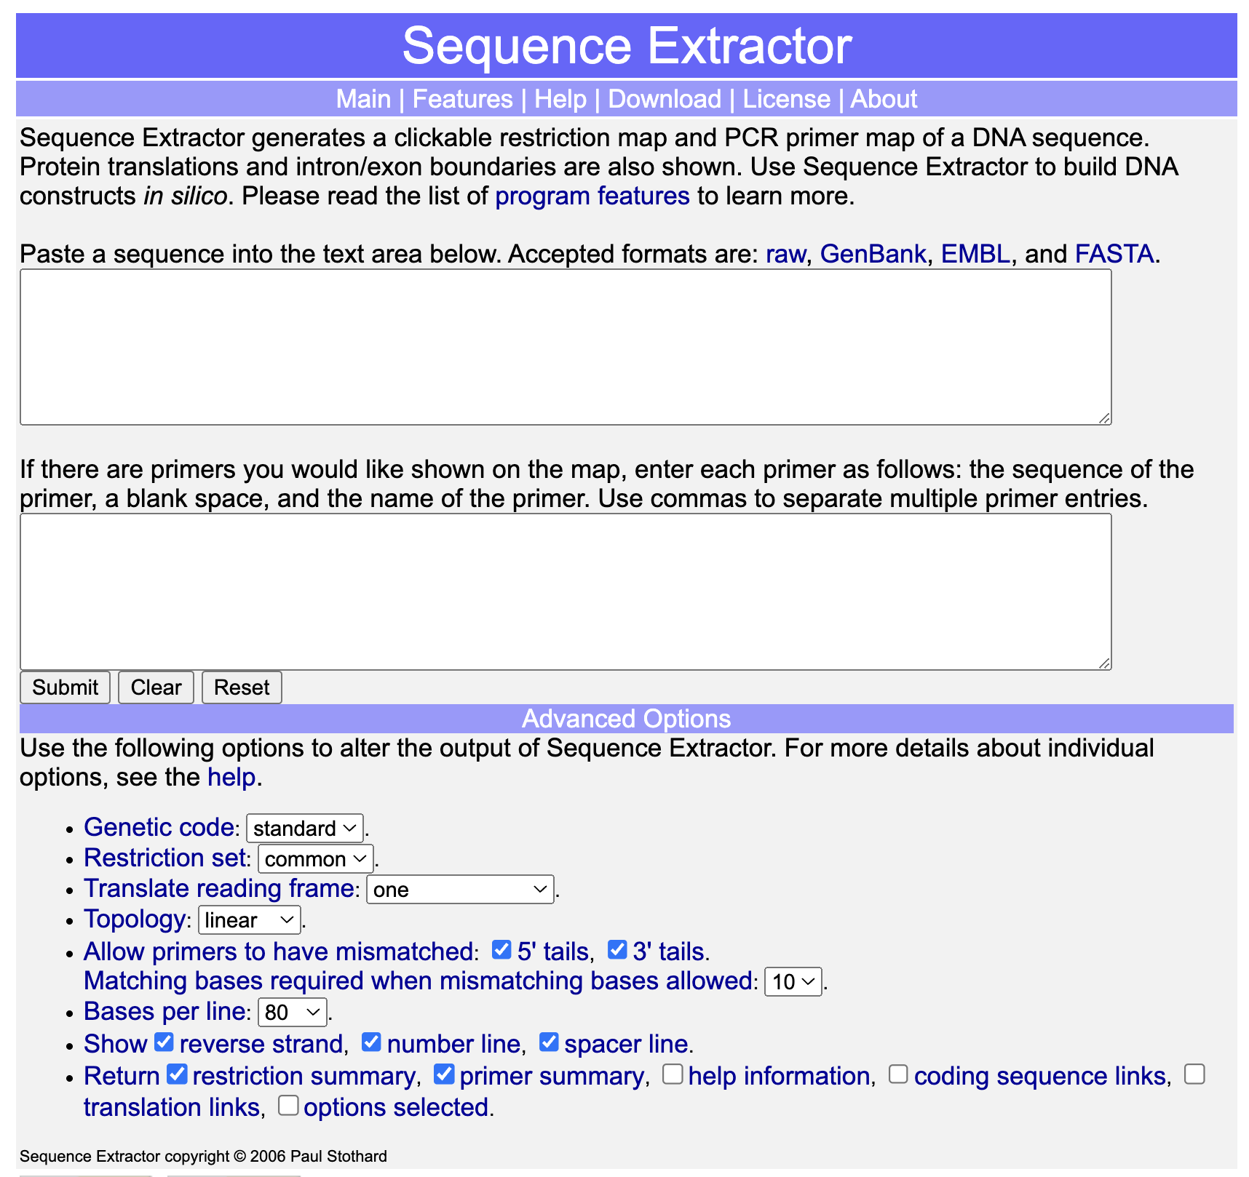
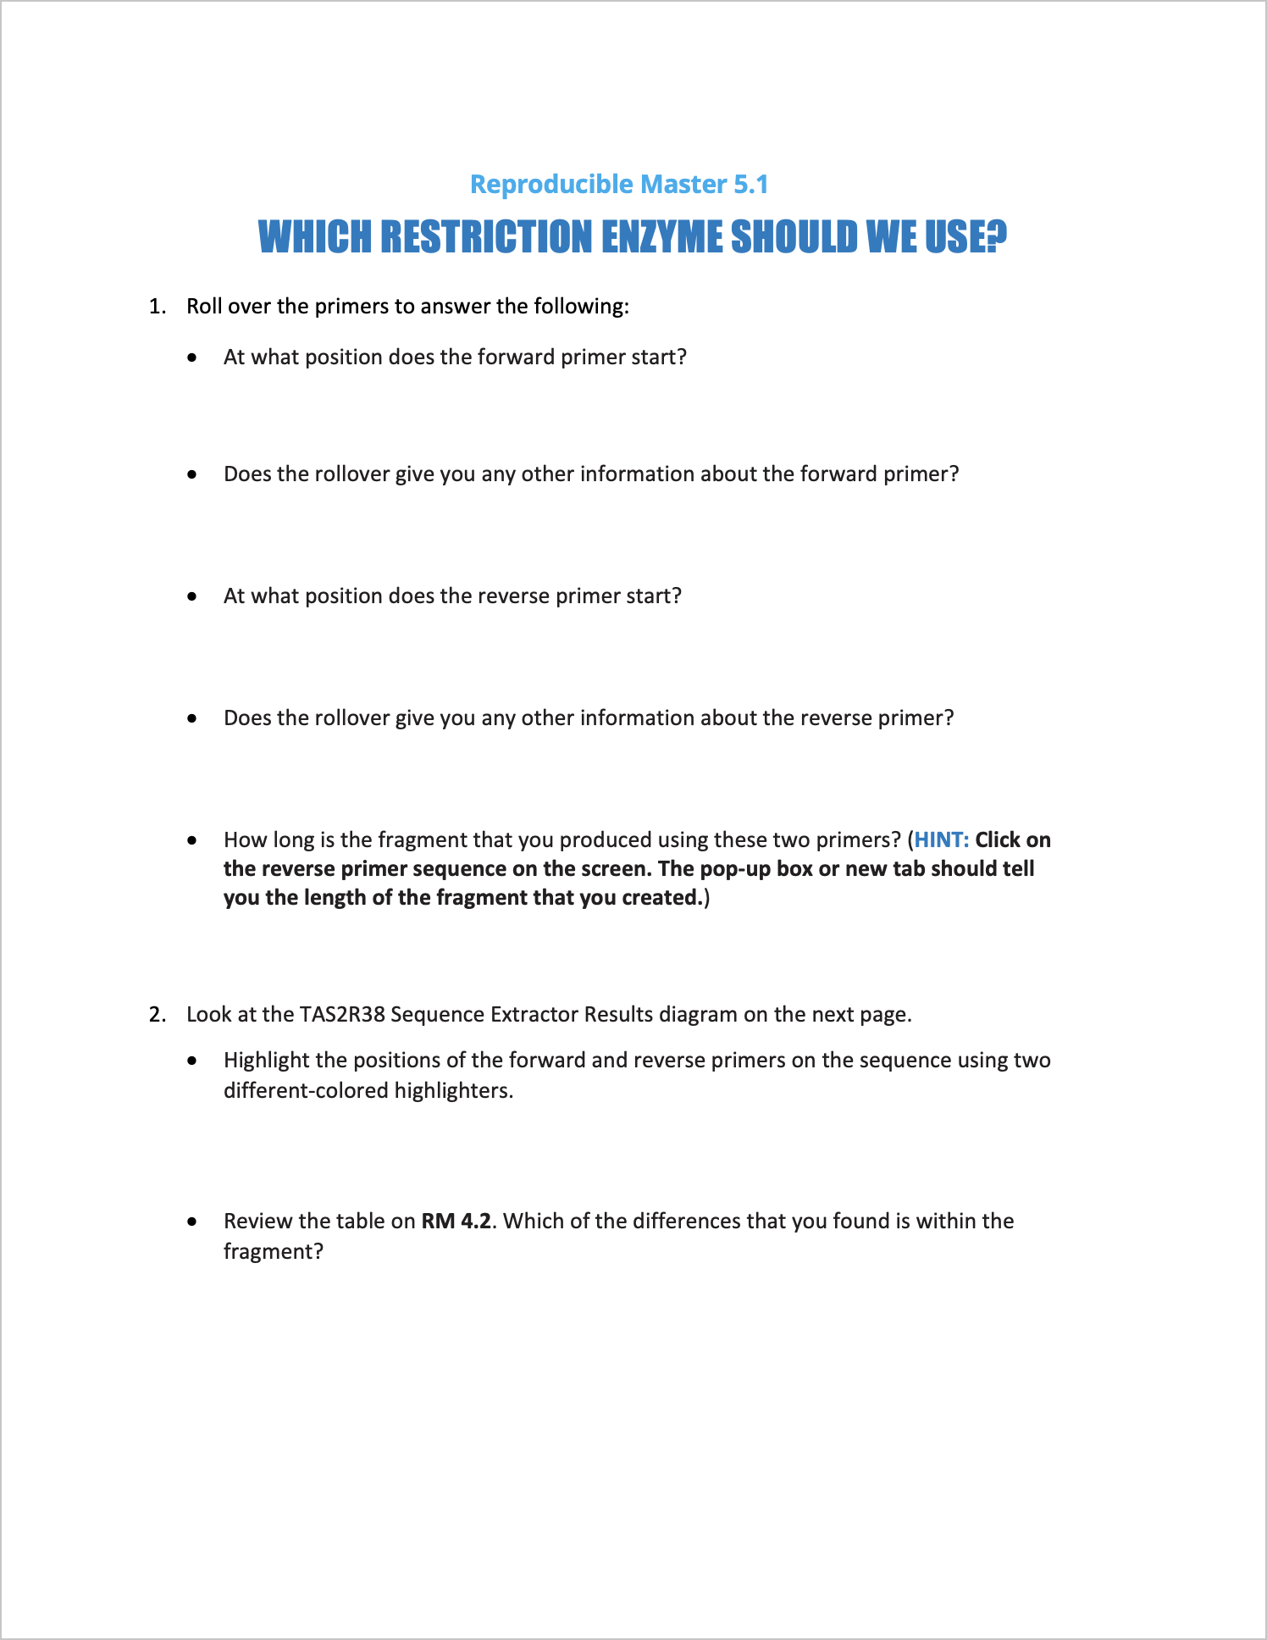
Activity: Which restriction enzyme should we use?
Use Sequence Extractor to determine which restriction enzyme to use
Complete RM 5.1

Slide 8
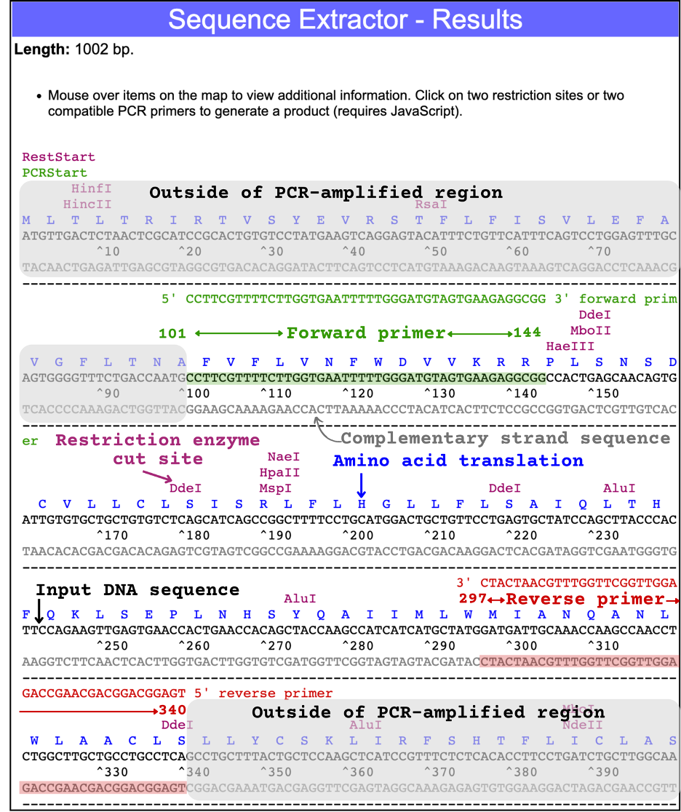
Discuss: RM 5.1
Notes:
From the Teacher Guide:
What do you think the blue letters above the sequences represent?
Amino acids
What color is the reverse primer?
Red
What color is the forward primer?
Green
Worksheet answers (please note that lengthy questions have been paraphrased):
At what position does the forward primer start?
101
Does the rollover give you any other information about the forward primer?
Yes. It tells the direction (>>>) and that there is a mismatching 3’ tail.
At what position does the reverse primer start?
341
Does the rollover give you any other information about the reverse primer?
Yes. It is in the <<< direction

Slide 9
Discuss: RM 5.1 (continued)
How long is the fragment you amplified?
240 bp
At what position should you cut to differentiate between tasters and nontasters?
The SNP at position 145
Which restriction enzyme did you choose to do the job?
HaeIII

Slide 10
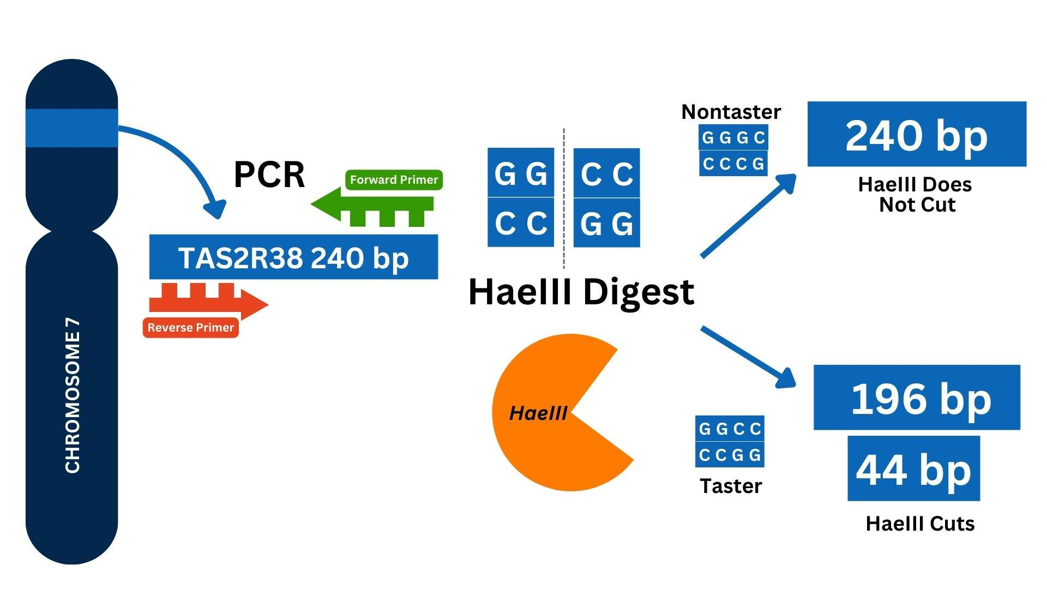
Discuss: RM 5.1 (continued)
All 3 lengths: 240 bp, 196 bp, and 44 bp
Whose DNA is cut by HaeIII? Bitter taster or nontaster?
Bitter taster
What length would the cut fragments of the 240-bp DNA be?
196 bp and 44 bp
How could a person end up with both alleles?
They would inherit one from their biological father and one from their biological mother
What length fragments would you expect after HaeIII digestion of a PCR from a heterozygote?

Slide 11
Discuss: RM 5.1 (continued)
What are the possible phenotypes for PTC tasting?
Phenotype | Genotype | Copy 1: Cut or uncut? | Copy 2: Cut or uncut? | DNA fragment length
44 bp
196 bp
240 bp
TT
cut
cut
X
X
weak taster
Tt
cut
uncut
X
X
X
nontaster
X
tt
uncut
uncut

Slide 12
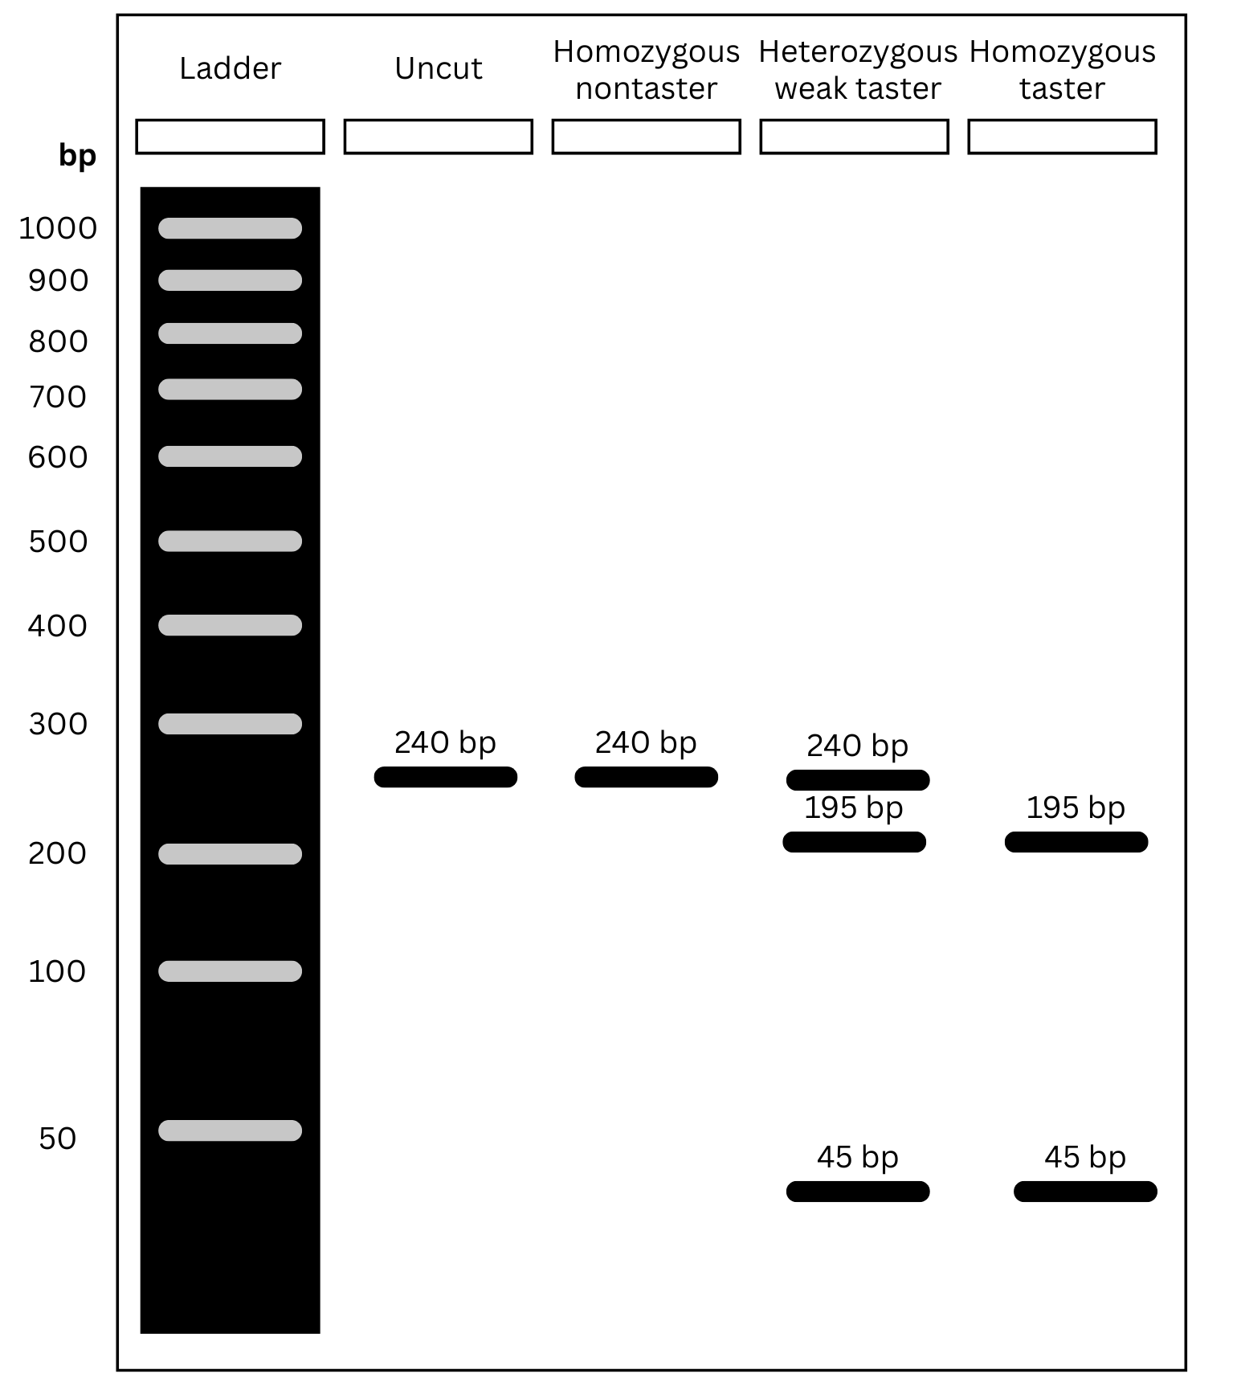
Predict the outcomes

Slide 13
Why would a heterozygous “weak” taster have 3 bands on a gel?
One allele is from a nontaster and is not cut by the restriction digest
The other allele from a taster is cut into two pieces by the restriction digest
Outcome: 3 fragments of DNA

Slide 14
How is our analysis of TAS2R38 similar to the ꞵ globin example?
DNA sequences of alleles differ
Researchers look for restriction enzymes which cut one allele but not the other
Different cuts = different size fragments on a gel
Can be used for genotyping

Slide 15
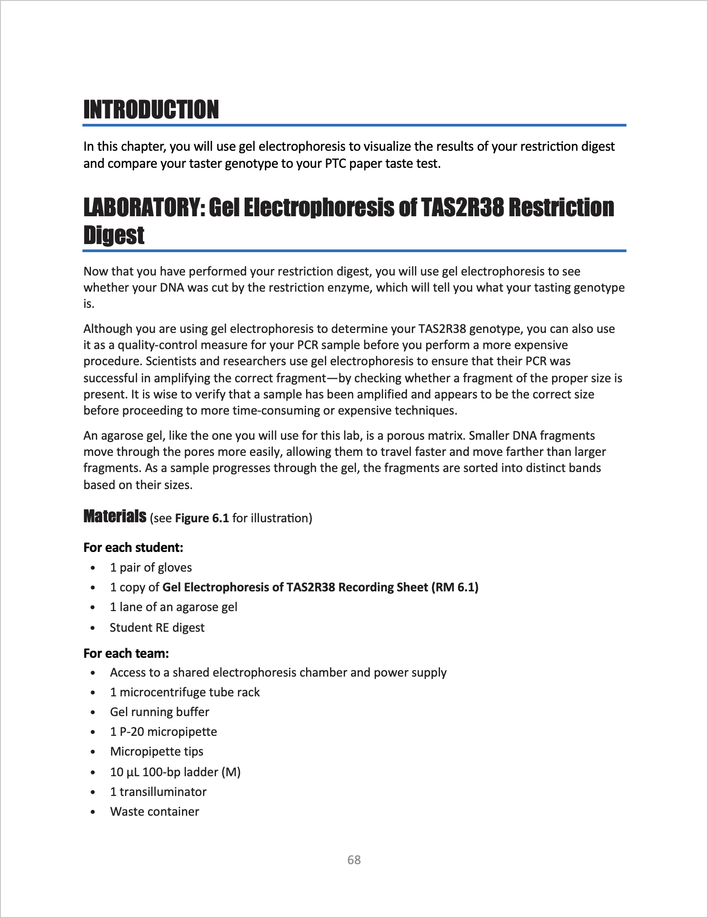
Read the lab intro “Restriction Digest and Gel Electrophoresis of TAS2R38”

Slide 16
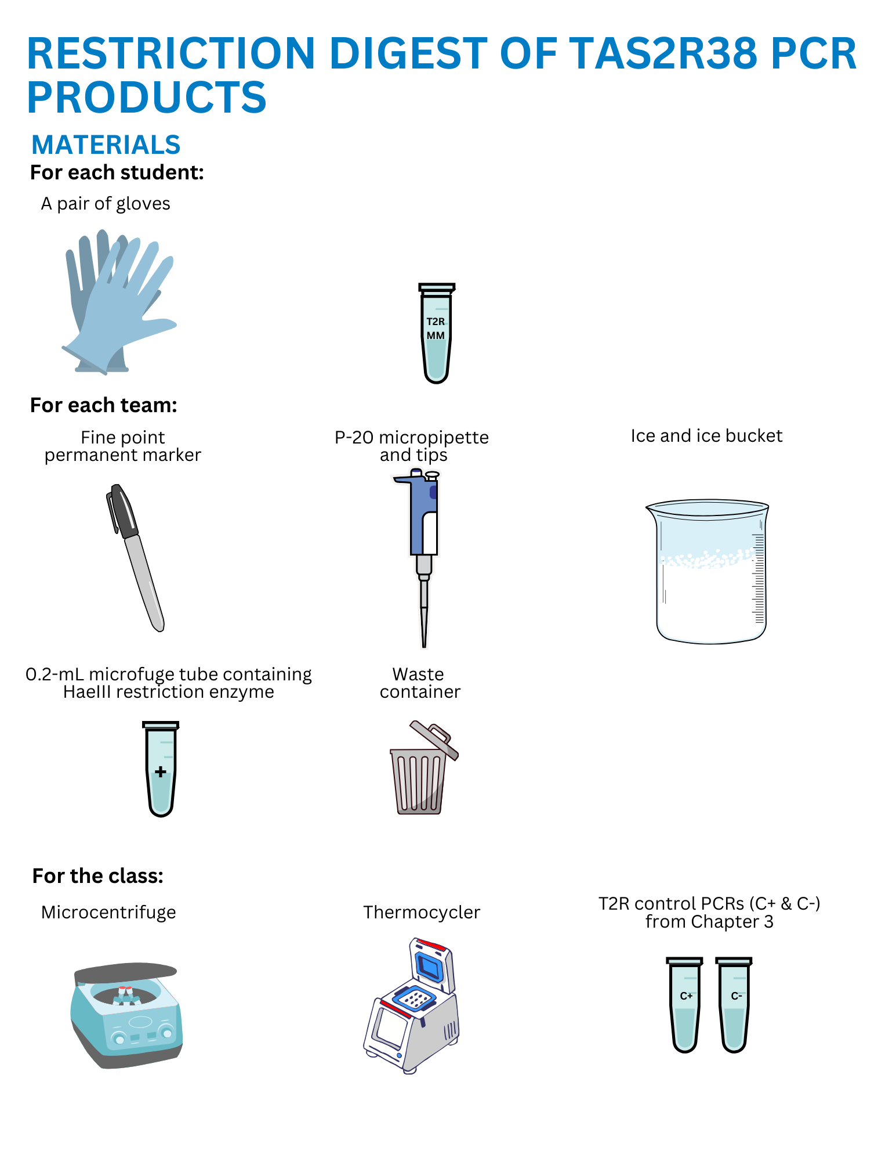
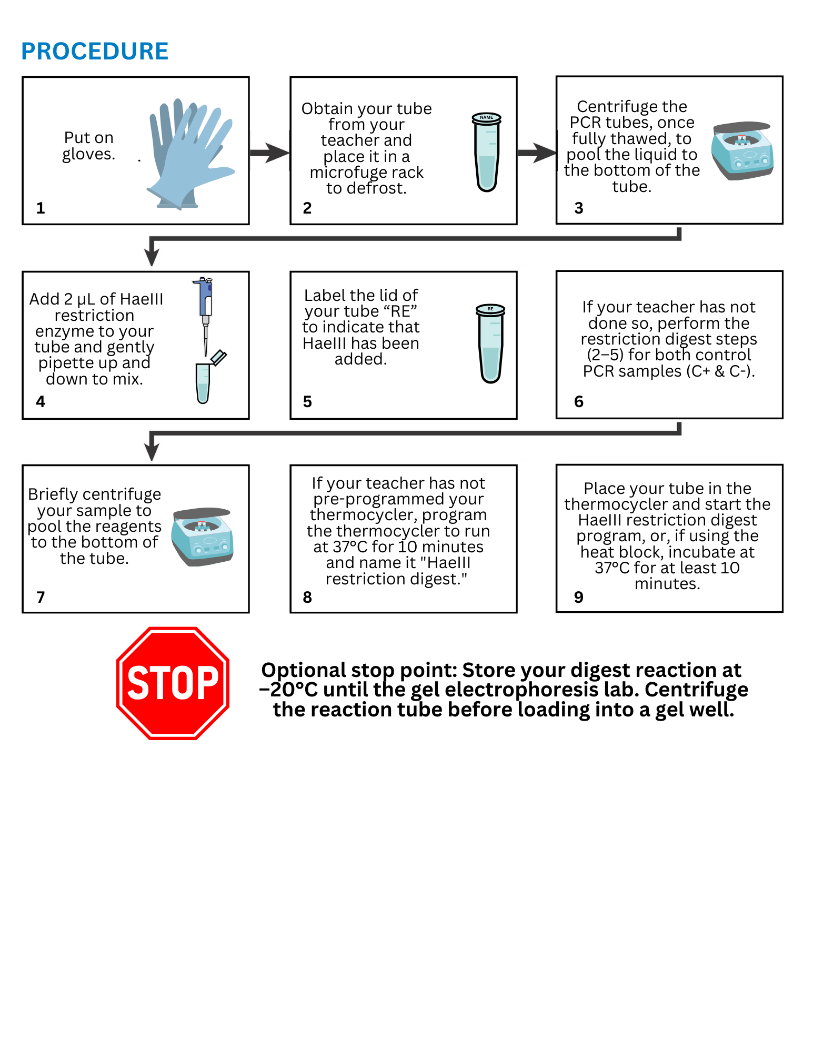
Set up your restriction digest

