Slide 1
Exploring Precision Medicine
Chapter 1: What’s the Right Medicine?
Chapter 2: Is My Sense of Taste Controlled by my Genes?
Chapter 3: Exploring Our DNA
Chapter 4: How Is DNA Sequenced, and What Can We Learn?
Chapter 5: Restriction Enzyme Digestion of TAS2R38 PCR Products
Chapter 6: Gel Electrophoresis and Genotyping
Chapter 7: SNPs and Drug Metabolism

Slide 2
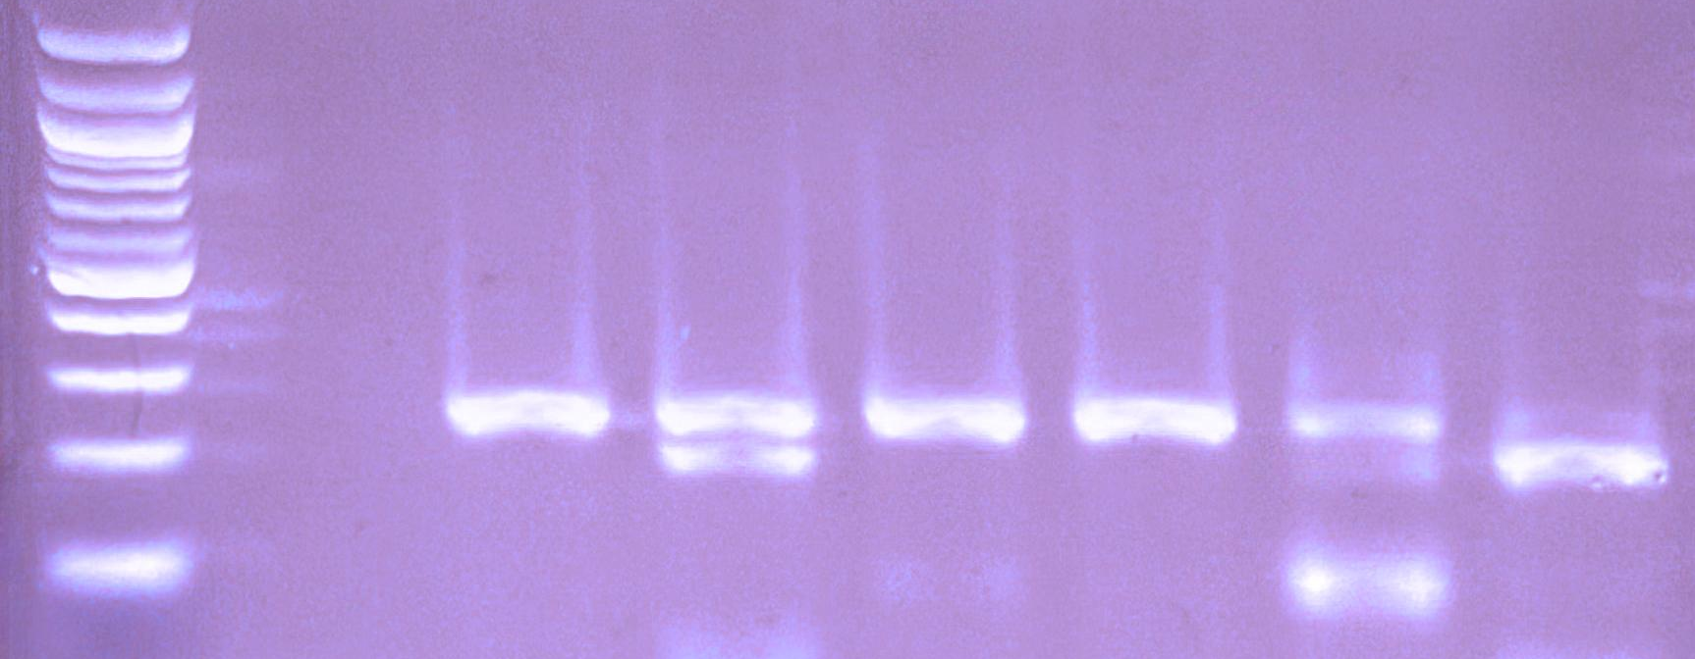
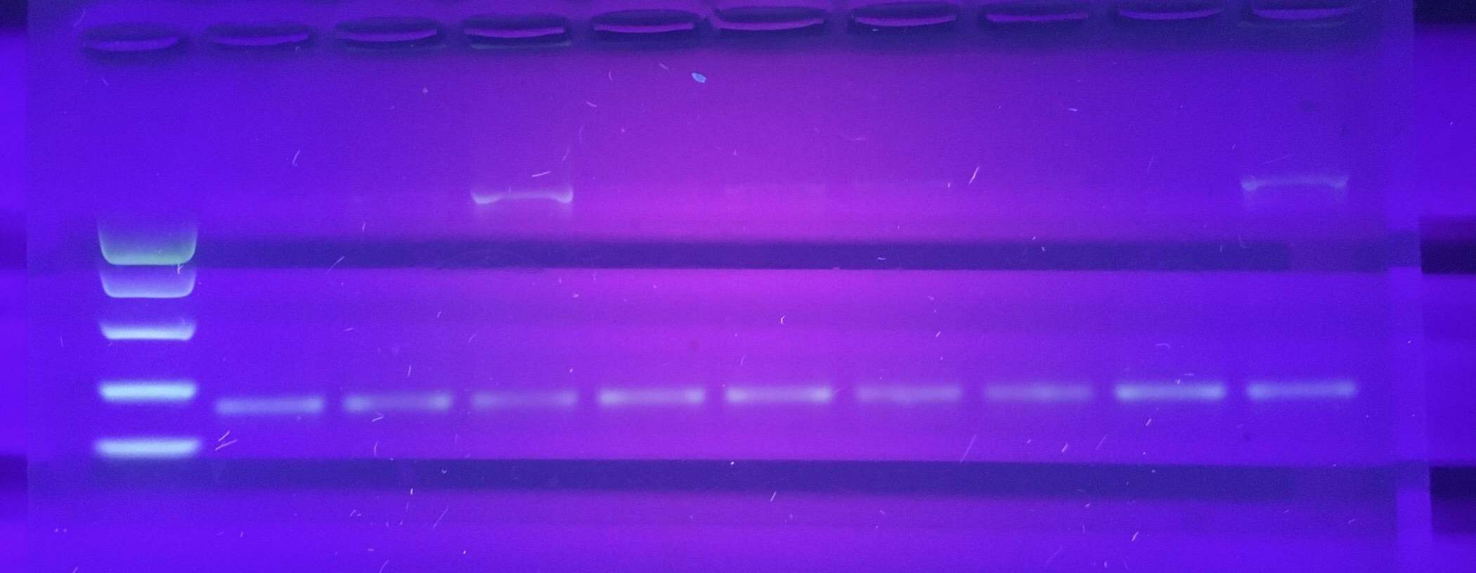
Chapter 6: Gel Electrophoresis and Genotyping
Chapter 5:
Genes and Gel
Electrophoresis
Use gel electrophoresis to conﬁrm taster genotype
Use restriction enzymes to distinguish genotypes
Compare genotypes to phenotypes determined by tasting PTC paper

Slide 3

Video: What Is Gel Electrophoresis?

Slide 4
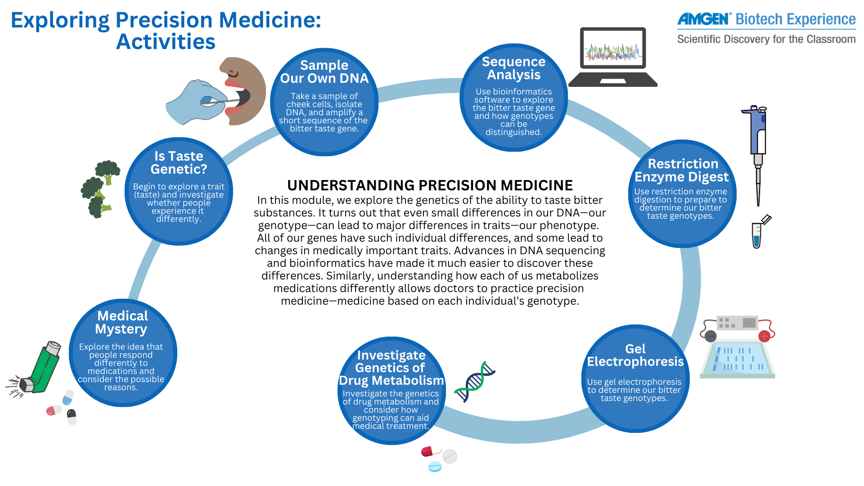


Slide 5
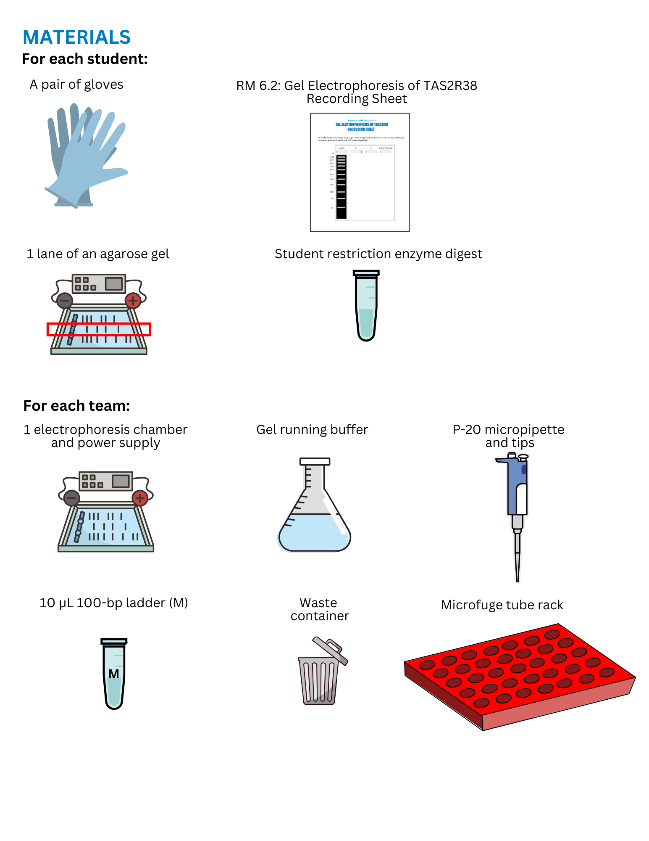
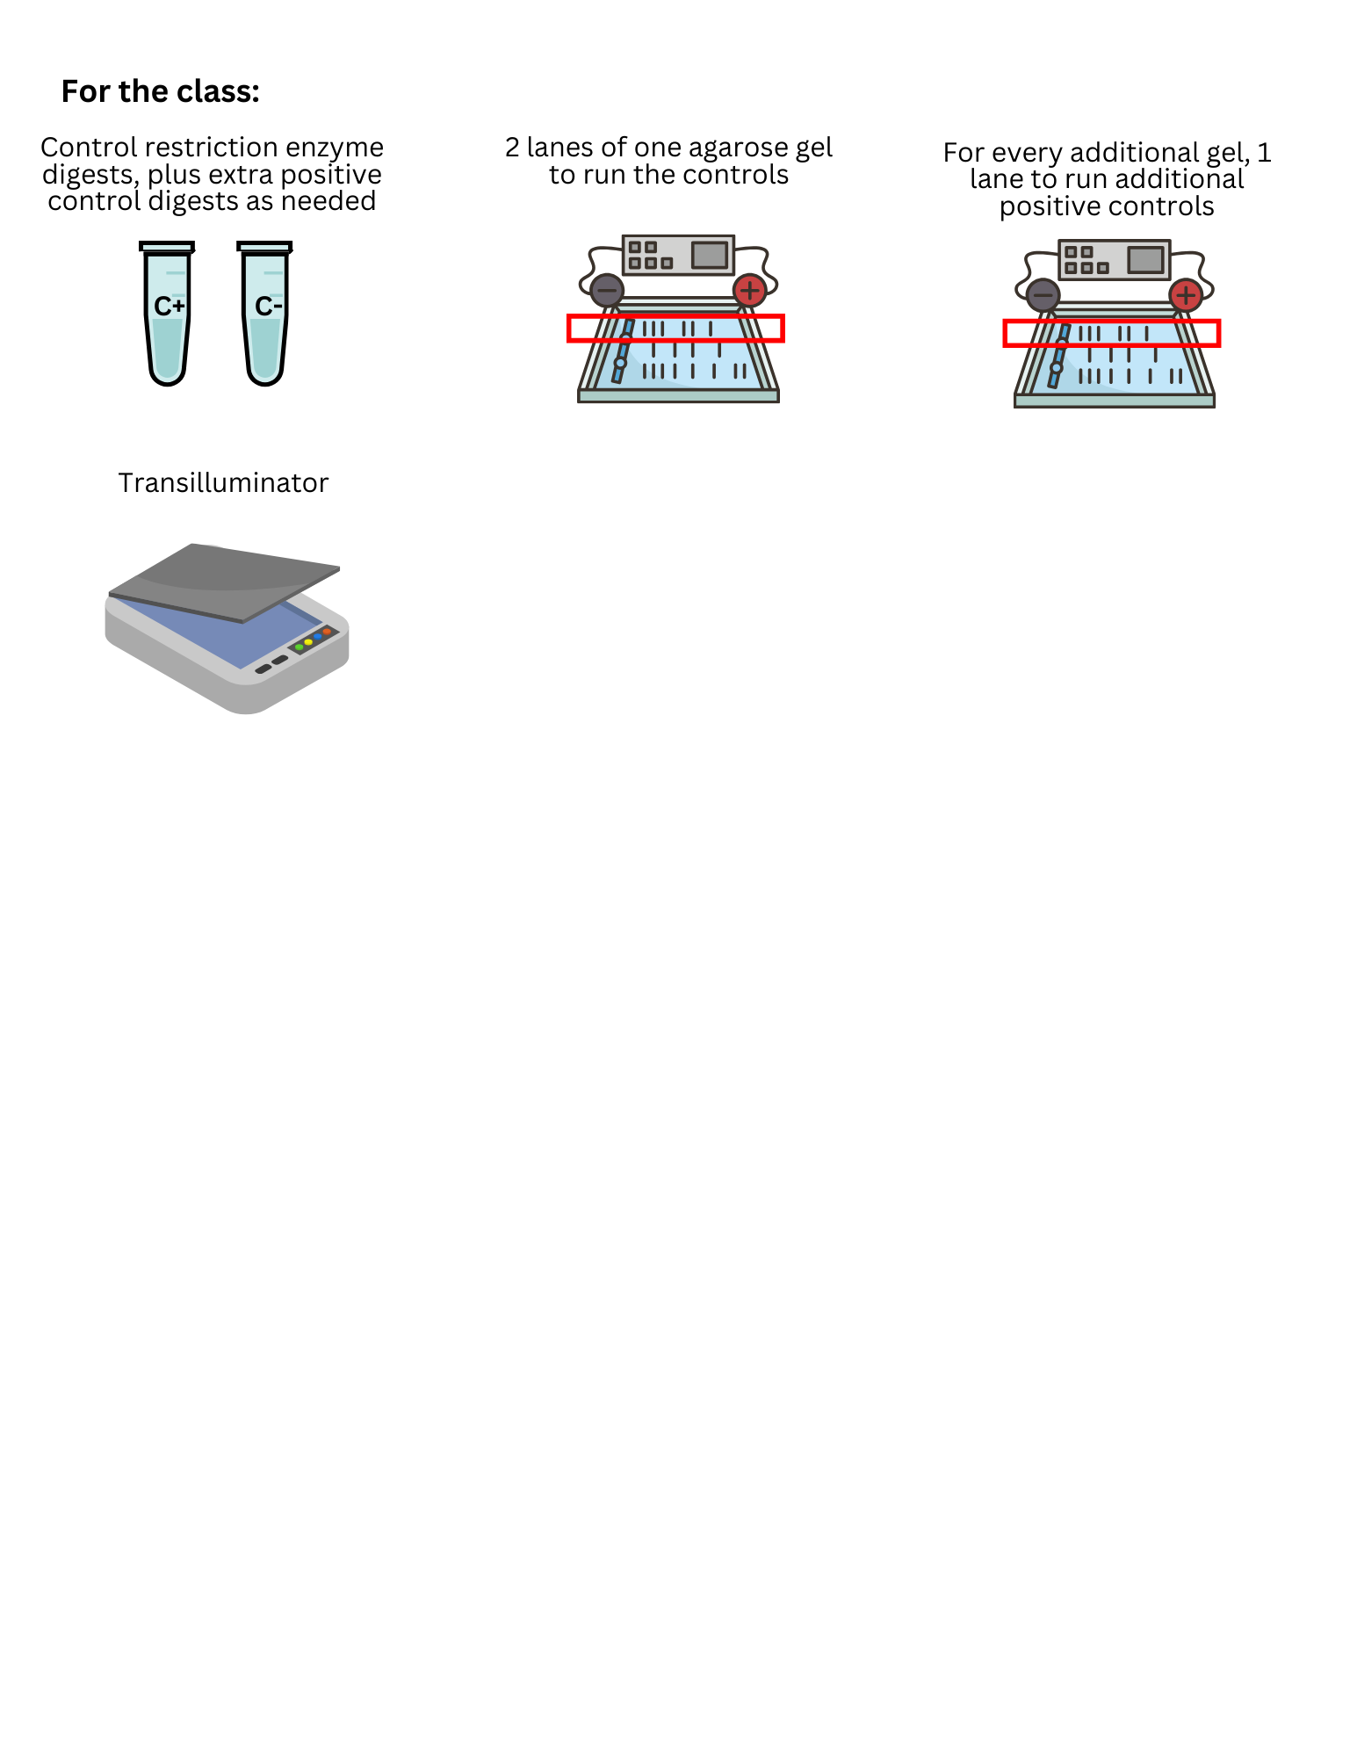
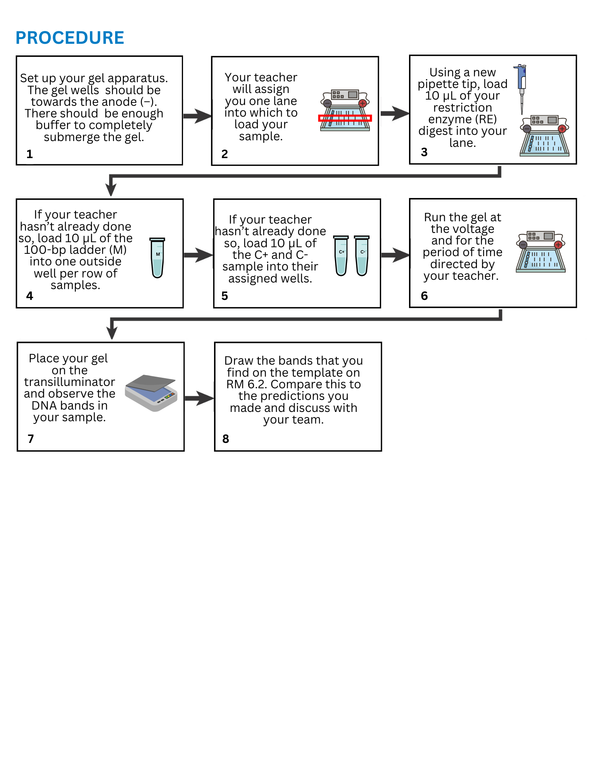
Load and run your gels following the lab directions

Slide 6
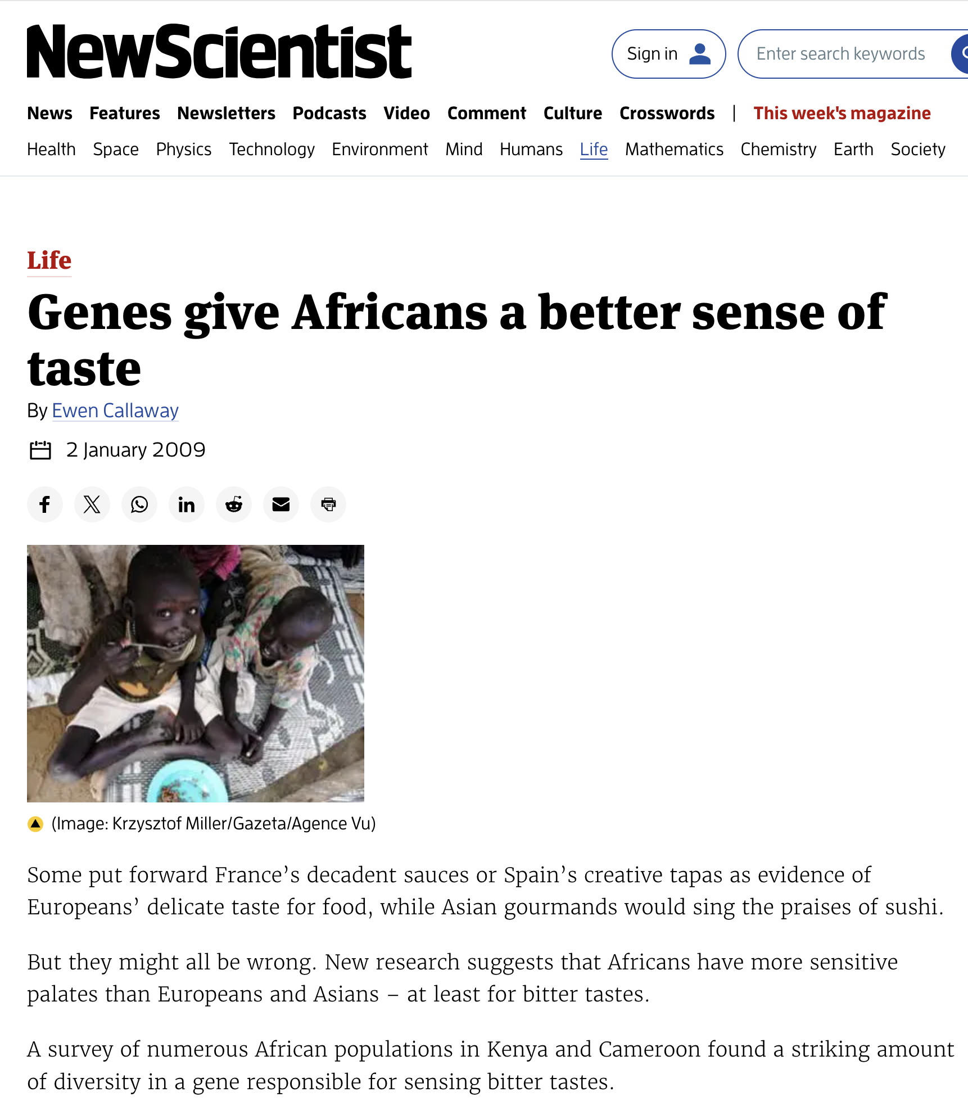
Reading: “Genes Give Africans a Better Sense of Taste”
Answer the questions on RM 6.1 for class discussion
Notes:
Discussion questions:
How were Kenyans’ and Cameroonians’ TAS2R38 genes different from those of Europeans and Asians?
One scientist speculated iodine might play a role in natural selection of this gene. What did they suggest?
What is another reason that Africans have more genetic diversity than Europeans?

Slide 7
Discussion: “Genes Give Africans a Better Sense of Taste”
How were Kenyans’ and Cameroonians’ TAS2R38 genes different from those of Europeans and Asians?
They had additional genetic variants.
One scientist speculated that iodine might play a role in natural selection of this gene. What did they suggest?
Maybe access to iodine protected the thyroid from toxic compounds in bitter foods?
What is another reason that Africans have more genetic diversity than Europeans?
Human migration from Africa to Asia caused a genetic “bottleneck.”

Slide 8
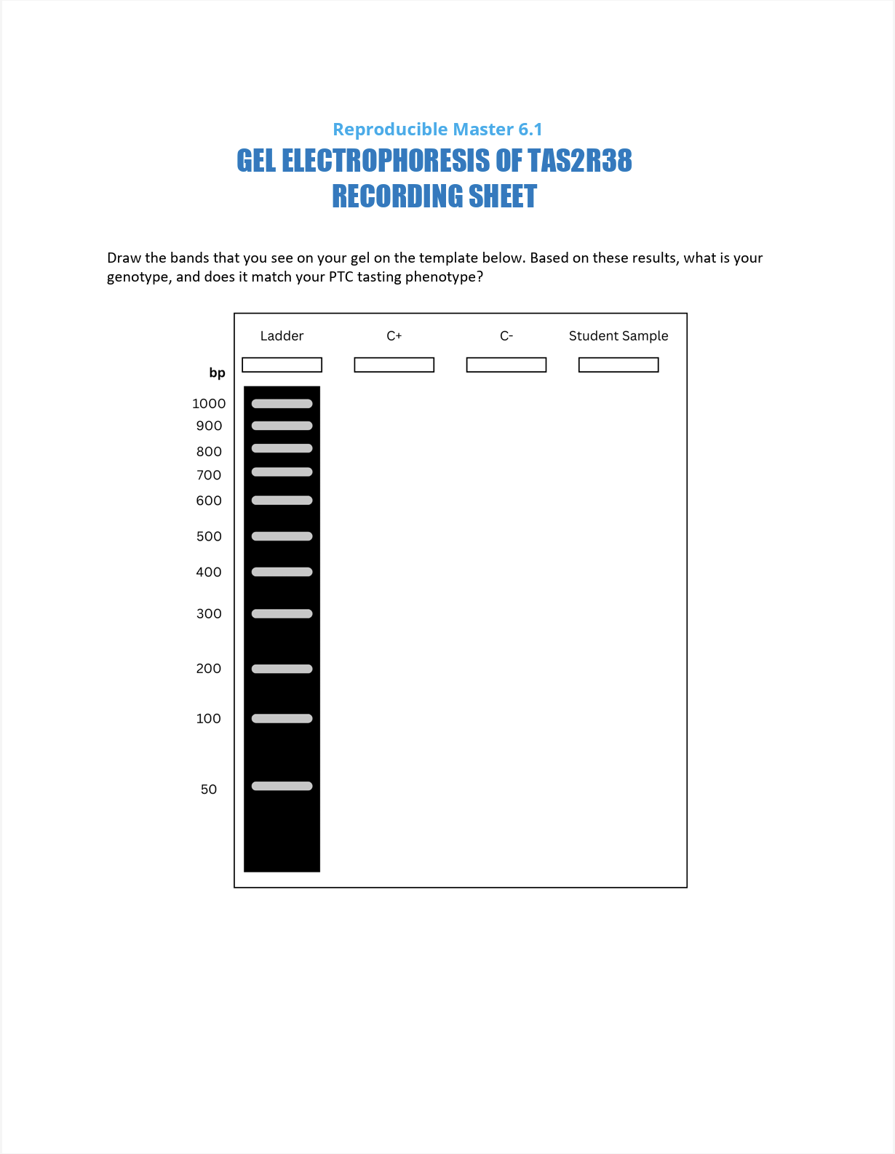
Once you have your gel image, complete RM 6.2.

Slide 9
Discussion: Your Taster Genotype
Did your genotype and phenotype match?
If not, where could experimental error have occurred?
Notes:
Possible reasons for failure:
The PCR may have failed.
The digest may not have worked correctly.
The sample might have been contaminated.
The gel may have been incorrectly mixed.
The voltage of the gel box may not have been correct.
The gel may have been run backwards.
The gel might not have been loaded properly.
The buffer may have been incorrectly mixed.
The gel might not have been run long enough to separate the small DNA fragments.

Slide 10
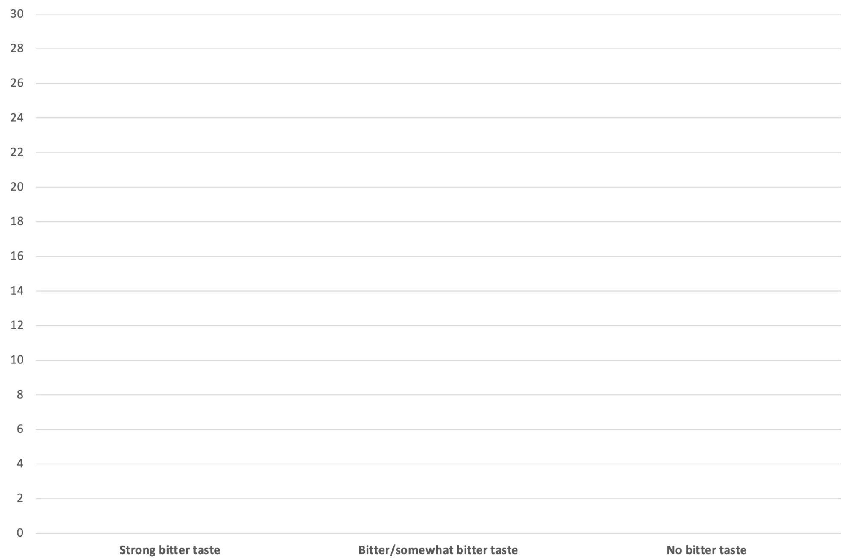
Did your phenotype and genotype match?
Phenotype: PTC taster
Genotype: TAS2R38
Strong taster Weak taster Nontaster
Notes:
Compare this bar graph to the broccoli bitterness data collected earlier.
Discussion questions:
Are the bar charts of broccoli’s bitterness (or lack thereof) and taster status similar or different?
Students may find that the bar charts are similar, perhaps due to the bitter molecule in broccoli and the PTC molecule being similar.
Do you notice any other patterns or similarities? What might account for this?
Do you think there’s a correlation between tasting broccoli as bitter, or not, and whether or not you could taste PTC?
Students may report that they saw significant overlap between PTC tasters and people who find broccoli to be bitter.

Slide 11
Based on your gel, what do you think the C+ genotype is?
Heterozygous (weak taster)

Slide 12
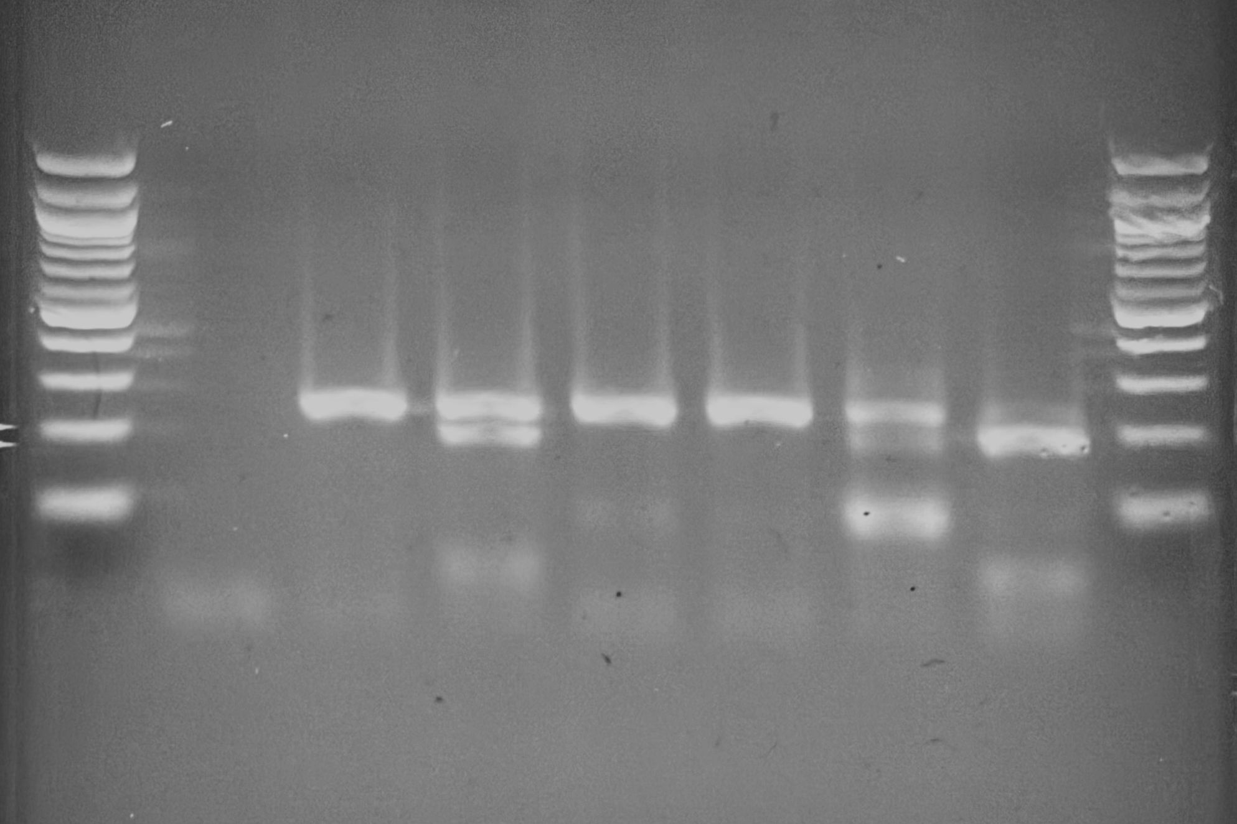
An example of various taster genotypes
Homozygous nontaster:
1 band (240 bp)
Heterozygous weak taster: 3 bands
(44 bp, 196 bp, 240 bp)
Homozygous strong taster: 2 bands
(44 bp, 196 bp)
300 bp
200 bp
100 bp
TT
Tt
tt
tt
Tt
tt
-
Notes:
Discuss the banding patterns participants can expect to see in their gels:
Homozygous strong taster: 2 bands
Homozygous nontaster: 1 band
Heterozygous weak taster: 3 bands (mix of 1 band and 2 bands)

Slide 13
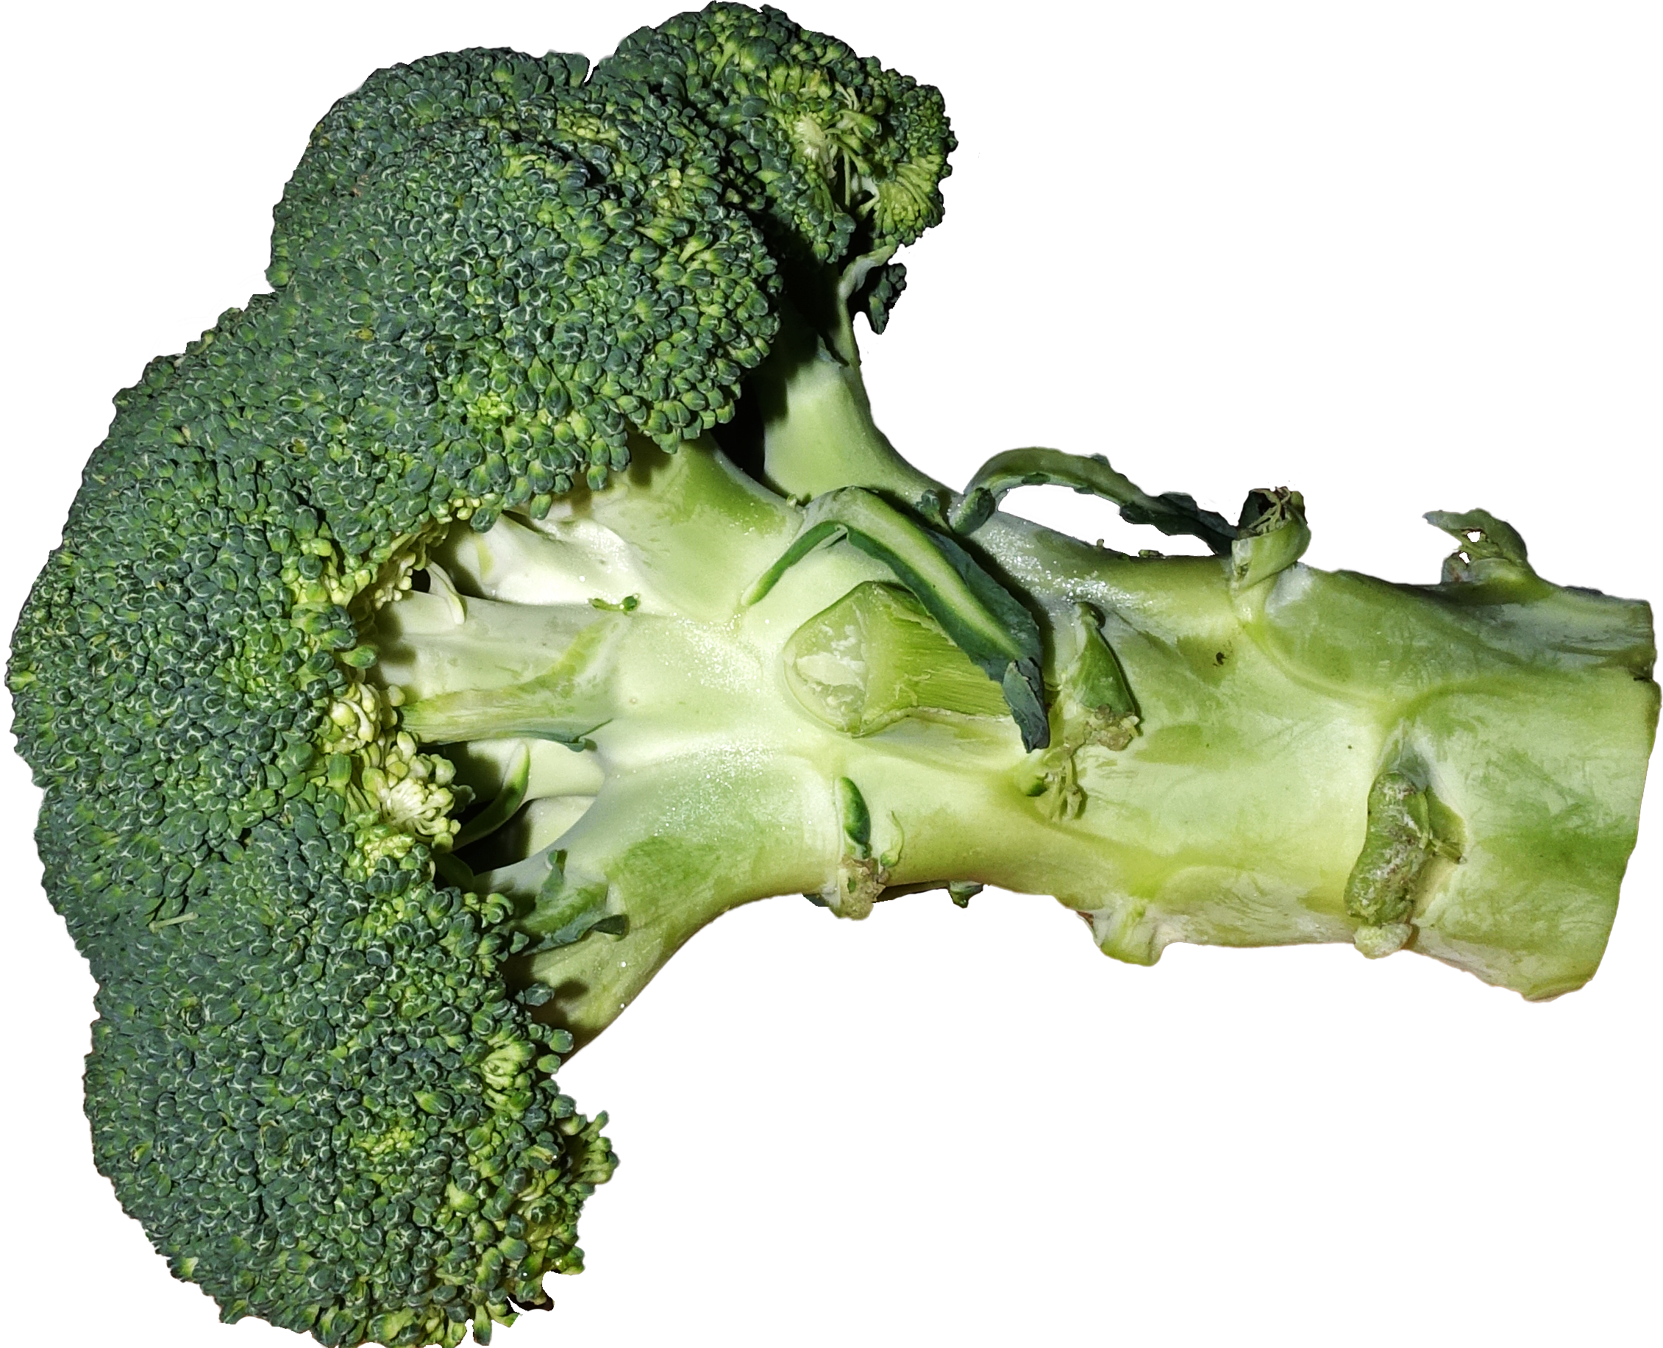
Were your phenotype and genotype perfect matches?
How did your rate broccoli bitterness?
Did that match your PTC taste test?
Did that match your TAS2R38 genotype?
Did you find PTC bitter, but not broccoli? Why?

Slide 14
Extend Your Findings to Precision Medicine
PTC taste testing is not really medically relevant . . .
. . . but can you name some other genetic tests which are important to patient health?

Slide 15
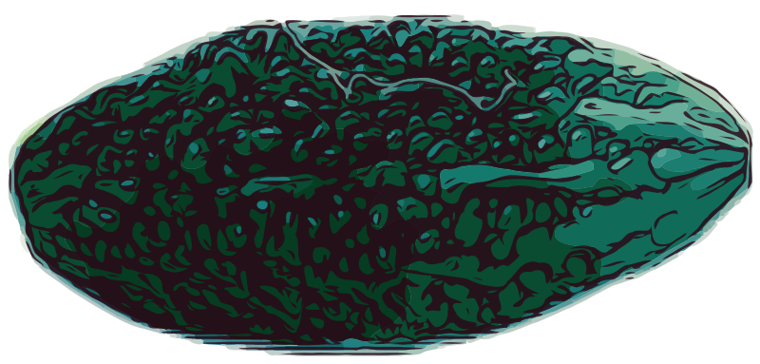
Hypothesize: What use are bitter-taste receptors?
Why do you think genes encoding receptors like TAS2R38 would have persisted through human evolution?
bitter melon
Notes:
Bitter melon: https://openclipart.org/image/800px/320528

Slide 16
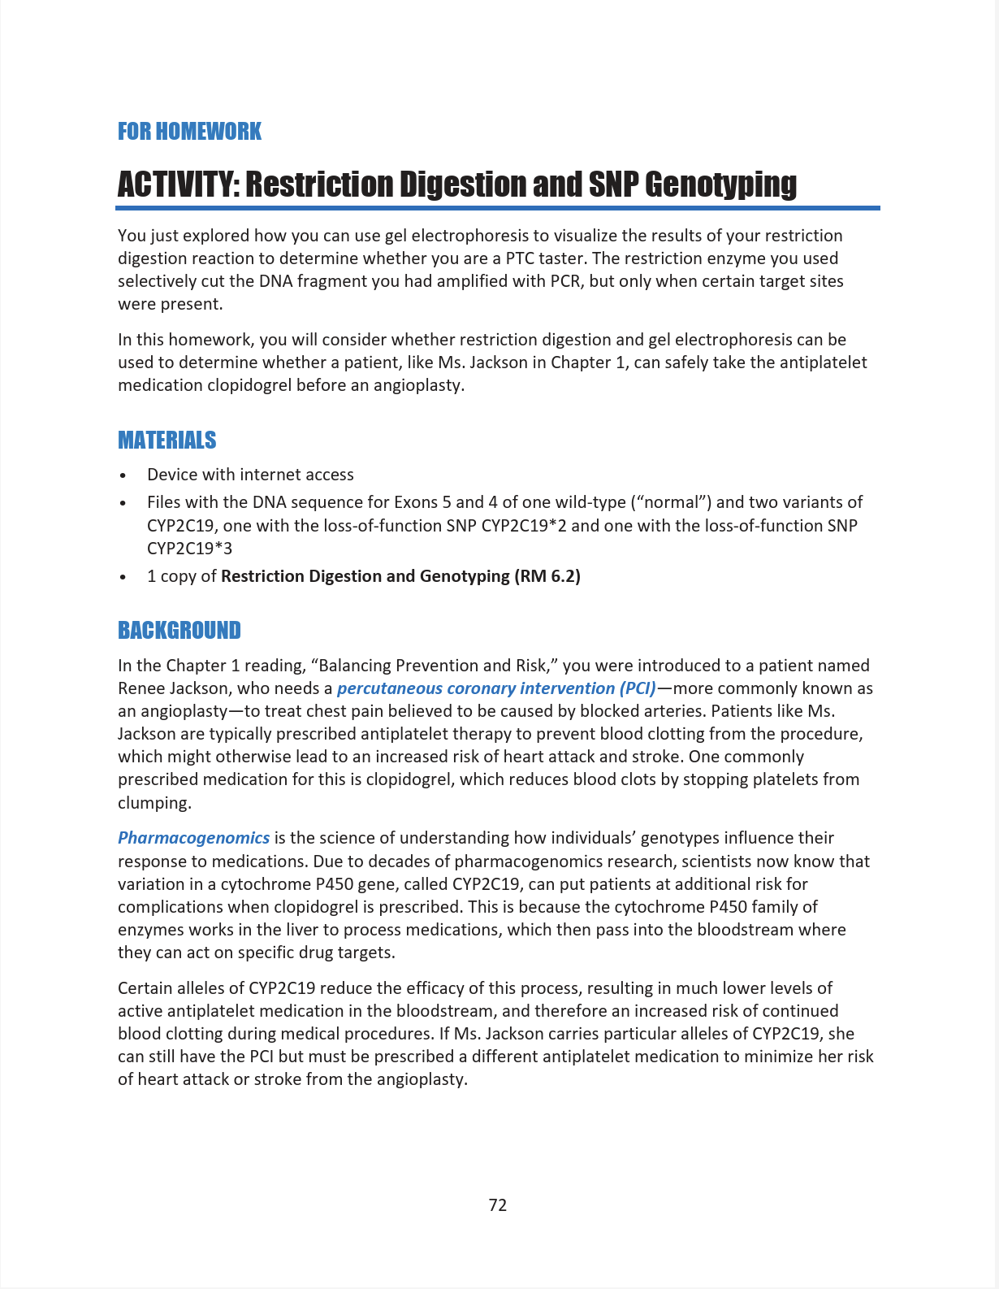
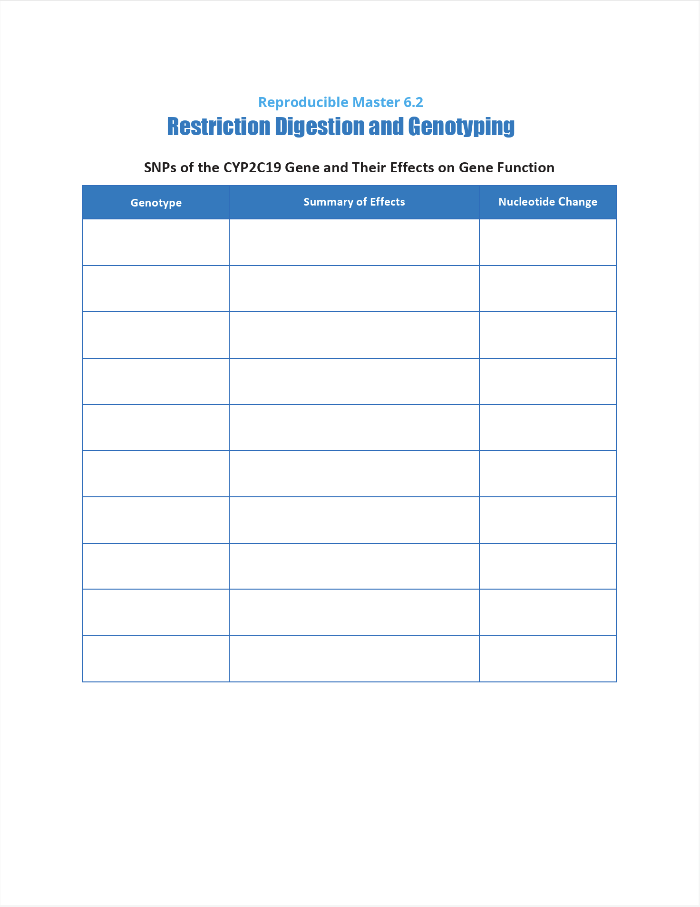
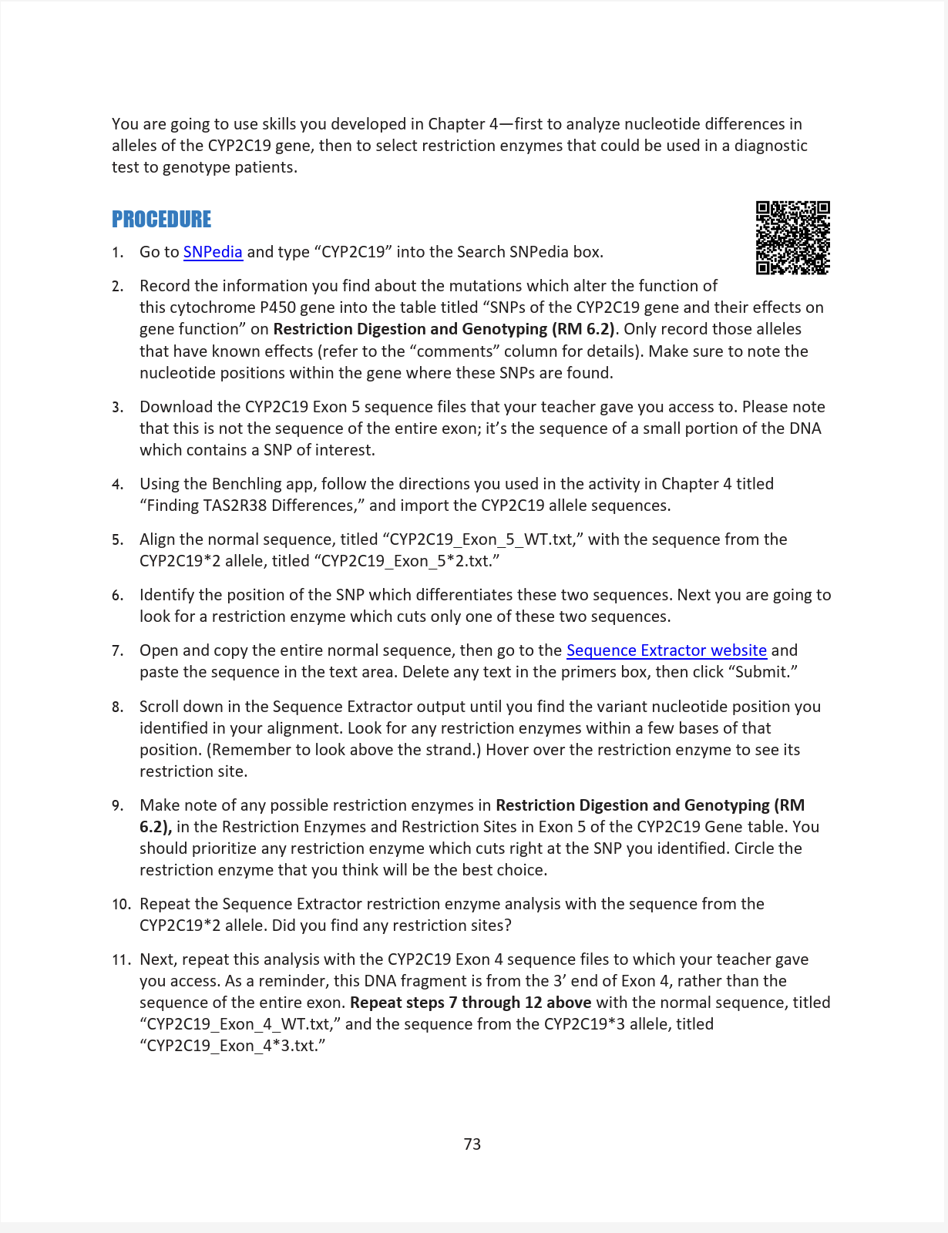
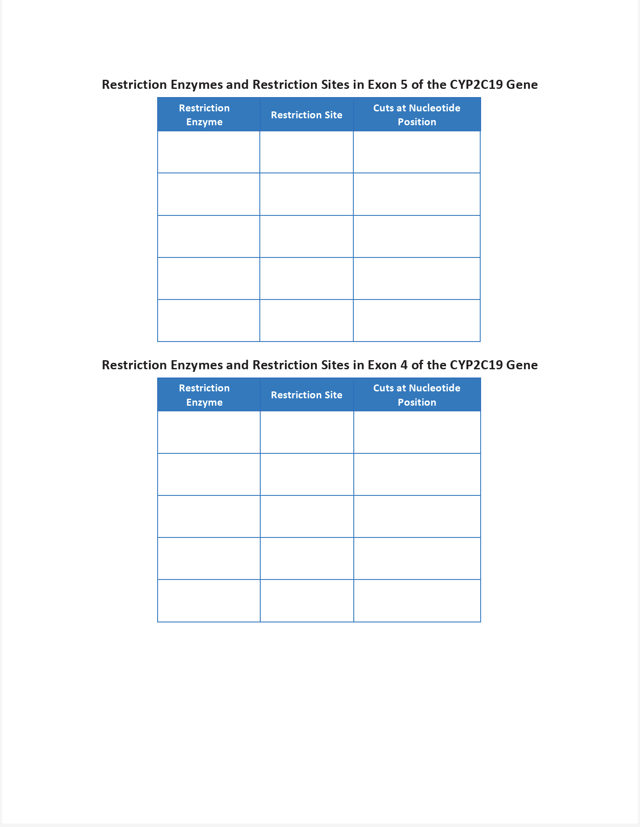
Carry out the activity “Restriction Digestion and SNP Genotyping”
Record answers on RM 6.3

Slide 17
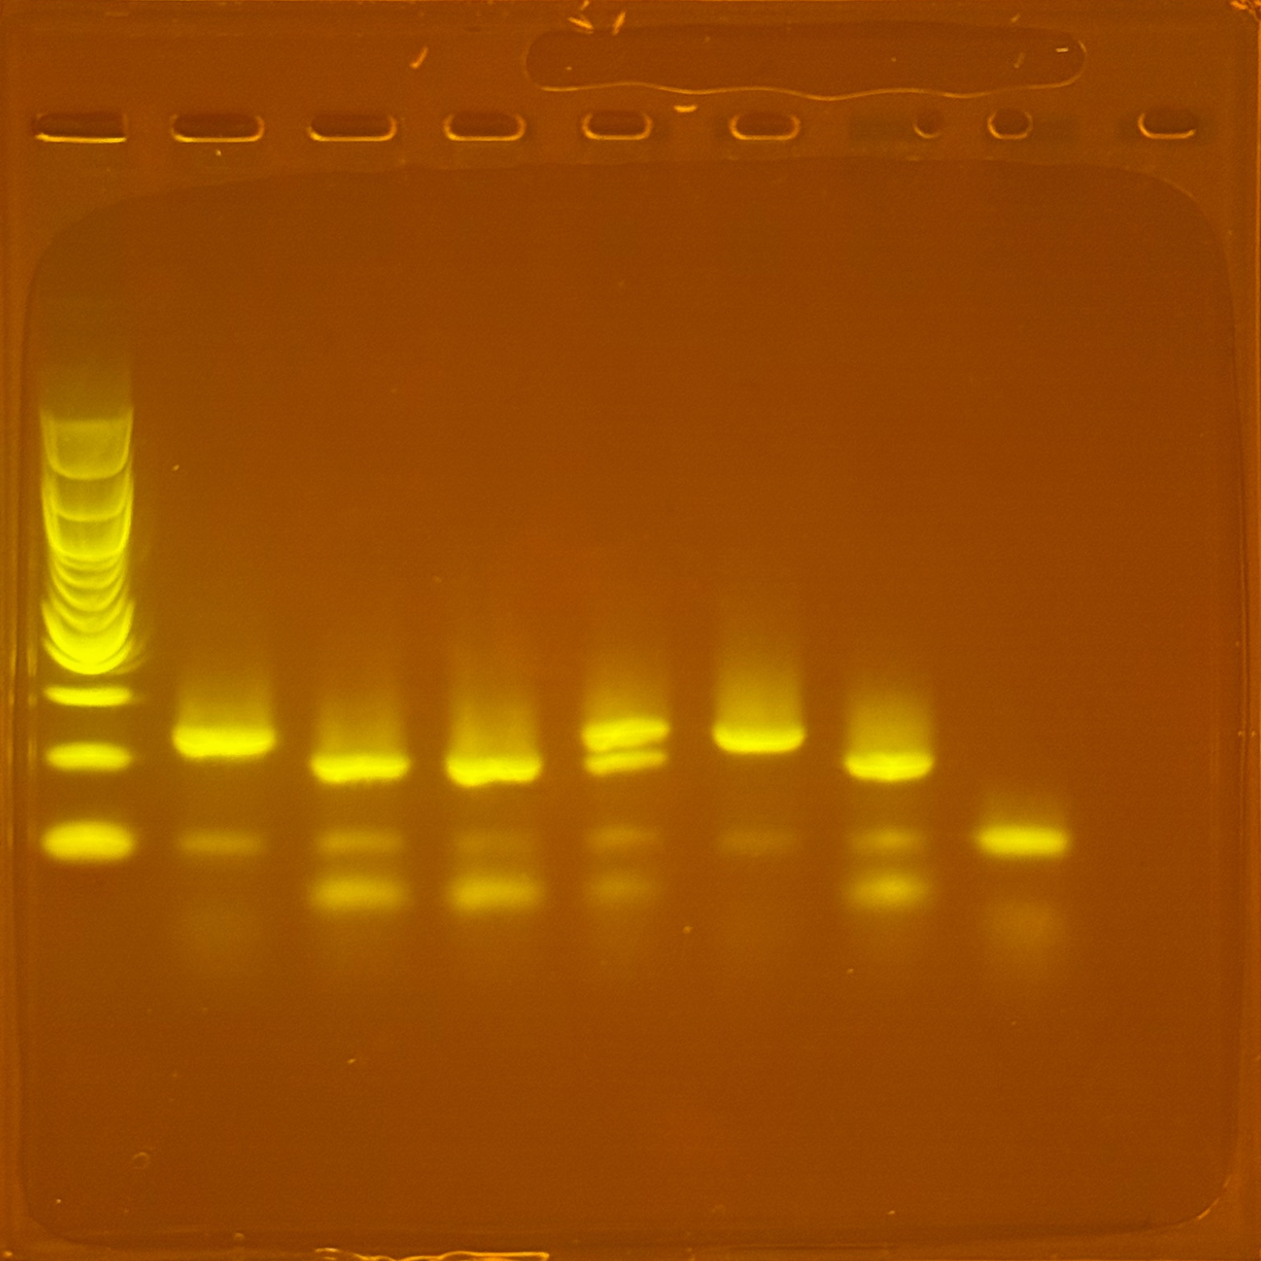
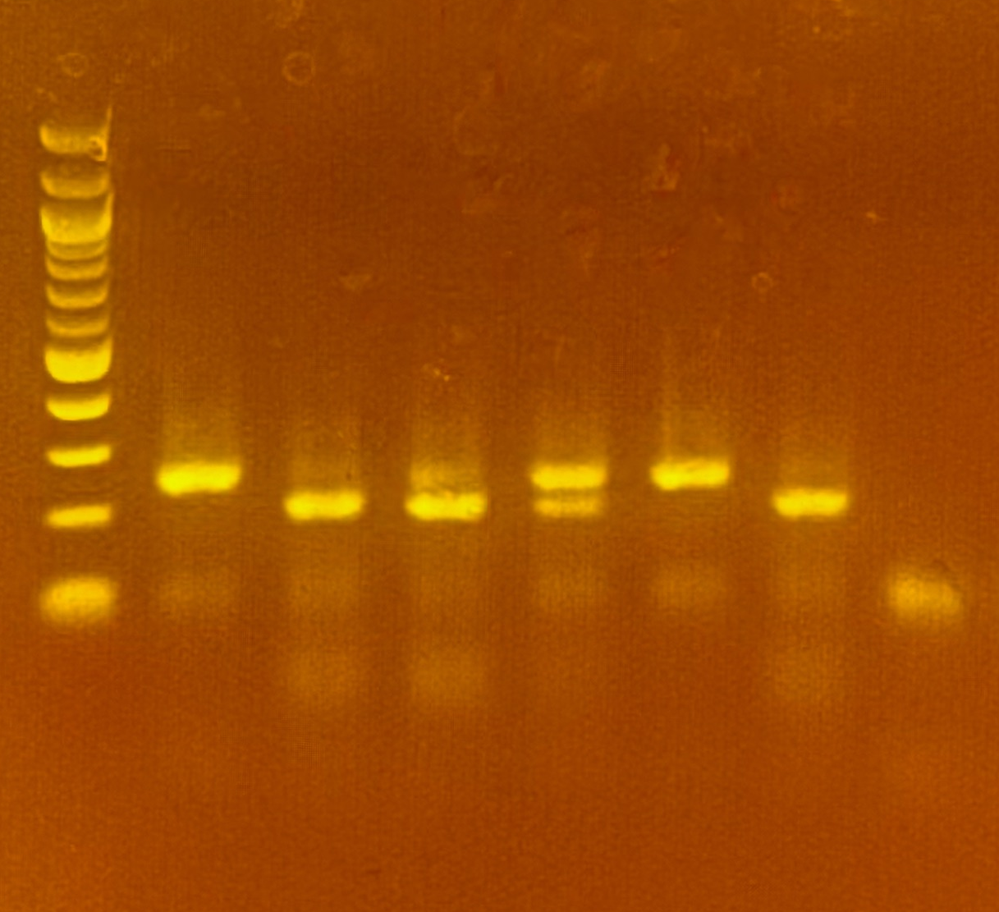
An Example of Various Taster Genotypes
300 bp
tt
TT
TT
Tt
tt
TT
-
200 bp
100 bp
Notes:
Discuss the banding patterns participants can expect to see in their gels:
Homozygous strong taster: 2 bands
Homozygous nontaster: 1 band
Heterozygous weak taster: 3 bands (mix of 1 band and 2 bands)

